Slide 1
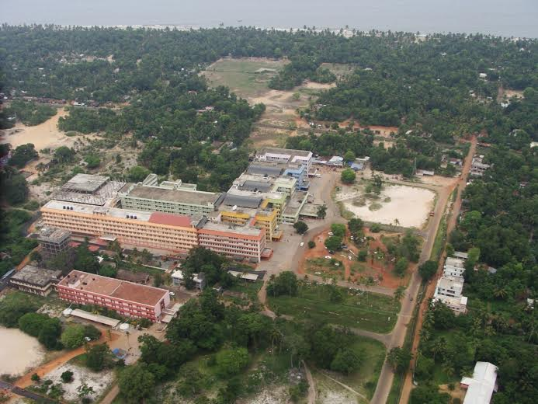
Culprit vessel vs Multi vessel PCI in STEMI
Sunitha Viswanathan; GTDMC ,Alappuzha

Slide 2
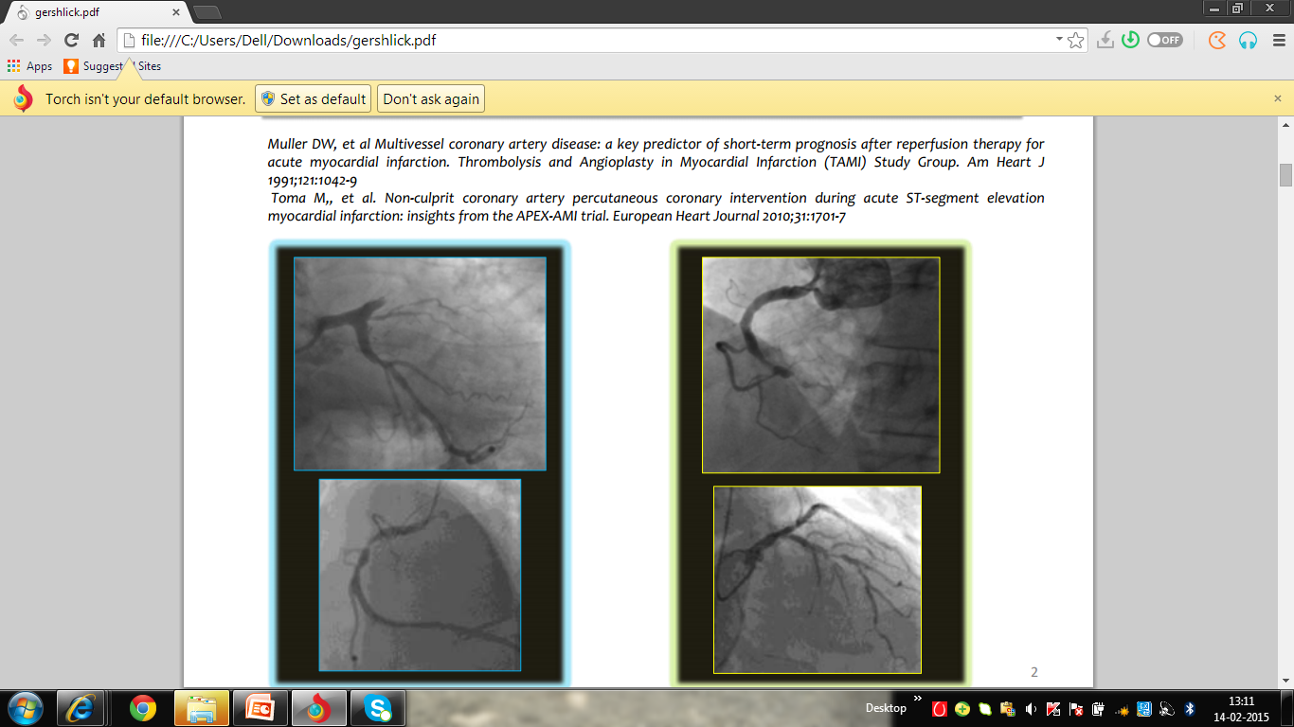
Multivessel Disease in STEMI
30-40%

Slide 3
Multi-Vessel Disease in STEMI
30-40%
Increased risk of CV morbidity & mortality
Lack of compensatory hyperkinesia
Decreased microvascular reserve
Enhanced systemic inflammatory response
Marker for extensive atherosclerosis

Slide 4
NHLBI data
Average No of lesions 2.4 /patient
Average No of Stents 1.3/patient
86-90% culprit only PCI is the norm

Slide 5
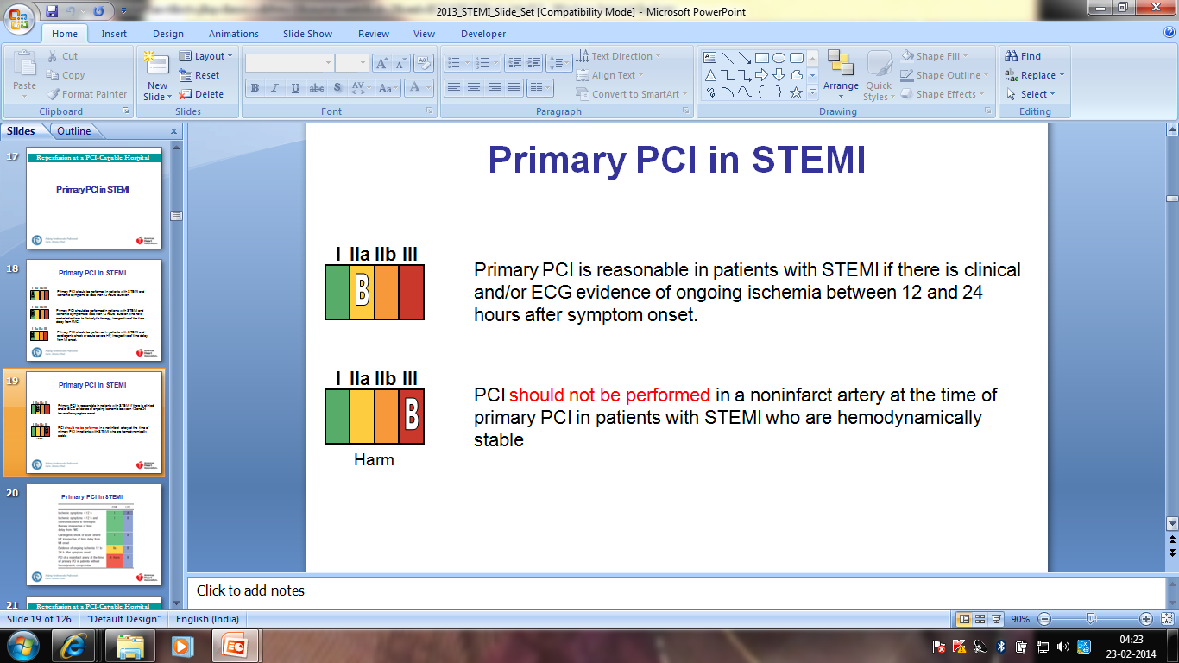
Non-Culprit PCI in STEMI-AHA

Slide 6
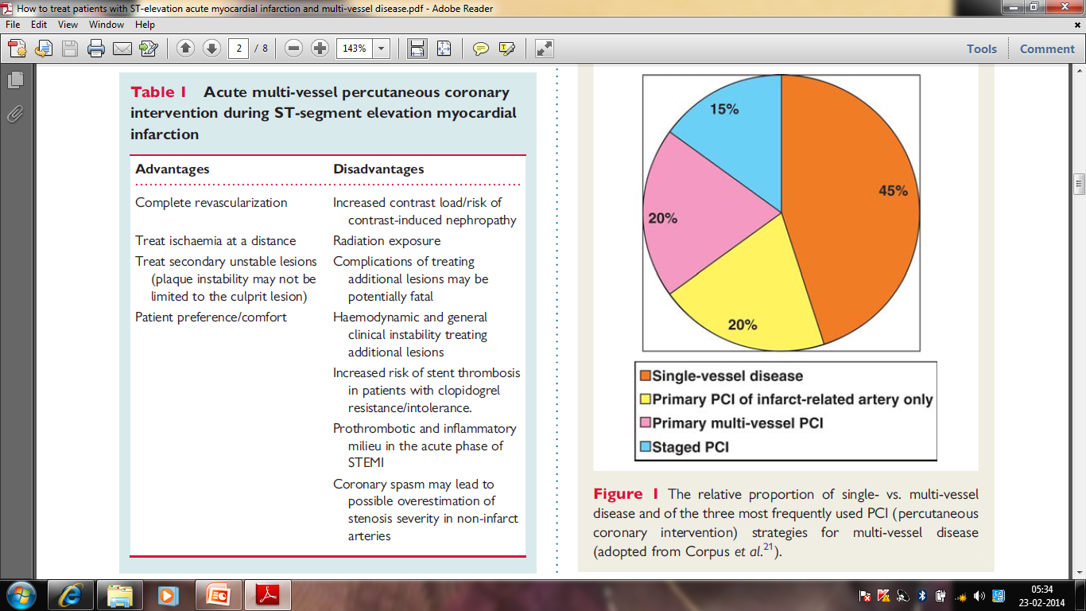
MultivesselP- PCI :Advantages & Disadvantages

Slide 7
AMI :MVD & SV -PCI
Do patients have events after P-PCI ?
Concept: MVD –PCI to prevent events ??

Slide 8
Non-Culprit Vessel PCI in STEMI 2004
X
Is there any evidence ??
 | Preventive PCI | IRA PCI
 | 52 patients | 17 patients
Rpt Revasc | 17% | 35% NS
Cardiac death/MI | 4% | 6% NS
HELP AMI DiMario C ,Intl J cardiovascular Interventions 2004

Slide 9
IRA-PCI only vs
Immediate /Staged Preventive PCI
 | 214 pts | Repeat Revasc% | Cardiac Death/MI % | 2.5 yrs F/U
No PreV PCI | 84 | 33 | 8.3 | 15.5
Immediate preventive PCI | 65 | 11 | 3.1 | 9.2
Staged Preventive PCI | 65 |  | 0 | 6.2
*lack of statistical power
*reliance on repeat revas(Bias)
Politi L’,Sgura F Heart 2010

Slide 10
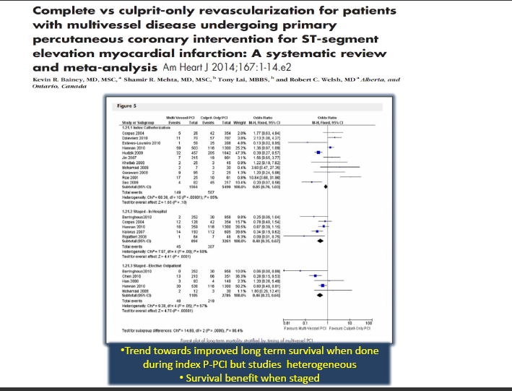

Slide 11
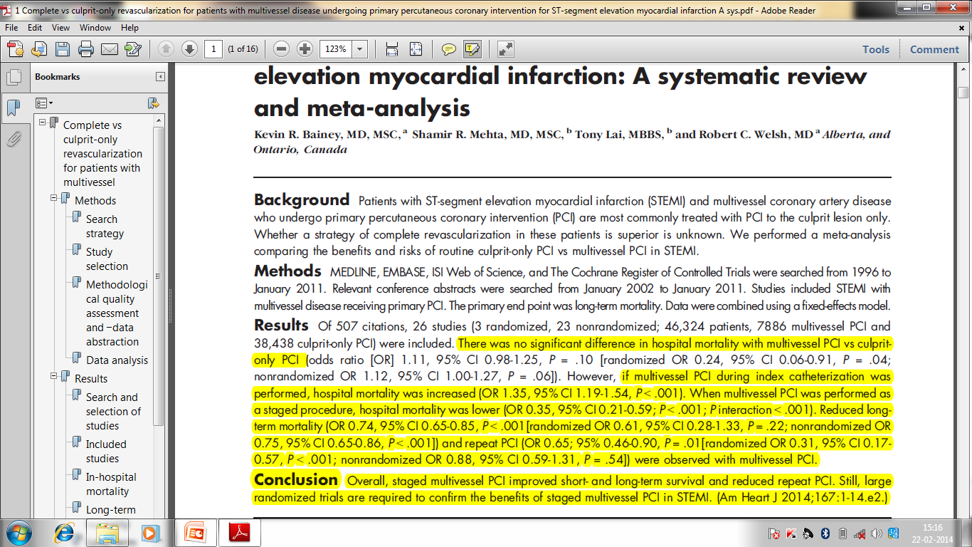

Slide 12
CARDIOGENIC SHOCK & PREVENTIVE PCI
Data limited
SHOCK TRIAL
81% had MVD
87% underwent culprit only PCI
55% 1 yr survival after SVPCI
20% 1 yr survival after same sitting PPCI

Slide 13
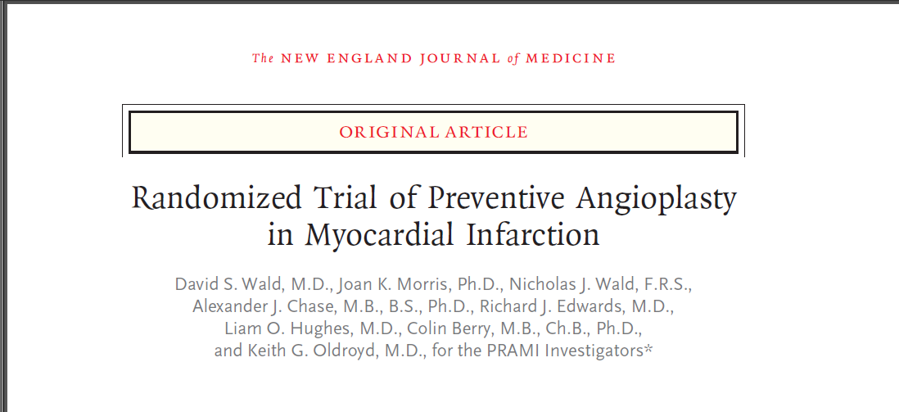
NEJM September 19th 2013

Slide 14
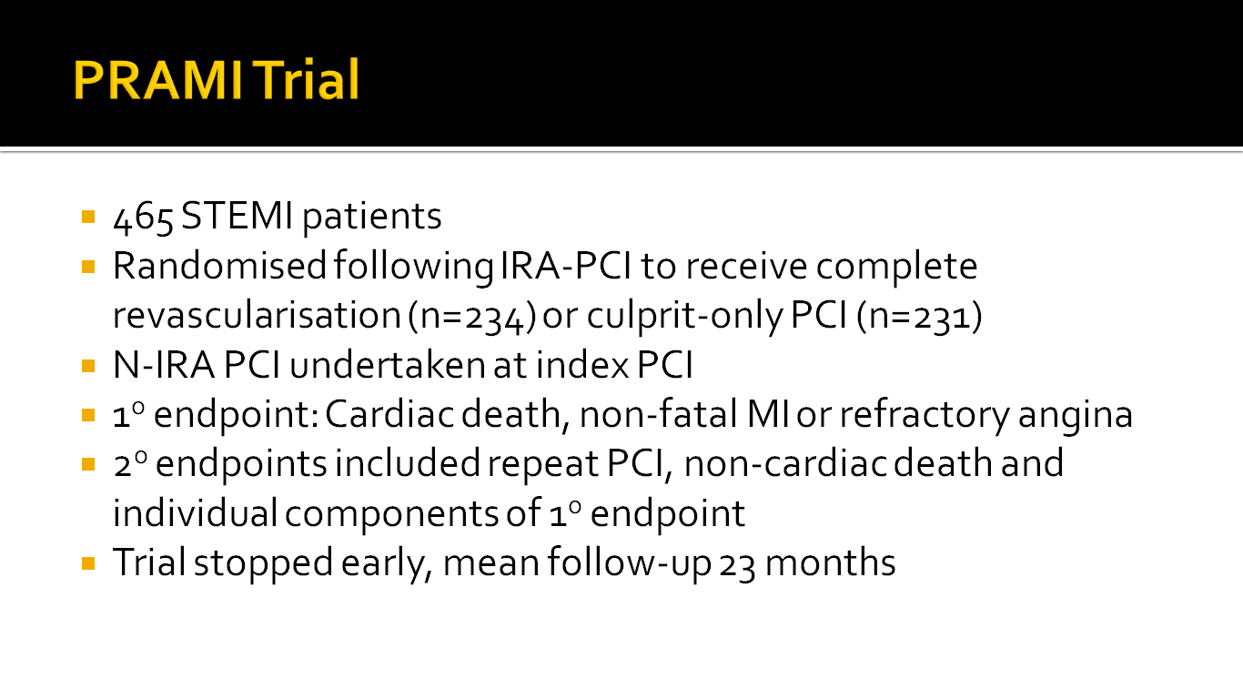

Slide 15
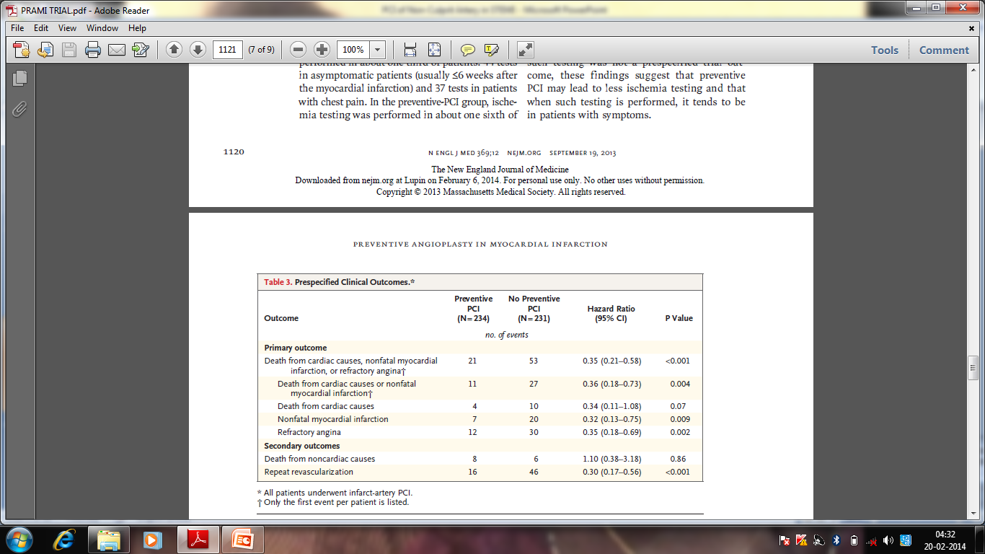
PRAMI:PRESPECIFIED CLINICAL OUTCOMES

Slide 16
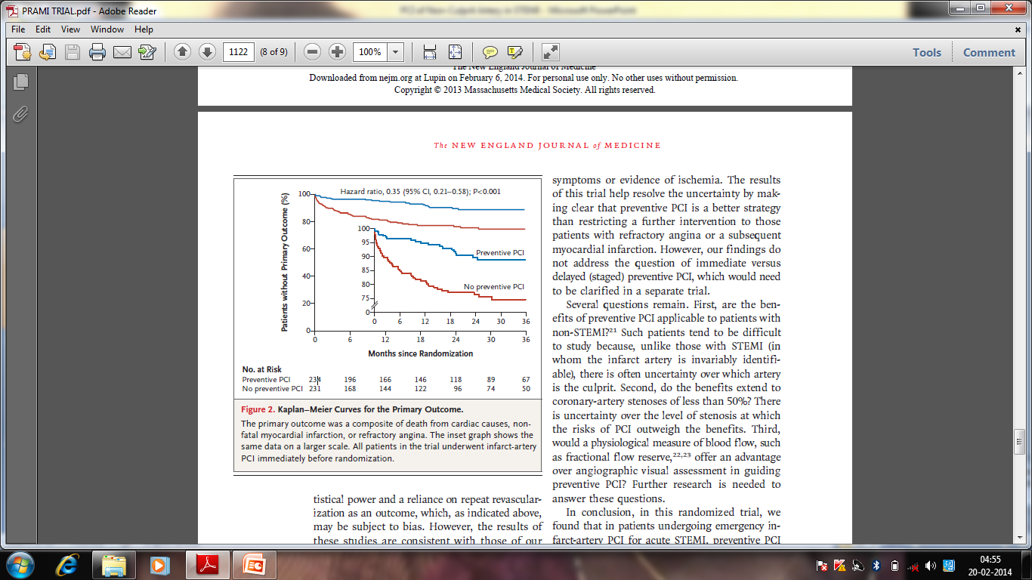
PRAMI:Primary Outcomes
Cardiac Death,Nonfatal MI,or Refractory Angna

Slide 17
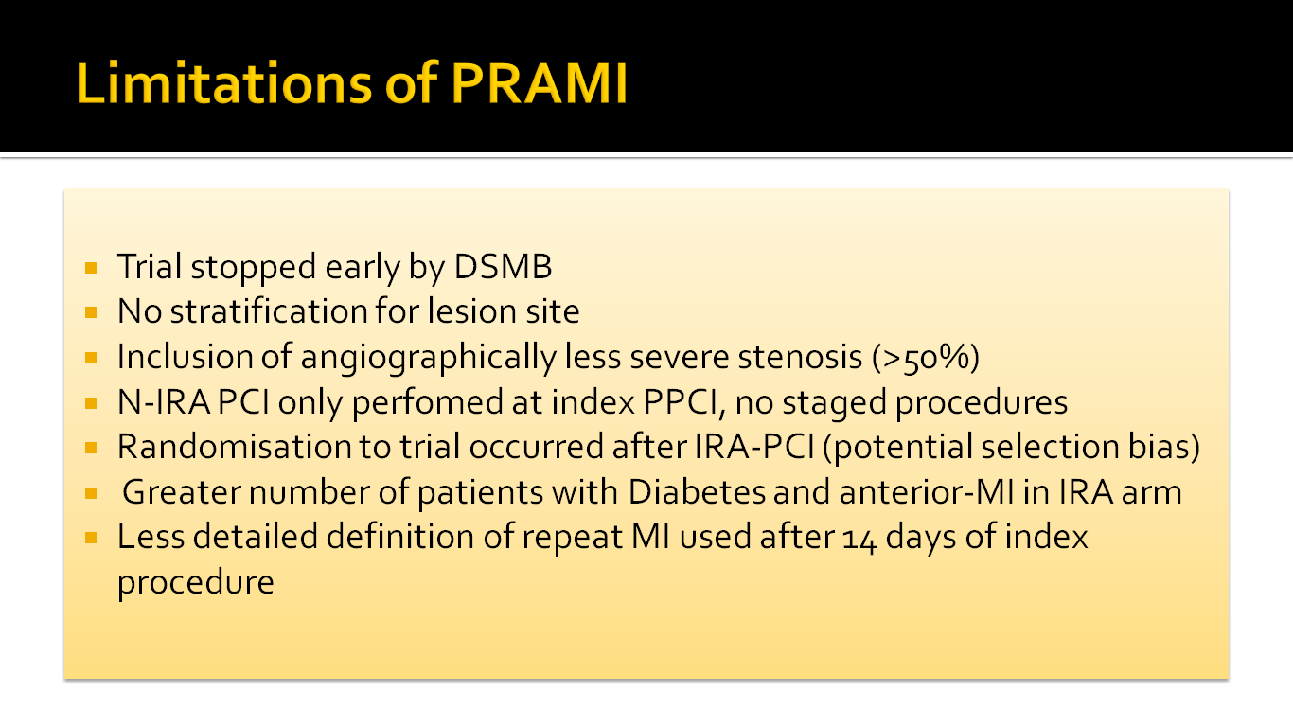

Slide 18
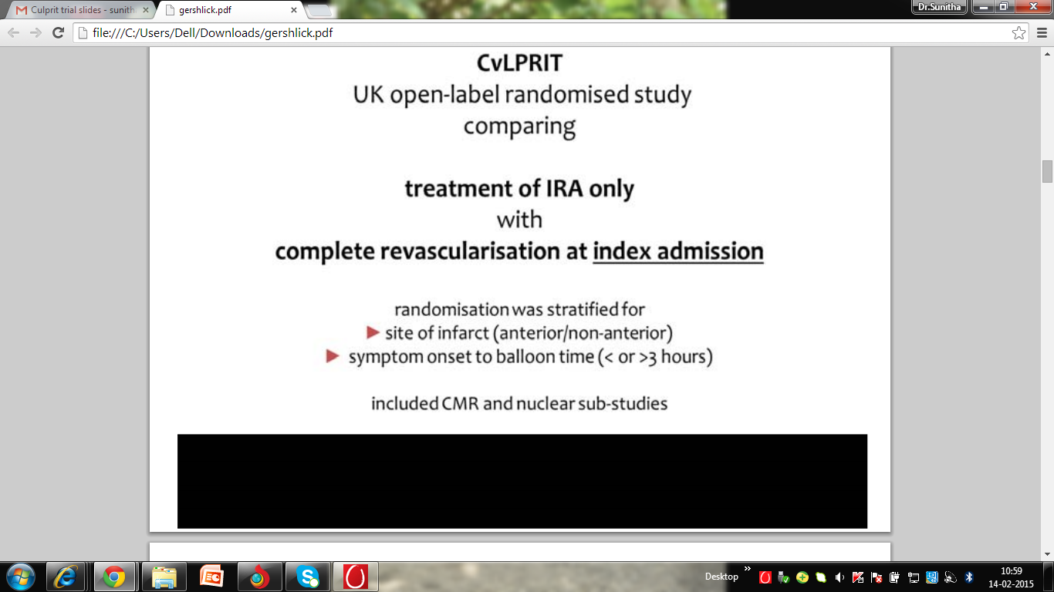
CULPRIT TRIAL

Slide 19
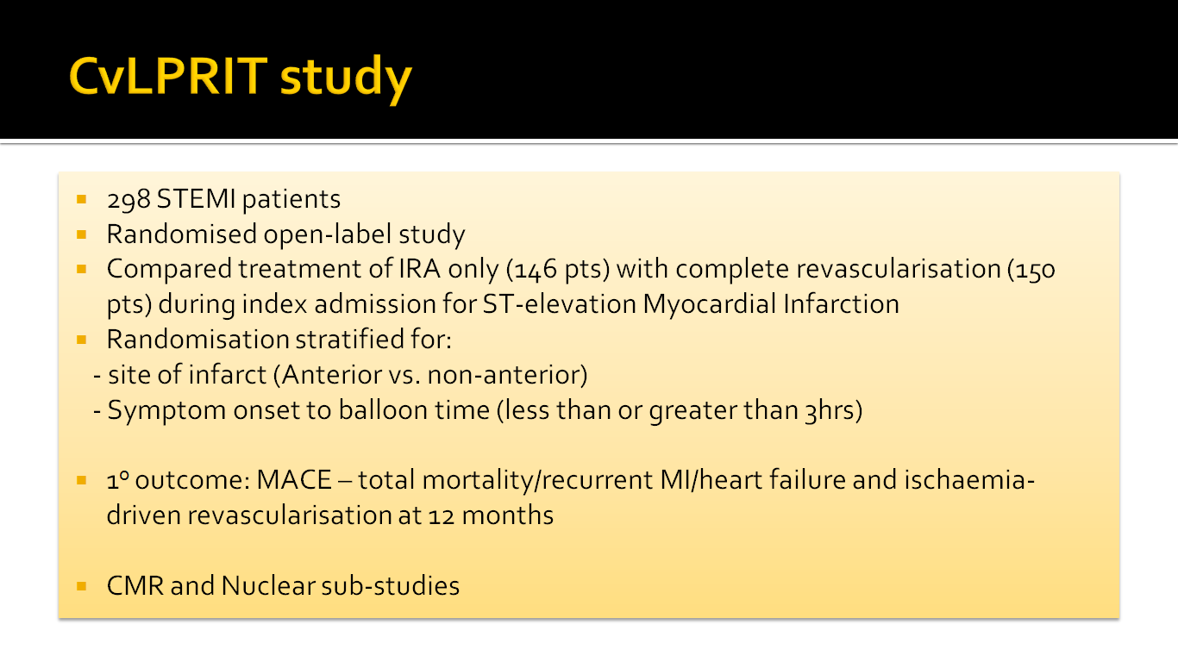

Slide 20
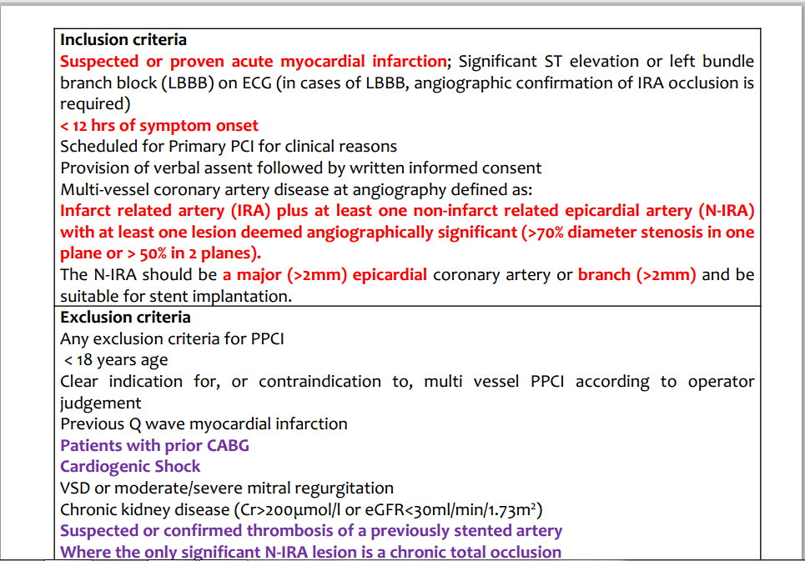
CvLPRIT : Inclusion & Exclusion

Slide 21
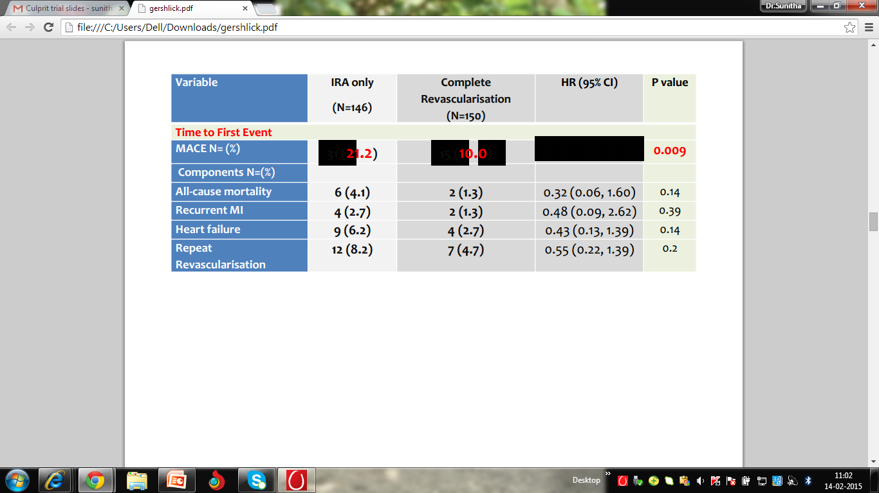
Cvlprit:Outcomes

Slide 22
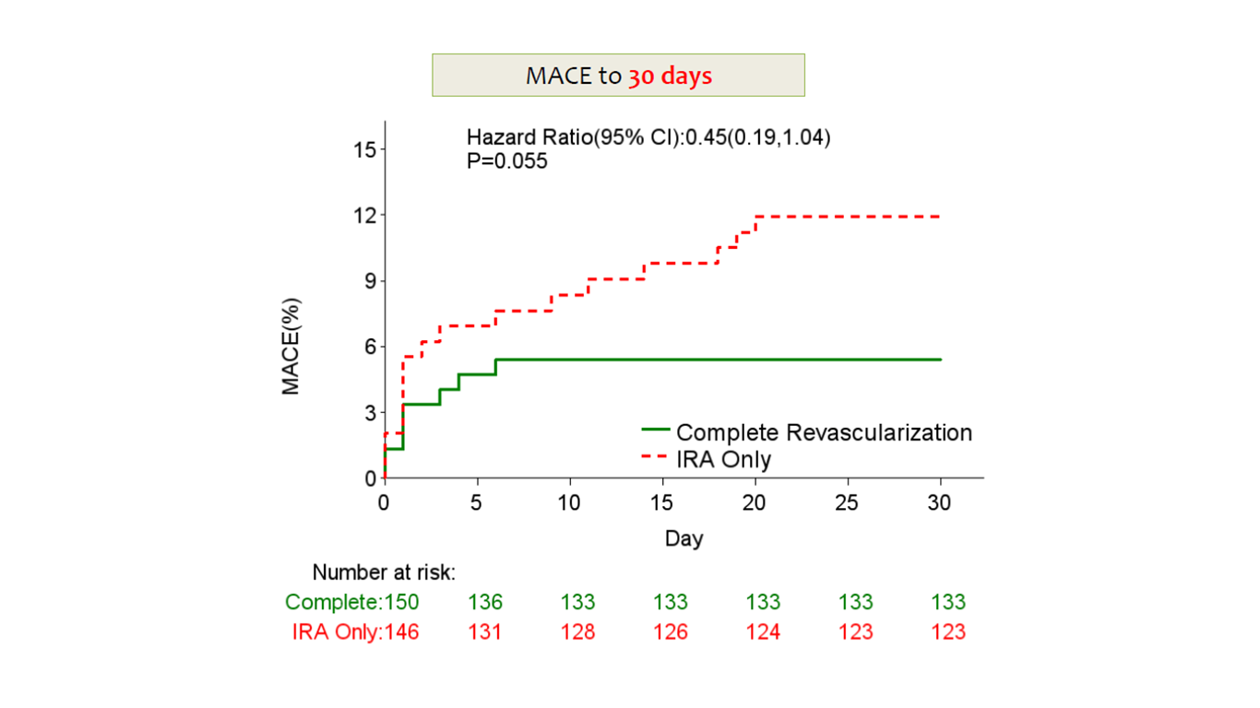
CvLPRIT :MACE outcomes

Slide 23
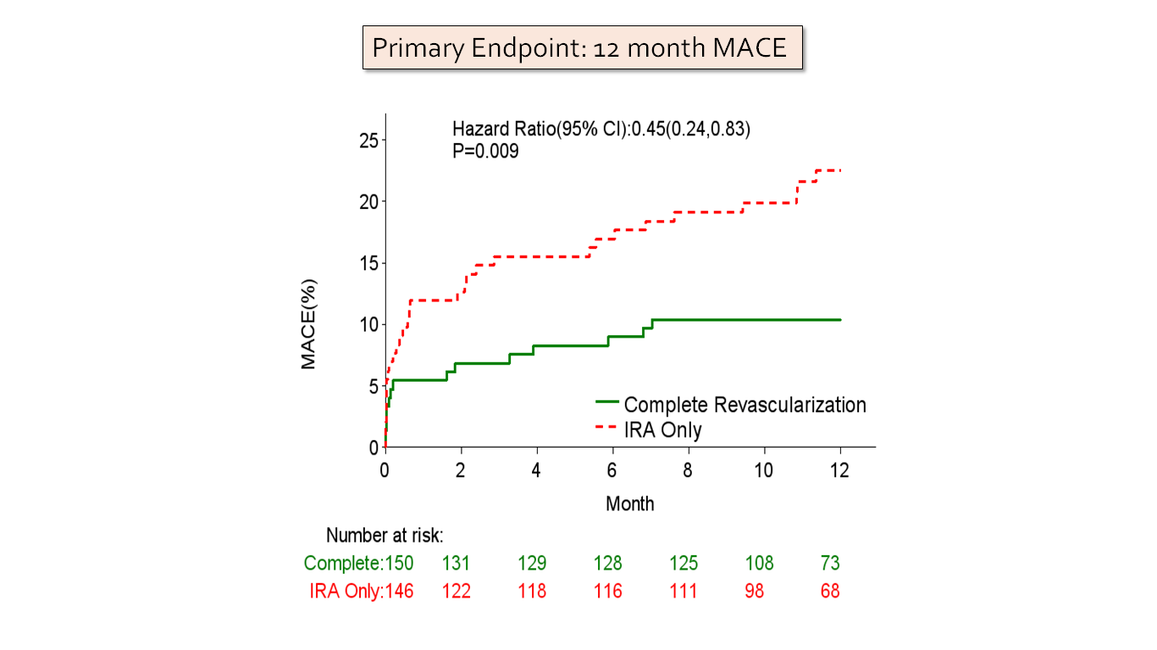
CvLPRIT : 12 month outcomes

Slide 24
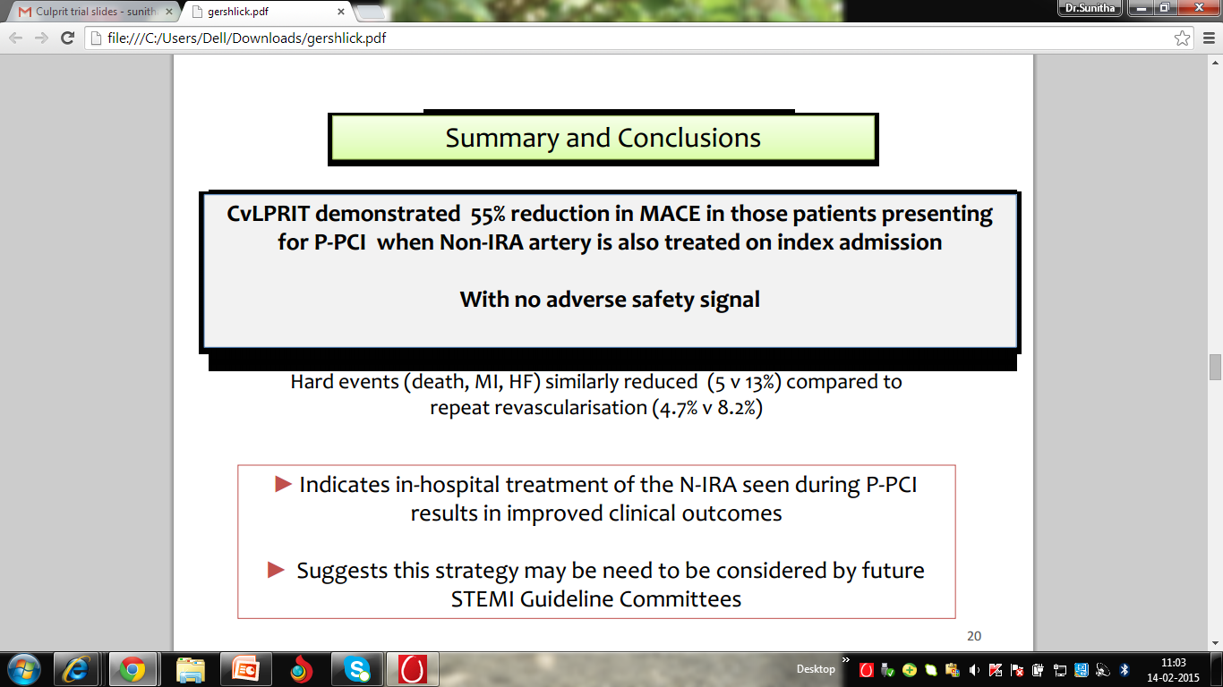
CvLPRIT: Summary & Conclusions

Slide 25
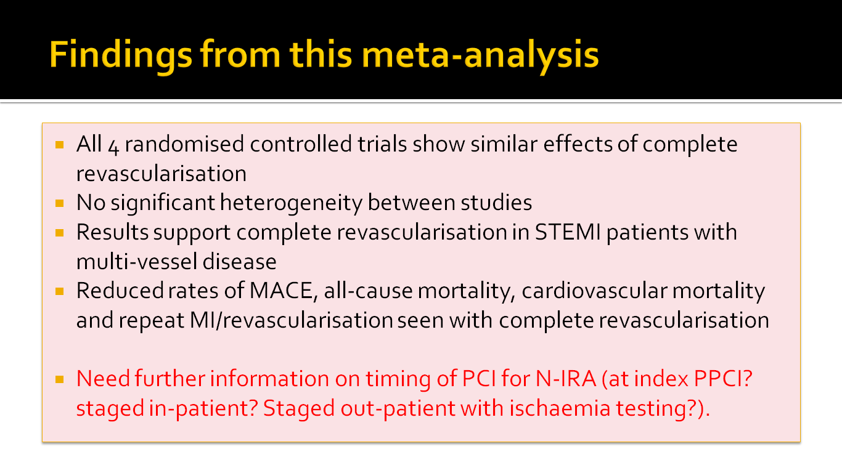

Slide 26
HAS PRAMI and CvLPRIT RESOLVED UNCERTAINTY IN STEMI PCI ??
Can we Expect a Guideline Change ???

Slide 27
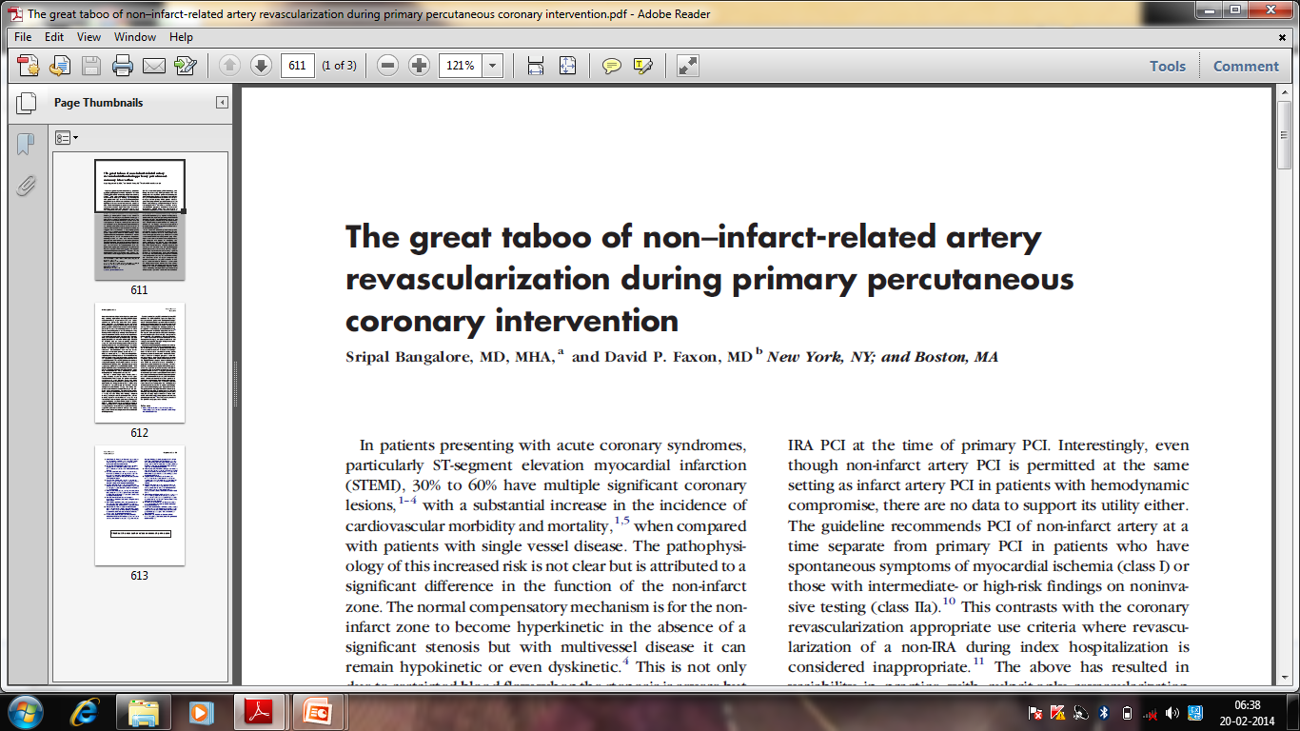
American Heart Journal October 2013
Is it still a great taboo ??

Slide 28
Immediate vs
Staged Preventive PCI ??
-Needs to be answered

Slide 29
THE COMPLETE TRIAL
3900 patients with STEMI and MV disease
Culprit vessel only PPCI vs multivessel PCI (Staged PCI only) –background of OMT

Slide 30
PCI of a Noninfarct Artery Before Hospital Discharge
I
IIa
IIb
III
PCI is indicated in a noninfarct artery at a time separate from primary PCI in patients who have spontaneous symptoms of myocardial ischemia.
I
IIa
IIb
III
PCI is reasonable in a noninfarct artery at a time separate from primary PCI in patients with intermediate- or high-risk findings on noninvasive testing.
B

Slide 31
ESC 2014
How to identify non-culprit lesions that need revascularisation
Single stage / Multistaged

Slide 32
Multivessel PPCI-ESC 2014
To be performed in STEMI & cardiogenic shock in presence of multiple critical stenoses
Highly unstable /critical lesion (e/o thrombus/lesion disruption) in nonculprit vessel
Persistent ischemia after PCI on supposed culprit vessel

Slide 33
Lingering Question
Would FFR offer advantage over visual assessment ???

Slide 34
Concluding Thoughts
No single approach to myriad presentations of STEMI
Culprit vessel PCI improves most patients with AMI
Preventive PCI shown to be more beneficial in PRAMI trial and CvLPRIT trials
Perhaps more answers from COMPLETE TRIAL
Staged preventive PCI has best short and long term outcomes :but no robust randomised data

Slide 35


Slide 36

Thank You

