Slide 1

Dr. V.K.AJIT KUMAR PROFESSOR, DEPT. of CARDIOLOGY, SCTIMST, TRIVANDRUM
STENT CHOICE IN AMI.

Slide 2
SCOPE
PATHOLOGY OF AMI
LYSIS vs PCI
PTCA vs STENT
VASCULAR BIOLOGY of STENTS
DES vs BMS
BVS vs DES
META ANALYSIS
MY CHOICE

Slide 3
Pathophysiology of AMI

Slide 4
Why is PCI better than Lysis
Reduces Stroke, Reinfarction
Reduces Mortality
Improves Patency of IRA
Reduces severity of residual stenotic lesion
Overall better LV Function

Slide 5
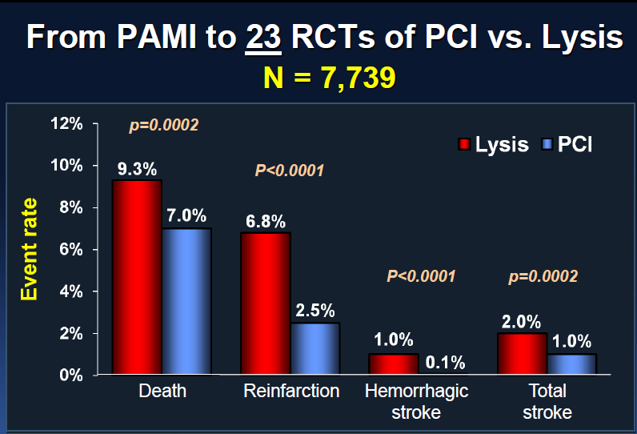
AMI: PCI vs Lysis

Slide 6
Why do we need stents in PCI?
Mechanically scaffold the IRA.
Larger lumen of vessel
Prevent abrupt closure & SCD.
Prevent late Restenosis.

Slide 7
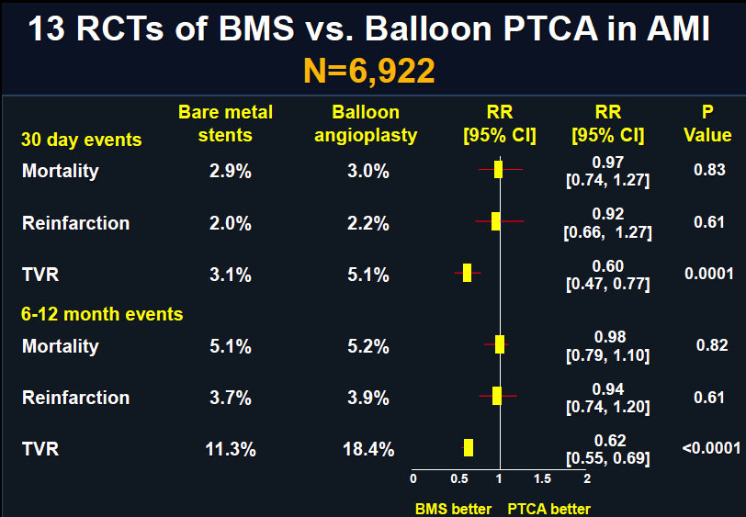
AMI: STENT BMS vs POBA

Slide 8
Vascular Biology of Stent

Slide 9
DES: THE CONCEPT

Slide 10
Vascular Response to STENT

Slide 11
Temporal : Vascular Response to STENT

Slide 12
VASCULAR INJURY to DES

Slide 13
The Stent Platform

Slide 14
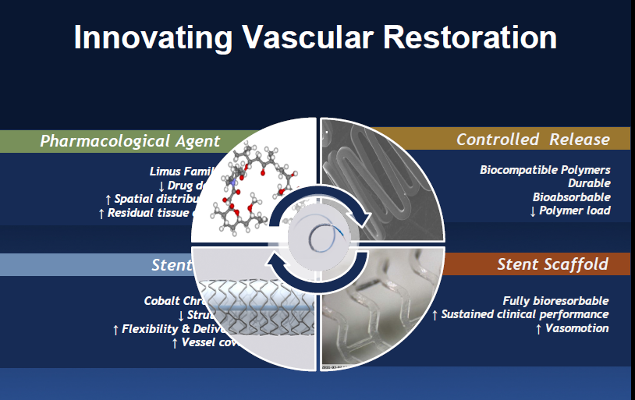
Stent Innovations

Slide 15
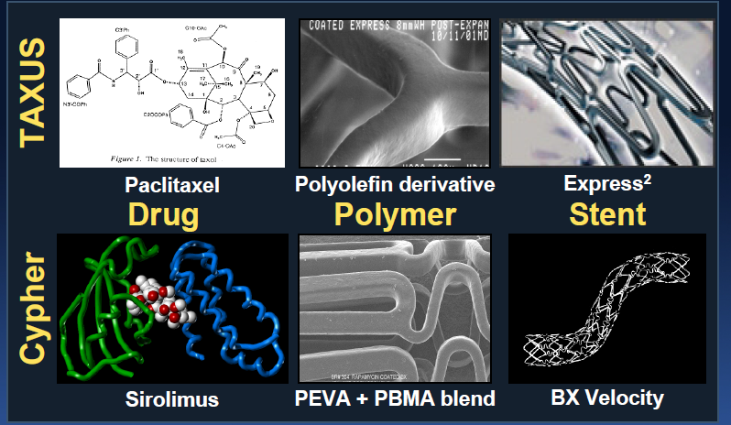
DES: First Generation

Slide 16
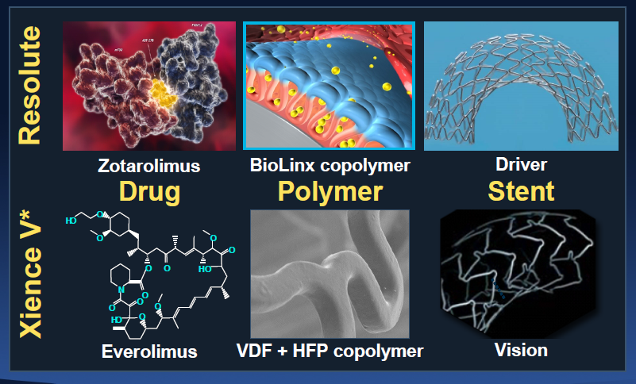
DES: Second generation

Slide 17
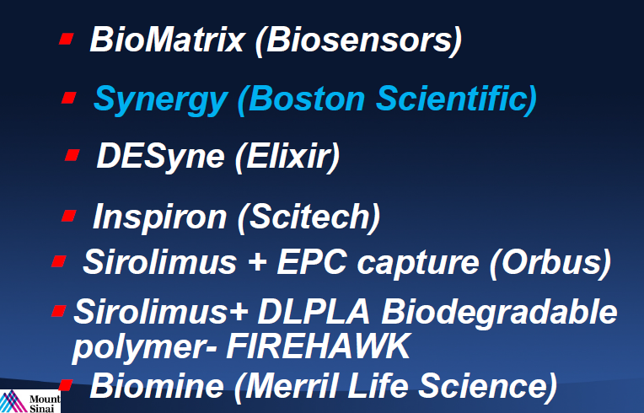
DES: Bioabsorbable Polymer

Slide 18
DES in AMI

Slide 19
DES in AMI: Background
Unstable patient for complex procedures.
Highly Thrombotic environment.
Sub optimal stent implantation.
Decreased outflow of IRA & No Reflow.
Thrombus Alters Drug Kinetics.

Slide 20
Does THROMBUS matter in MI?
Alters drug diffusivity
Alters binding
Barrier to drug orderly release
Second release platform

Slide 21
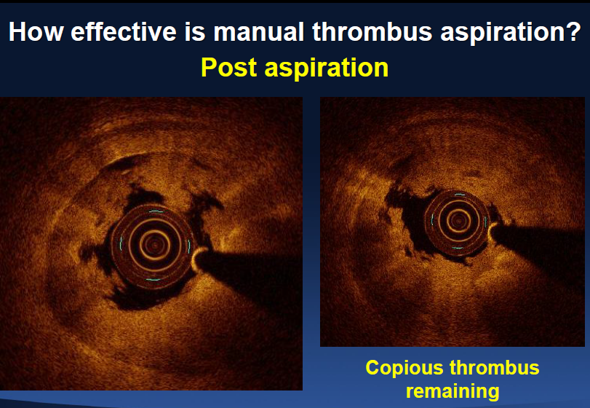
OCT: Post Thrombus aspiration!!

Slide 22
Problems of DES in AMI
Drug: Impairs re-endothelialisation , induces tissue factor (prothrombogenic) , impairs endothelial function.
Polymer: Hypersensitivity & Inflammatory
Procedure: Underexpansion, Malapposition, Edge dissection, slow flow.
Patient: DAPT non compliance

Slide 23
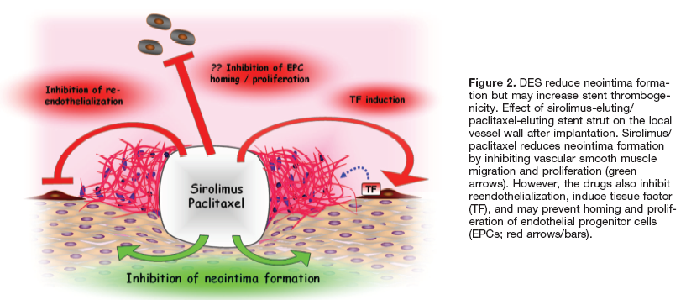
THROMBOGENICITY of DES

Slide 24
OCT : Endothelialisation of Stents

Slide 25
STENT Trials in AMI

Slide 26
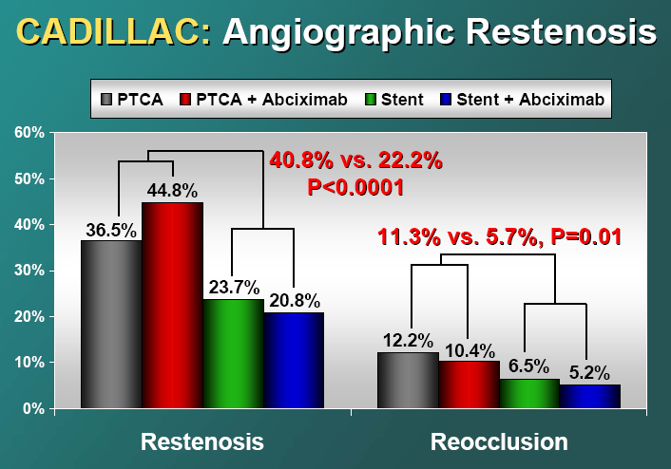
STENT vs POBA in AMI

Slide 27
Typhoon: SES vs BMS

Slide 28
Passion Trial: PES vs BMS

Slide 29
Early Randomized Trials: AMI

Slide 30
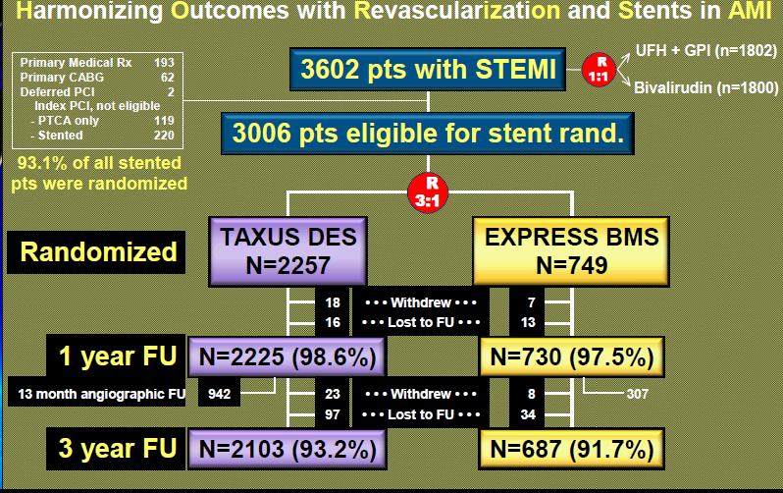
HORIZONS AMI

Slide 31
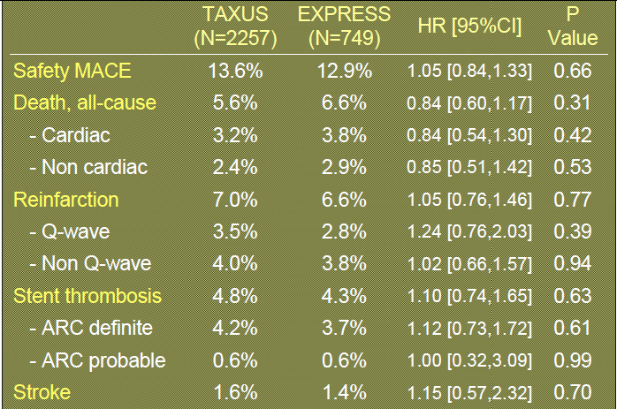
HORIZONS AMI: MACE

Slide 32
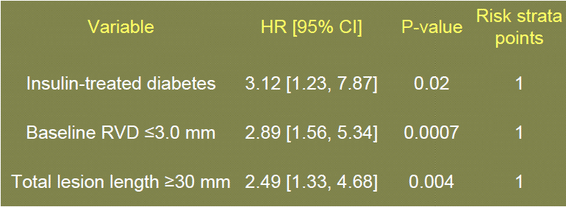
WHO should receive DES

Slide 33
What about Long Term & Very Long Term Stent Thrombosis?

Slide 34
Is Stent Thrombosis a problem in AMI ?

Slide 35
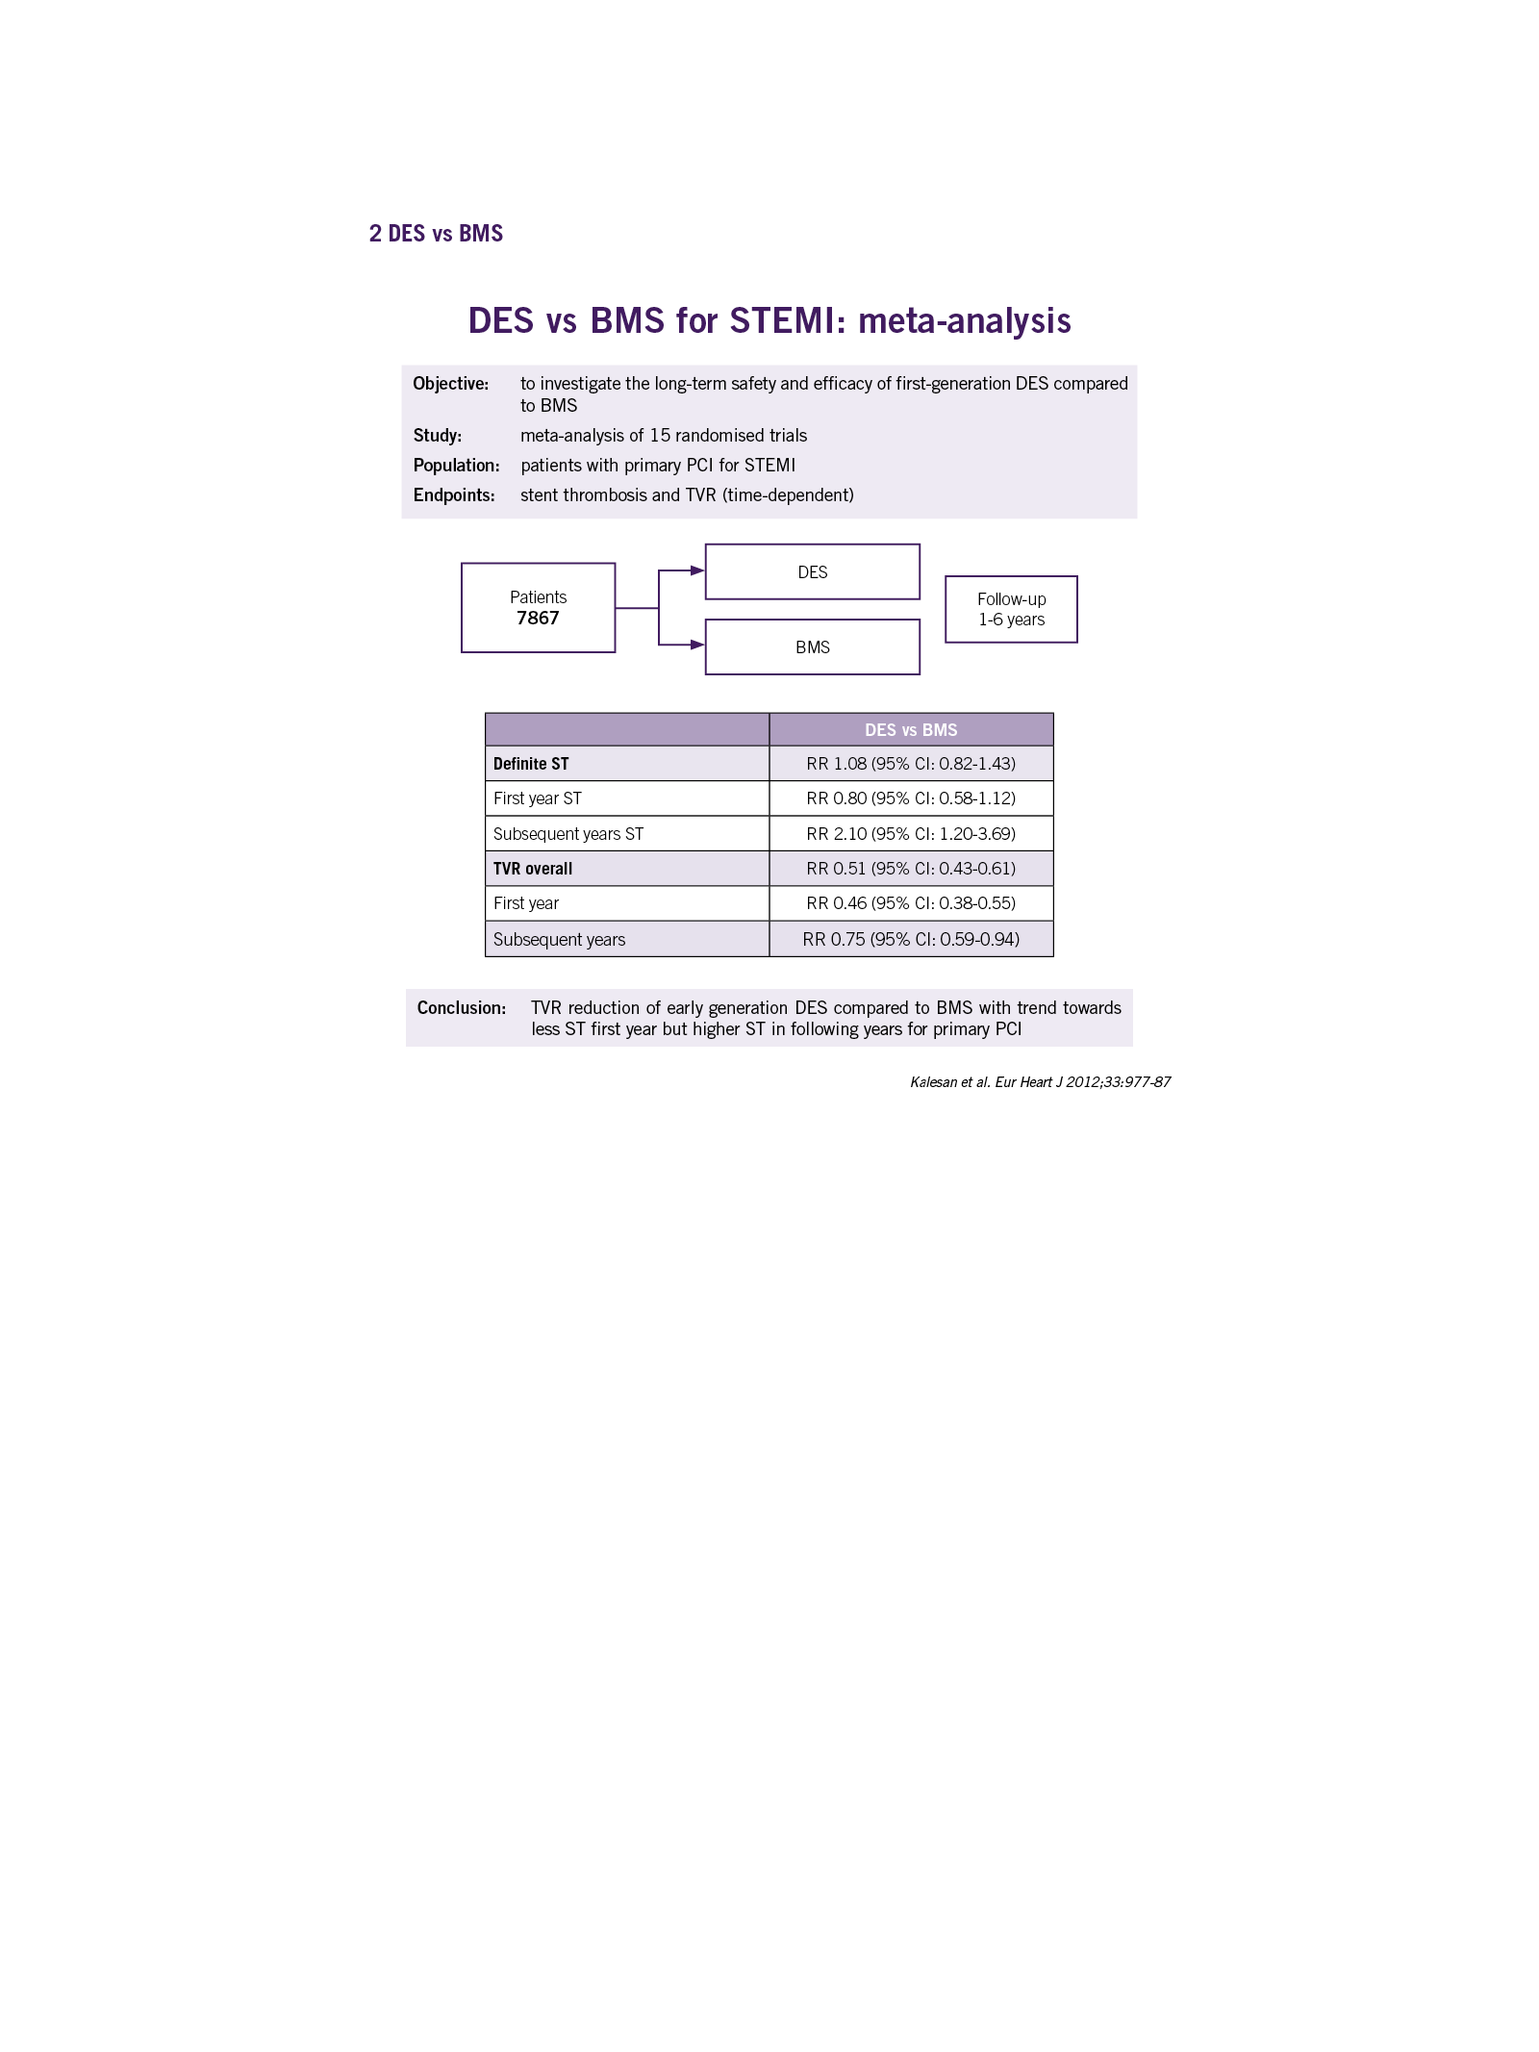
MA of First generation DES

Slide 36
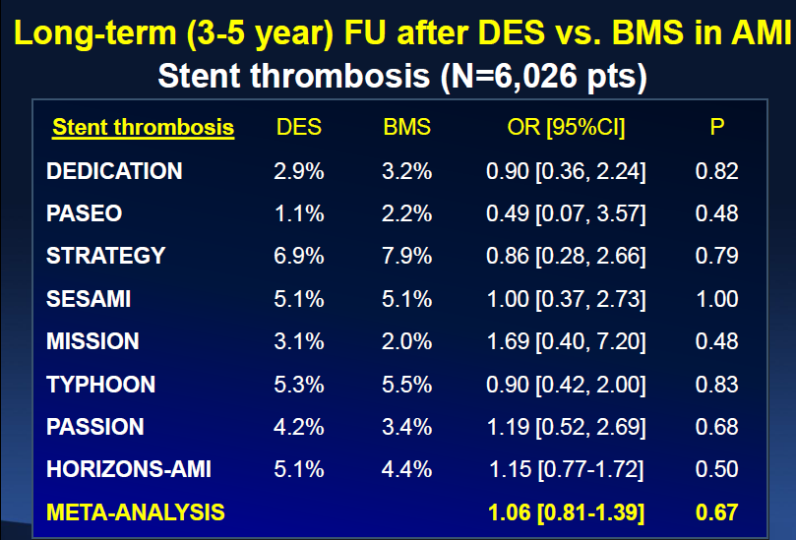
LONG TERM ST IN DES MI

Slide 37
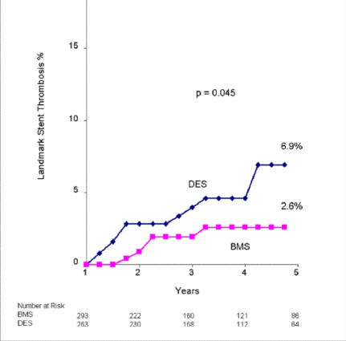
Very Late Stent Thrombosis
ST rates c BMS & DES similar at 1 yr 5.1 vs 4%.
Increased more with DES after the first year 1.9%/yr vs 0.6%/yr.
Higher significant VLST (p<.001) & Reinfarction.
JACC 2011

Slide 38
New Generation Stent vs BMS

Slide 39
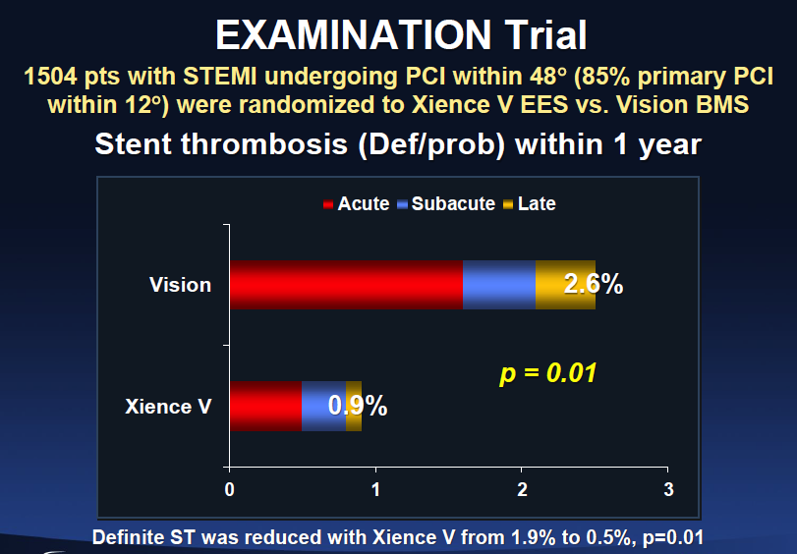
EES vs BMS

Slide 40
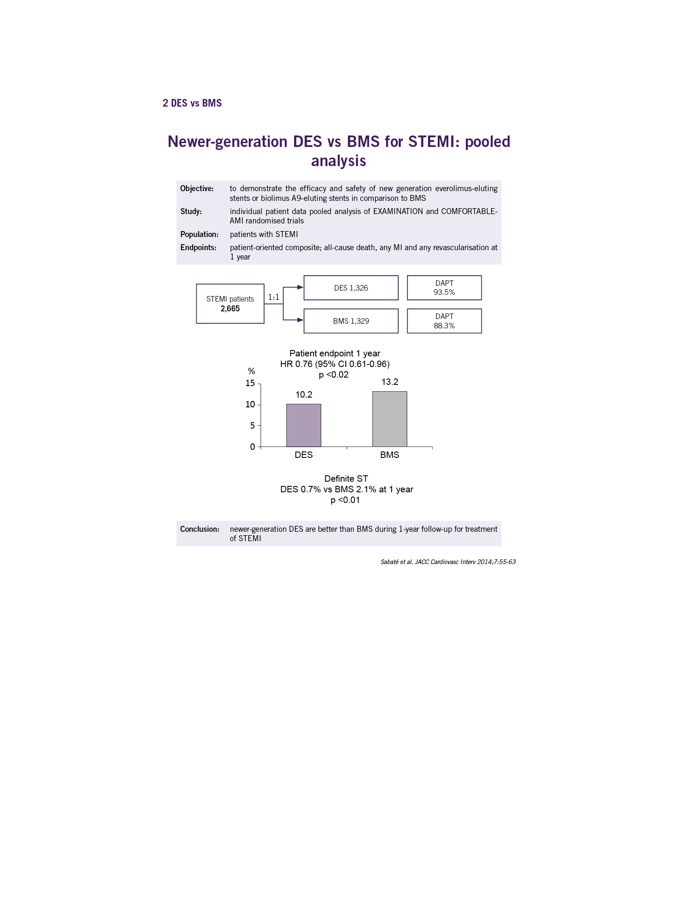
Pooled Analysis of New Gen DES vs BMS

Slide 41
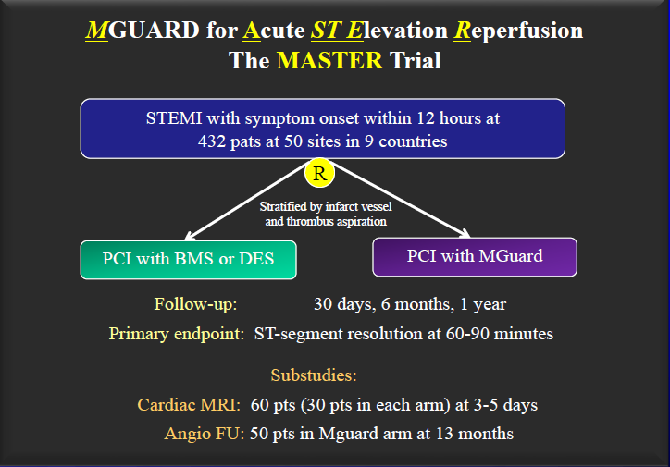
Mguard in AMI: Master Trial

Slide 42
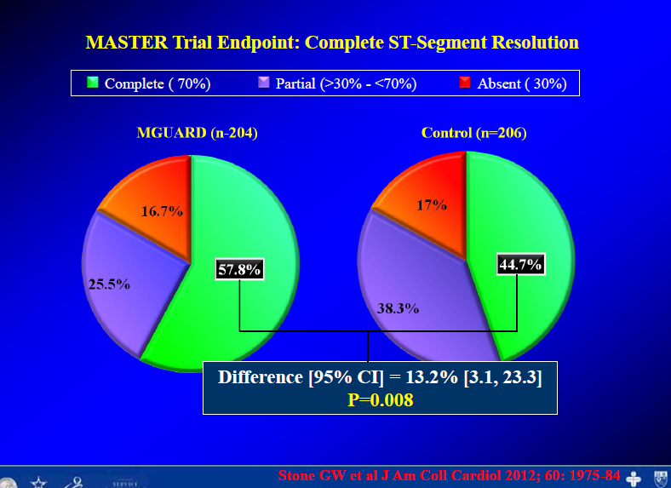
Master Trial Results

Slide 43
Long DES vs BMS
Clinical Outcome in Long length > 28mm DES vs BMS. Singapore study.
DES 86 vs BMS 89 for STEMI
MACE rate at 1yr: 7.9% vs 2.3% DES
No difference in Mortality or Reinfarction or ST.
Lower rate of TLR 0% vs 4.9%.

Slide 44
Meta Analysis

Slide 45
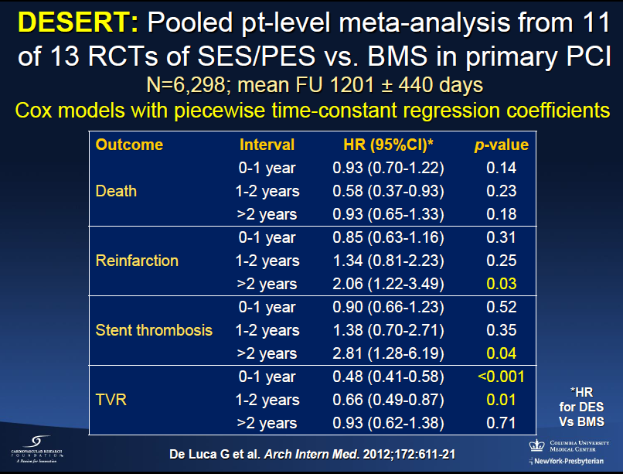
DES vs BMS

Slide 46
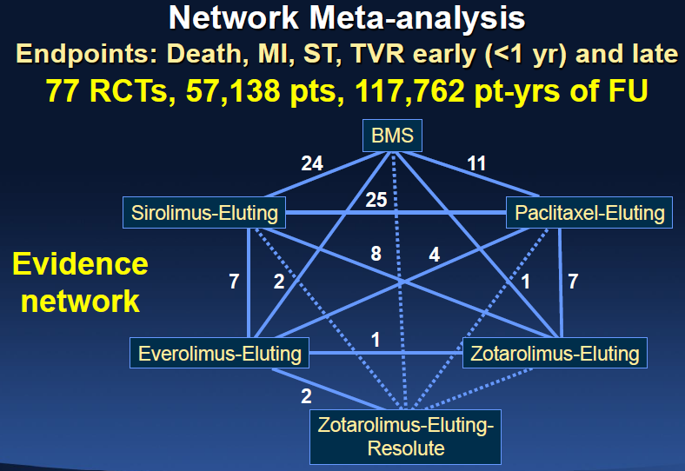
Largest MA: Bangalore

Slide 47
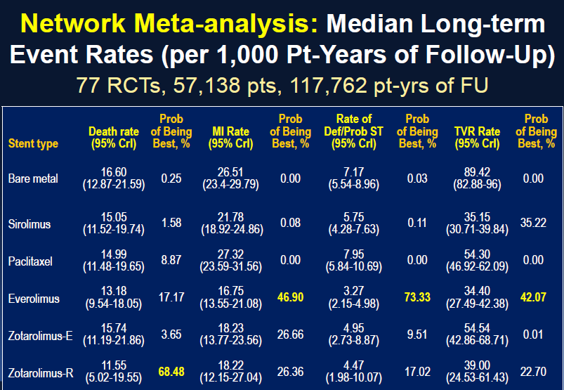
Which is the best?

Slide 48
BVS in AMI

Slide 49
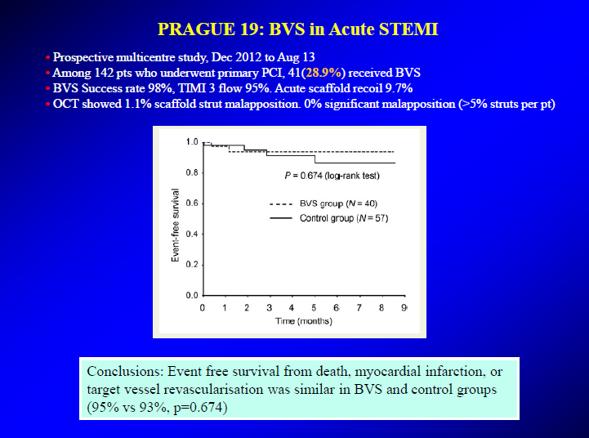
Prague Trial

Slide 50
BVS VS EES: BVS STEMIS STUDY
Methods
290 STEMI : BVS, compared with either 290 STEMI Pts c with EES or 290 STEMI c BMS.
Results
DOCE did not differ between the BVS and EES or BMS groups either at 30 days or at 1 year (4.1% vs. 4.1%, HR: 0.99
Definite/probable BVS thrombosis rate was numerically higher either at 30 days or at 1 year (2 .4% vs. 1.4%, p = 0.948; vs. 1.7%, p = 0.825, respectively), as compared with EES or BMS.
Conclusions
At 1-year :, STEMI with BVS had similar rates of DOCE with EES or BMS, although ST clustered in early phase, was not negligible. Larger studies with longer follow-up are needed.

Slide 51
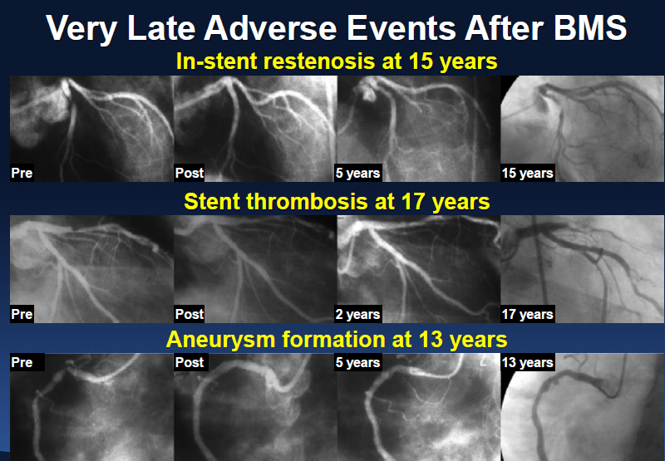
Very Very Late events BMS

Slide 52
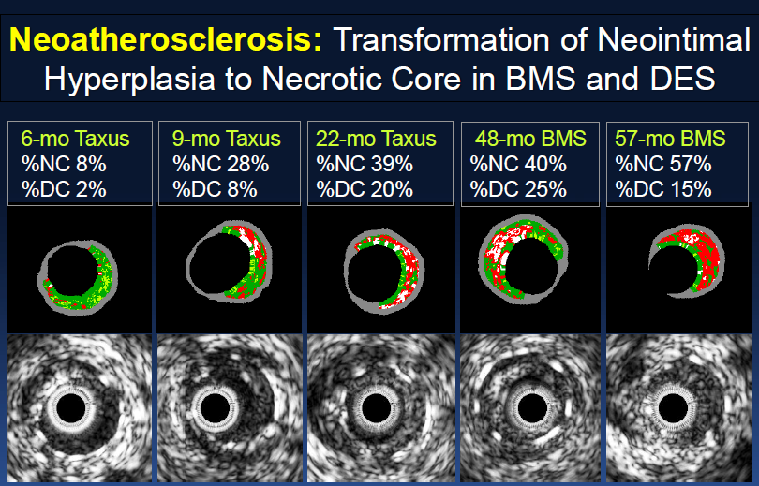
Neo Atherosclerosis: BMS vs DES

Slide 53
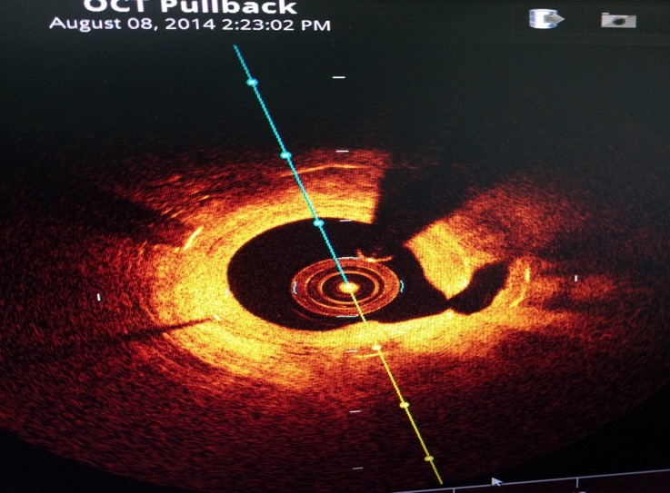
Plaque rupture in ISR Neoatherosclerosis

Slide 54
CONCLUSION
Restenosis, TLR, TVR significantly less with DES.
Death MI ST similar at 1 yr.
Late and Very Late ST marginally higher after 1 year.
Newer generation Stents : ST same or less.
Data required for BVS: presently not recommended.
My choice: New Gen DES

Slide 55
THANK YOU
.

Slide 56

Thank You

Slide 57
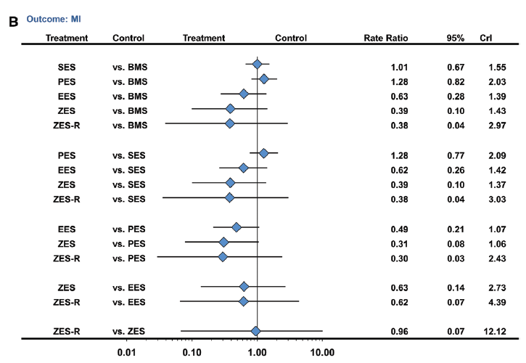
MI

Slide 58
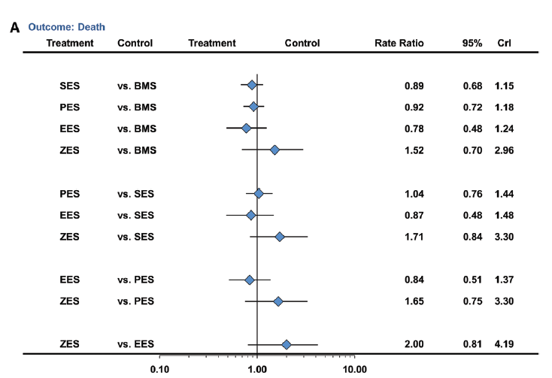
DEATH

Slide 59
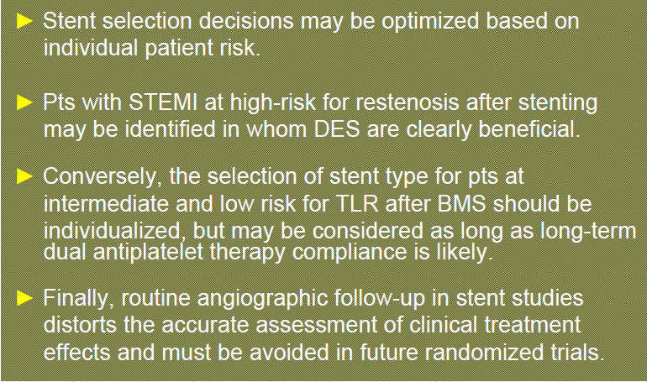

Slide 62
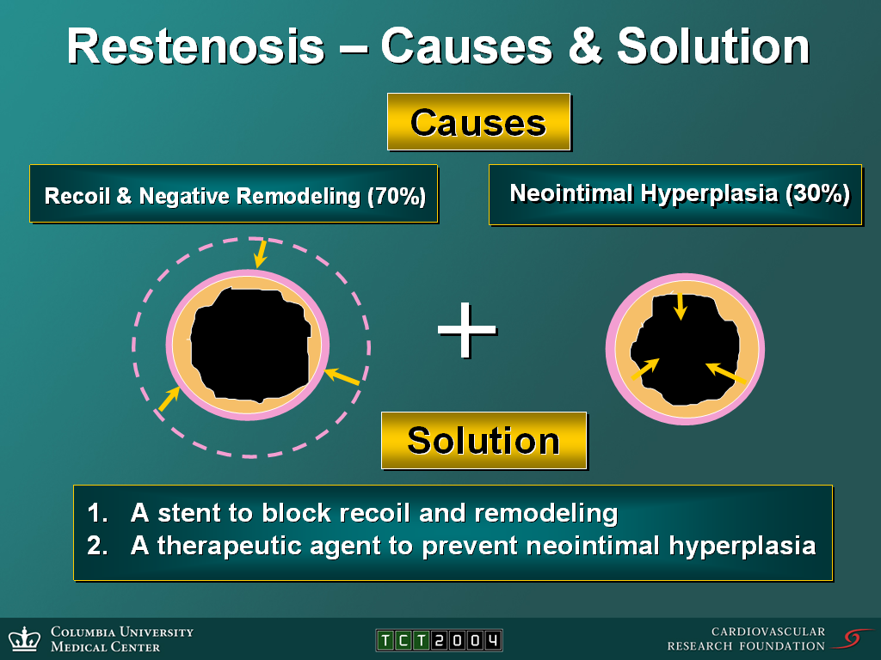
RESTENOSIS: POBA

Slide 79
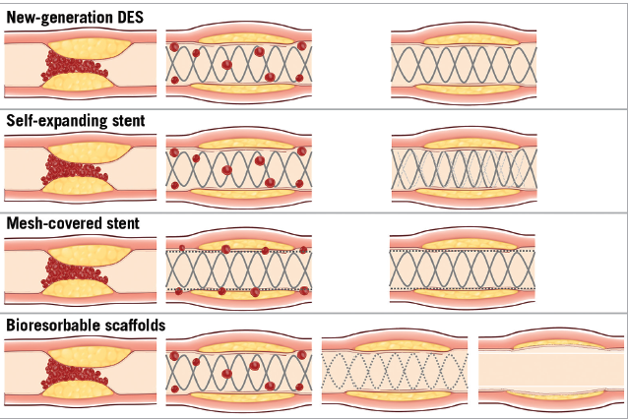
Newer Stents for AMI

Slide 80
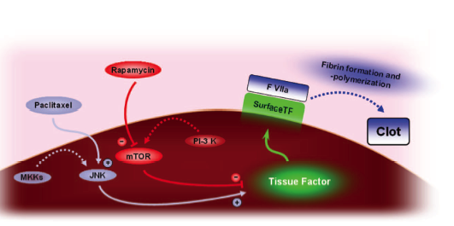
TISSUE FACTOR expression of DES

