Slide 1
Pharmaco invasive PCI
DR. P.B. JAYAGOPAL
MD DM DNB FACC FICC FCSI FESC
LAKSHMI HOSPITAL, PALAKKAD.

Slide 2
Pharmaco invasive Strategy
Routine Administration of pharmacological agent (fibrinolytic/glycoprotein 2b/3a)
Prior to planned PCI in STEMI

Slide 3
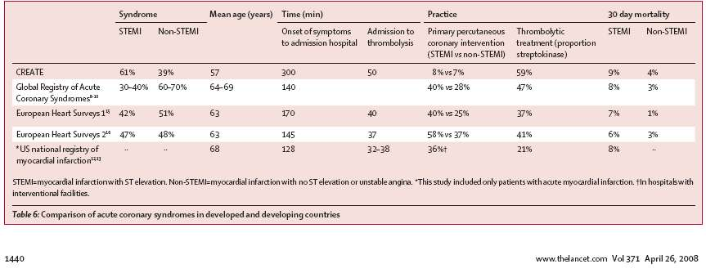
CREATE data in context
Circa 2008, 59% received thrombolytics and 8% got PCI, with 9% mortality. [N=20468]

Slide 4
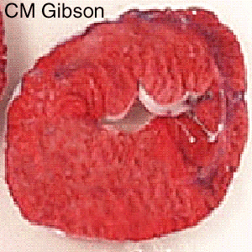
100
D
1) Time is Myocardium 2) Infarct Size is Outcome
80
60
Mortality Reduction (%)
C
40
20
B
A
Extent of
Myocardial Salvage
0
0
4
8
12
16
20
24
Time From Symptom Onset to Reperfusion Therapy, h
Critical Time-dependent Period
Goal: Myocardial Salvage
Time-independent Period
Goal: Open Infarct-Related Artery

Slide 5


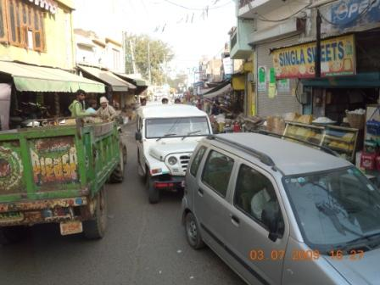
Traffic Jams In India
PAMI IN INDIA - LIMITATIONS
<10% eligible, <41% before 4 hrs
500 centres
CAD burden 32 million patients,
> 3 million ACS.
Speed of reperfusion is a key.
DBT <90 min. - 33% in PCI centres.
NRMI – 3 / 4 DBT <90 (4.2%)
<120 (16.2%) in transfer patients.
Create Registry India –
Time to reach hospital 300 min.

Slide 6
Feasibility of Primary PCI vs. thrombolysis
No cath-lab facility in rural areas
Centers with cath-lab facility –
round the-clock availability of trained personnel
Instead, timely and even pre-hospital administration of thrombolytic is a more feasible strategy.
3rd gen agents,
Bolus administration.

Slide 7
Place of thrombolytics in the era of PCI
Fibrinolytic therapy - within 30 minutes of hospital arrival at non-PCI capable hospitals when the anticipated First medical contact to device time at the PCI capable hospital exceeds 120 minutes because of unavoidable delays –
ACC AHA 2013 Guidelines
Fibrinolytic therapy is recommended within 12 h of symptom onset in patients without contraindications if primary PCI cannot be performed by an experienced team within 120 min of FMC (IA), particularly if possible in a pre-hospital setting –
ESC 2012

Slide 8
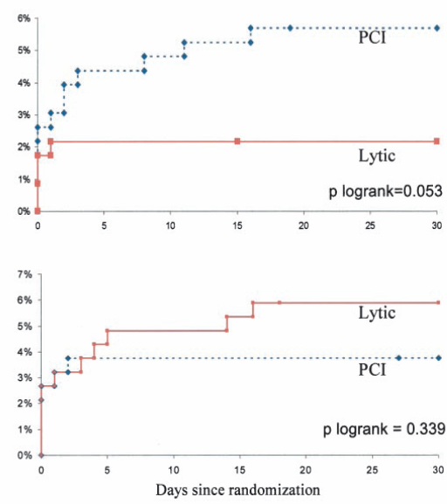
CAPTIM trial: Pre-hospital thrombolysis within 2 hours is superior to Primary PCI
Patients randomized <2 hrs had lower 30-day mortality with pre-hospital thrombolysis by TNK-tPA compared to primary PCI (2.2% versus 5.7%, P=0.058), whereas mortality was similar in patients randomized >2 hours (5.9% versus 3.7%, P=0.47).
Cir. 2003; 108; 2851-2856

Slide 9
Pharmacoinvasive Strategy
Two Registries & Four Studies showed a different path
The Vienna Registry (1053 patients) (Circulation 2006)
FAST-MI Registry (223 Centres,1714patients) (Circulation 2008)
GRACIA-2 (Comparison with PPCI) (212 patients) E.H. Journal (2007)
TRANSFER-AMI (Comparison with Conservative use of PCI)(1060 patients)
(Presented at ACC 2008)
NORDISTEMI (Immediate PCI Vs Ischaemia guided PCI) (226 patients)
(JAM Coll Cardiol 2010)
STREAM (Fibrinolysis or Primary PCI ) (1892 patients) (N Engl J Med 2013).

Slide 10
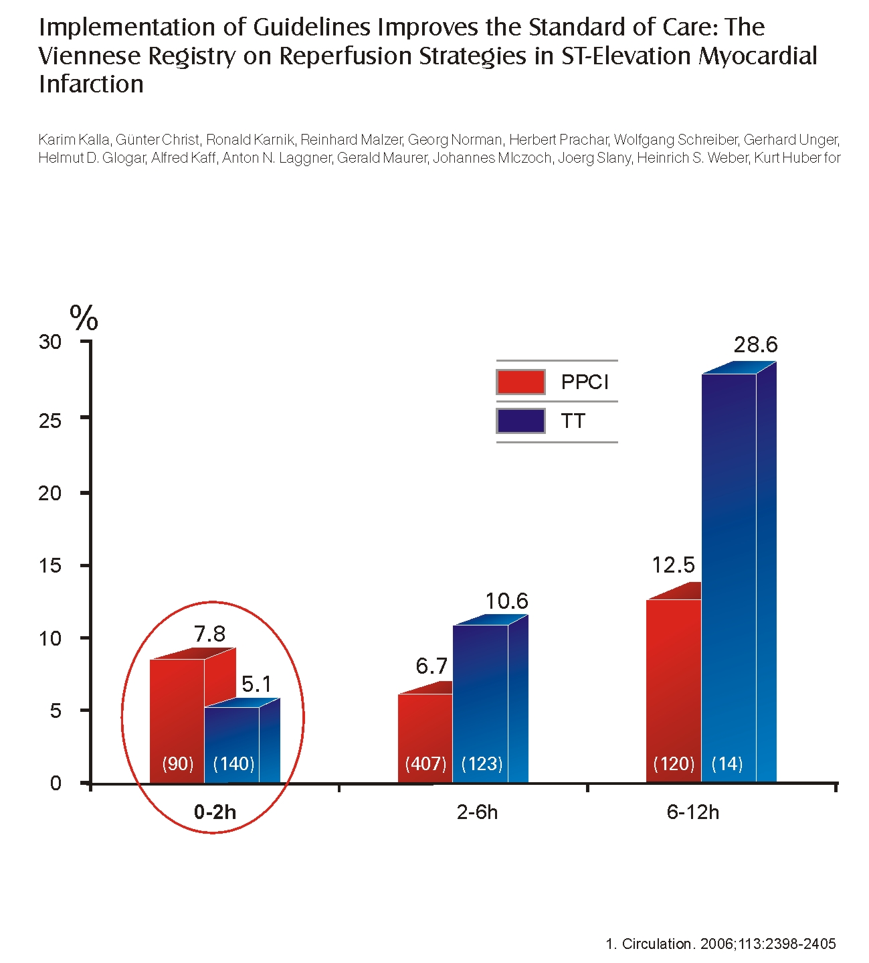
The Vienna Registry
Within 2 hrs thrombolysis better than PPCI

Slide 11
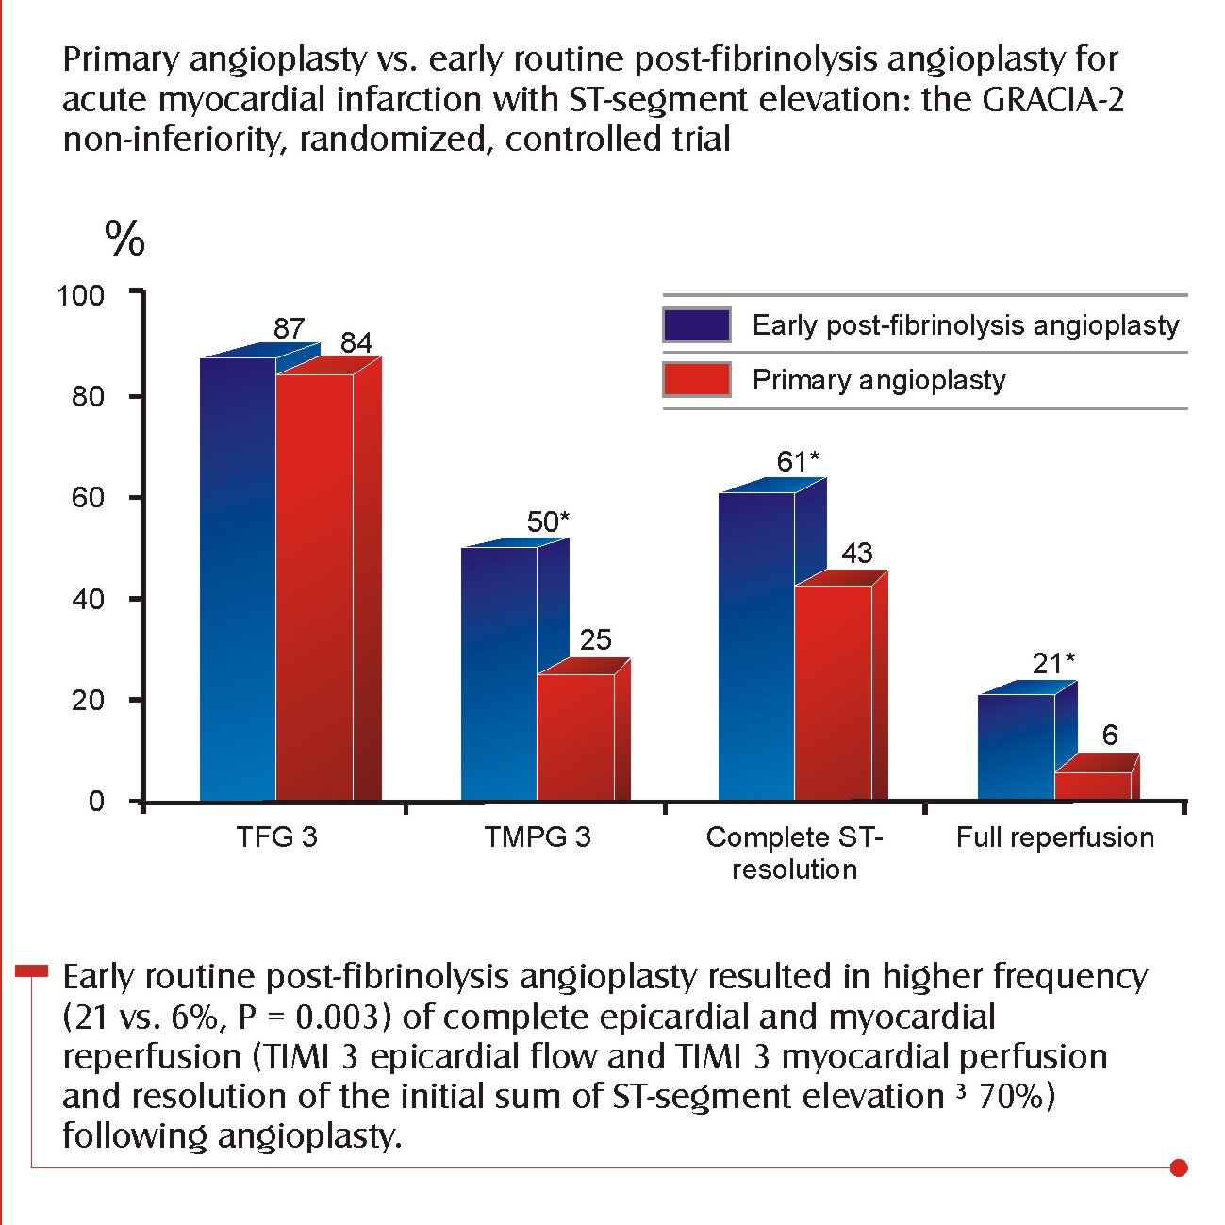
GRACIA 2

Slide 12
GRACIA -2 TRIAL
Lytic based delayed pharmaco-mechanical reperfusion could represent a reasonable alternative to primary PCI when not feasible.
It is as safe and effective as a primary PCI
Thus provides wider time window for PCI when needed.

Slide 13
TRANSFER-MI
Trial Design: TRANSFER-MI was a randomized study comparing pharmacoinvasive strategy (transfer to PCI center for routine early PCI within 6 hrs) with standard treatment (early transfer only for failed reperfusion) for high-risk STEMI patients receiving thrombolysis at non-PCI centers (N=1,060). The primary endpoint was 30-day composite of death, reinfarction, recurrent Ischemia, CHF, shock.
30 Day Composite (death, reinfarction, recurrent ischemia, CHF, shock)
OR = 0.537
p =0.0013
Results
Early PCI within 6 hrs after thrombolysis was associated with a 6% absolute reduction in the primary study composite endpoint . Standard 16.6% vs Pharmacoinvasive 10.6% (OR = 0.0013 = 0.537 [.368, 0.783]: p = 0.0013 (Figure)
Conclusions
Challenges findings of older studies regarding timing of fibrinolysis and PCI
Pharmacoinvasive strategy was safe and effective
Findings provide important information for shaping future guidelines
% of pts
Standard
Pharmacoinvasive
Kastrani, K et al. Presented at ACC, 2008 @2008, American Heart Association. All rights reserved.
Notes:
13

Slide 14
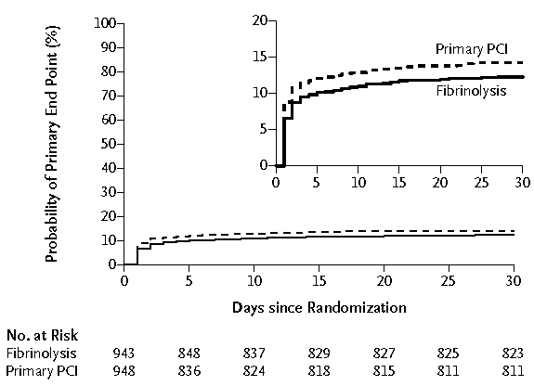
STREAM Trial Fibrinolysis or Primary PCI in ST-Segment Elevation Myocardial Infarction
The primary end point was a composite of death from any cause, shock, congestive heart failure, or reinfarction within 30 days (P = 0.21 by the logrank test). PCI denotes percutaneous coronary intervention. The inset shows the same data on an enlarged y axis

Slide 15
STREAM Trial Fibrinolysis or Primary PCI in ST-Segment Elevation Myocardial Infarction
Conclusion:
Pre-hospital fibrinolysis with timely coronary angiography resulted in effective reperfusion in patients with early STEMI who could not undergo primary PCI within 1 hour after the first medical contact.

Slide 16
Five-Year Survival in Patients with STEMI According to Modalities of Reperfusion Therapy: FAST-MI Study

Slide 17
Baseline characteristics, early management and in-hospital complications
1492 patients with STEMI and a time to first call ≤ 12 hours from symptom
447 (30%) fibrinolytic therapy (20% - pre-hospital fibrinolysis)
583 (39%) intended primary PCI
462 (31%) no reperfusion therapy
Tenecteplase in 78% - 96% CAG -- 84% had a PCI
Initial TIMI flow 3- more frequently seen in lytic-treated .
Final TIMI flow 3 - more commonly after primary PCI (90%)

Slide 18
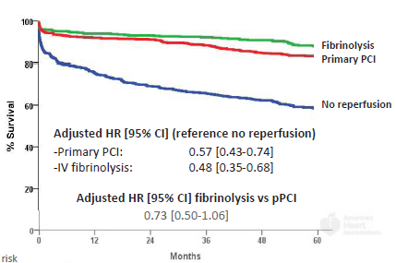
Five-year outcome according to use and type of reperfusion therapy
Adjusted hazard ratio (95% confidence interval) for 5 year death, in reference to patients getting no reperfusion therapy was 0.57 (0.43-0.74) for primary PCI and 0.48 (0.35-0.68) for the pharmaco-invasive strategy.
Direct comparison of the two reperfusion techniques showed a nonsignificant trend favouring fibrinolytic treatment (HR 0.73, 0.50-1.06; P=0.10).

Slide 19
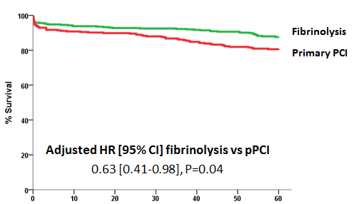
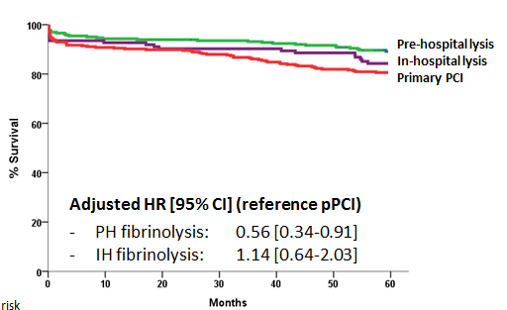
Five-year outcome according to use and type of reperfusion therapy
"STREAM-like" population
5-year survival was 88% with the fibrinolysis-based strategy and 81% with intended primary PCI (P=0.009), with an adjusted HR of 0.63 (95% confidence interval: 0.41-0.98, P=0.039)
When considering only pre-hospital fibrinolysis, five year survival with pre-hospital fibrinolysis was 89% (HR versus primary PCI: 0.56, 95% CI 0.34-0.91, P=0.019)

Slide 20
NORDISTEMI
Objective : To compare a strategy of immediate transfer for percutaneous coronary intervention (PCI) with an ischemia-guided approach after thrombolysis in patients with very long transfer distances to PCI.

Slide 21
NORDISTEMI
Early Invasive strategy better than Conservative Strategy
(J Am Coll Cardiol 2010;55:102–10)

Slide 22
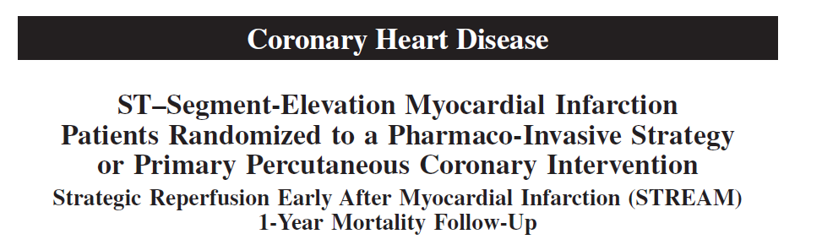
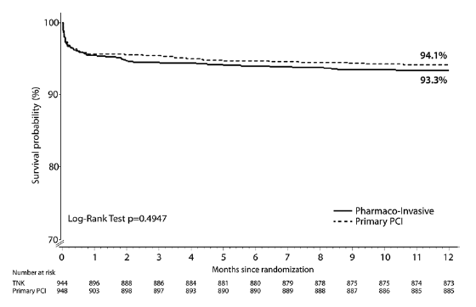

(Circulation. 2014;130:1139-1145.)

Slide 23
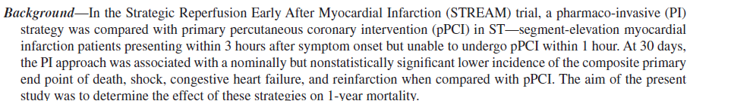
STREAM -1year followup
(Circulation. 2014;130:1139-1145.)

Slide 24
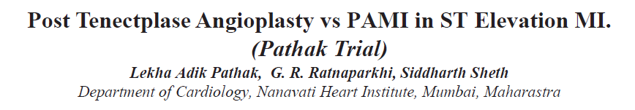
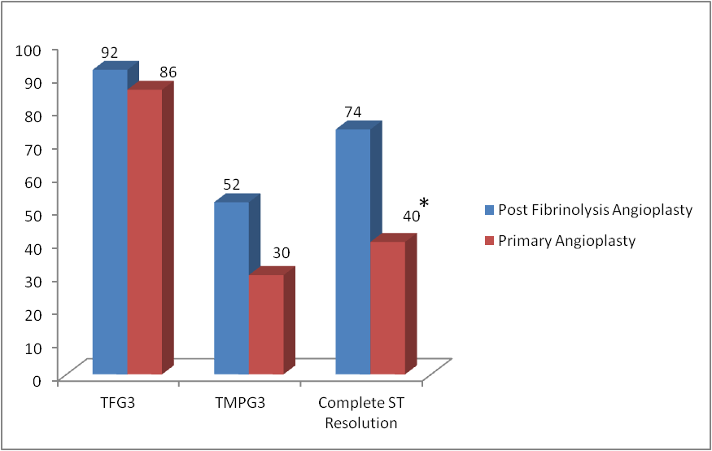
*
n=200
The post fibrinolysis angioplasty resulted in better & higher TIMI 3 epicardial & TMPG 3 myocardial perfusion, resolutionof ST segment & LVEF was same in both groups.

Slide 25
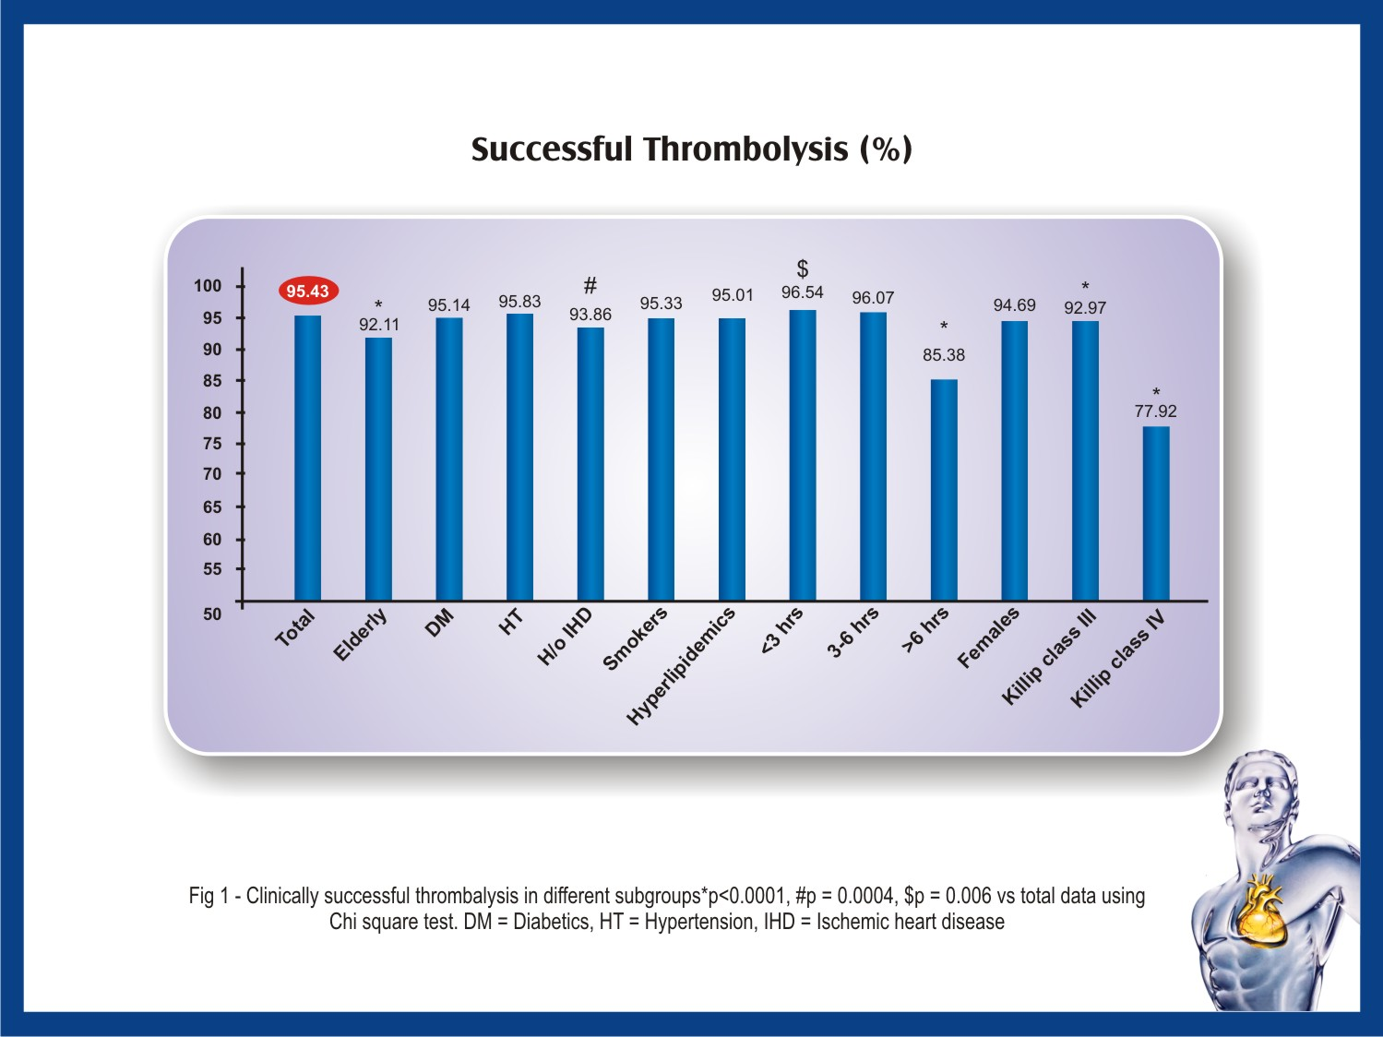

Slide 26
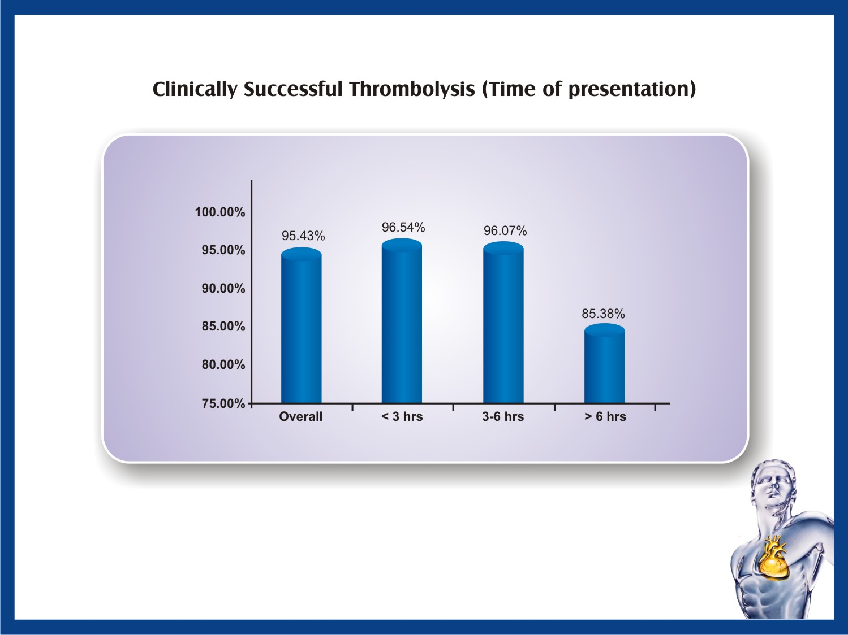

Slide 27
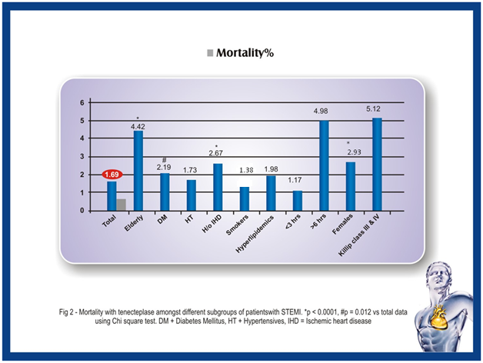

Slide 28
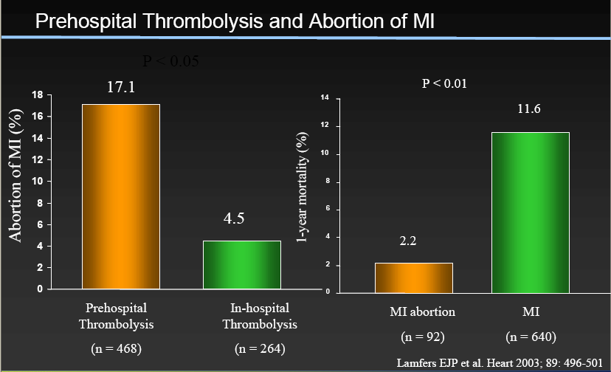

Slide 29
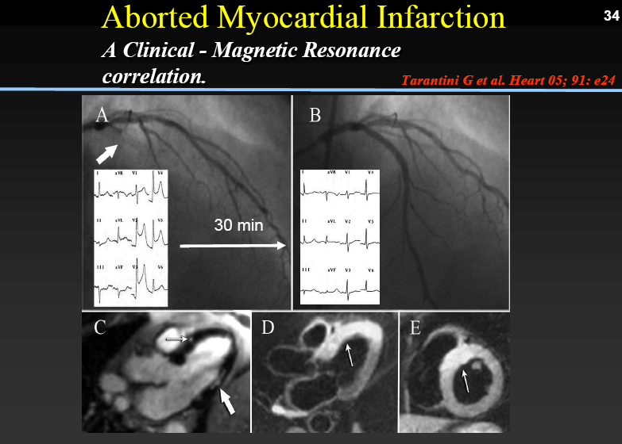

Slide 30
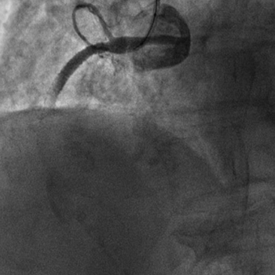

Slide 31
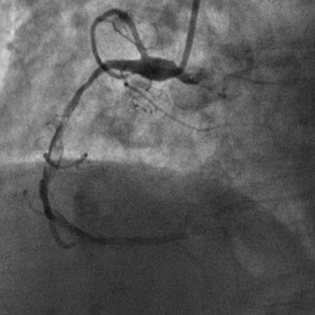

Slide 32
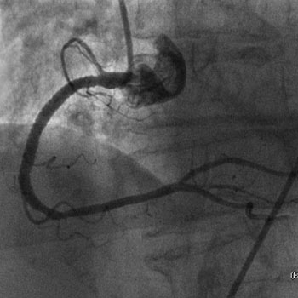

Slide 33
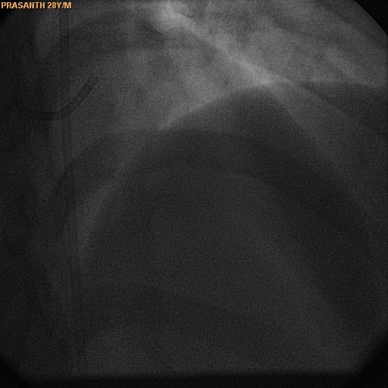
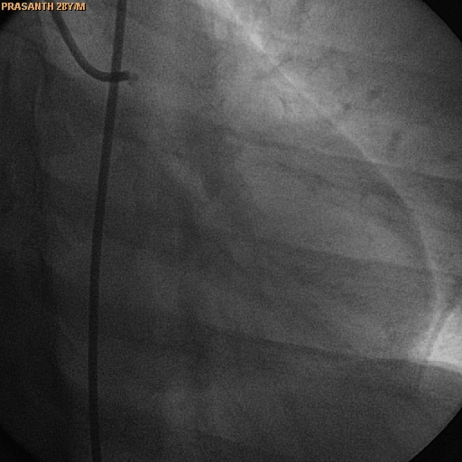
Young patient with MI

Slide 34
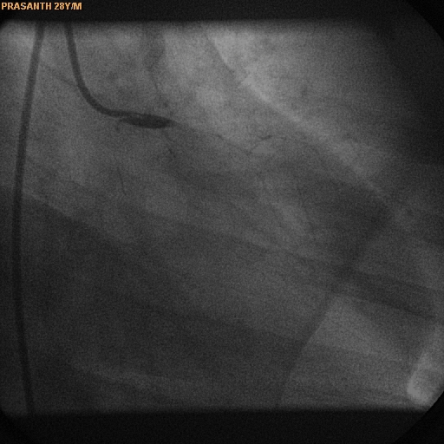
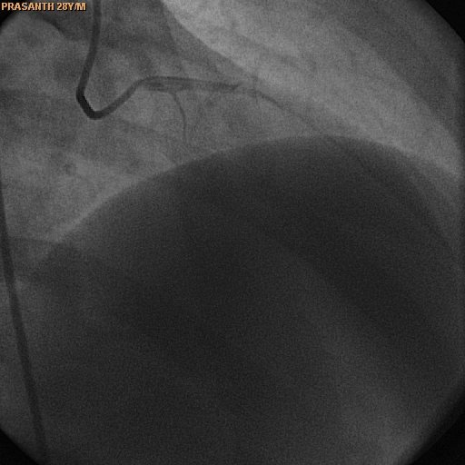
Young patient with MI

Slide 35
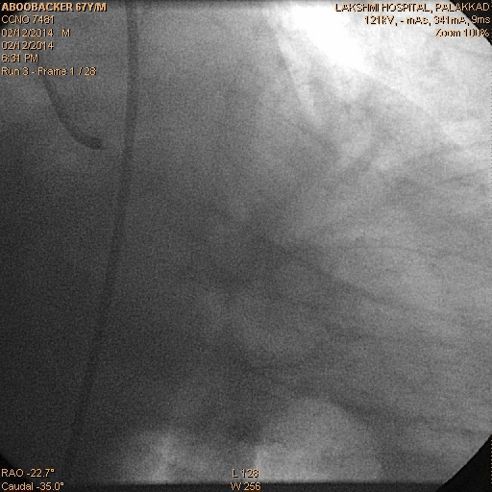
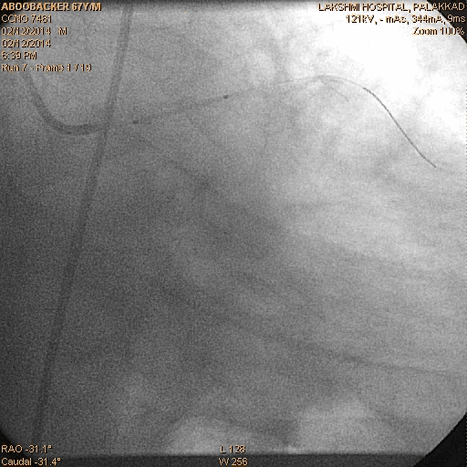
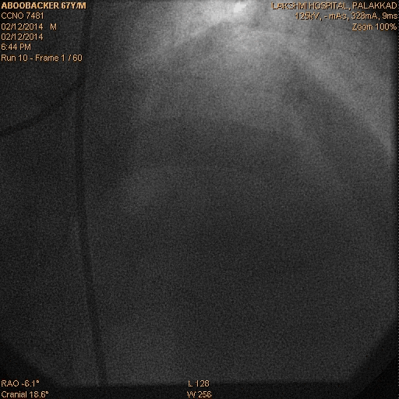

Slide 36
Data So Far
Year | Trial | Patients | AIM | Time of intervention | Result
2007 | GRACIA 2 | 212 | PPCI VS Pharmacoinvasive | after 3 Hrs | Pharmaco Invasive Better
2008 | FAST MI | 1714 | PPCI VS Pharmacoinvasive | after 3 Hrs | Pharmaco Invasive Better
2008 | Transfer AMI | 1060 | Lysis VsPharmacoinvasive | Within 6 hrs | Pharmaco Invasive Better
2010 | NORDISTEMI | 266 | Early PCI Vs Delayed PCI | Early | Early better
2013 | STREAM | 1892 | PPCI Vs Lysis + Late PCI | About 17 Hrs | Lysis+ Late Better

Slide 37
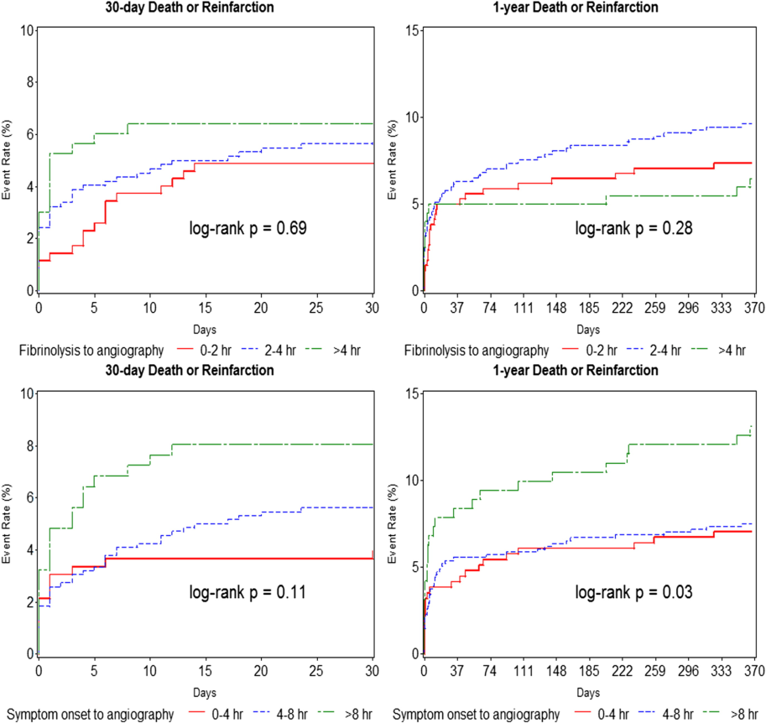
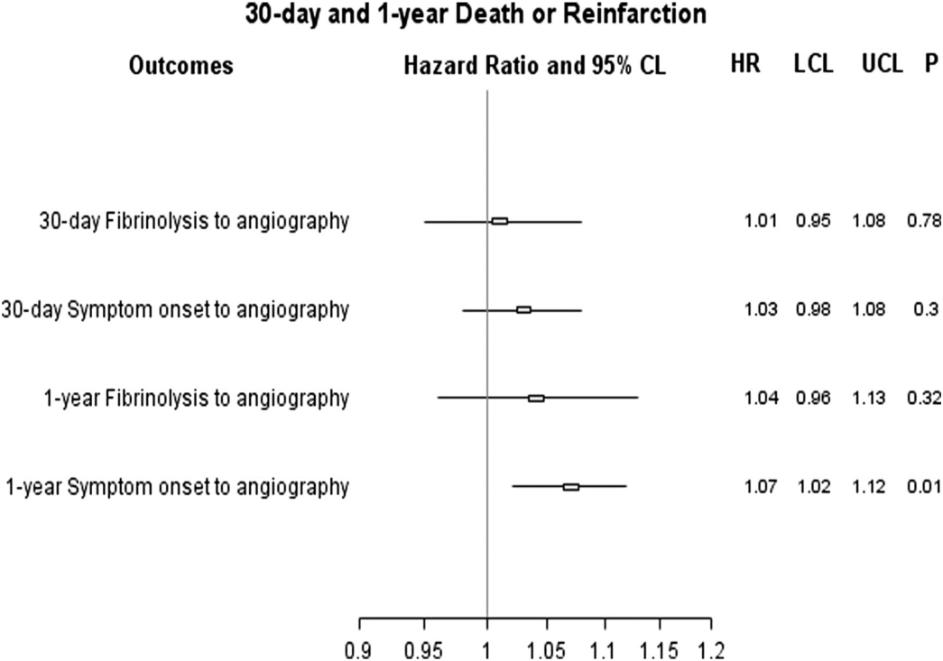
Time to Invasive Assessment
J Am Coll Cardiol Intv. 2015;8(1_PB):166-174. doi:10.1016/j.jcin.2014.09.005
J Am Coll Cardiol Intv. 2015;8(1_PB):166-174. doi:10.1016/j.jcin.2014.09.005

Slide 38
Largest Pooled data
6 Trial 1261 pts – 1238 pts
165 mts / 5.30 hrs
87% PCI(femoral access)
84.5% (Stenting)
14% (DES)
90% after PI PCI -TIMI 3
G2b/3a - 63.2%
Mina Madan et al Jacc 2015

Slide 39
REPERFUSION STRATEGIES IN INDIA
STEMI India
Kovai – Erode Pilot study - Hub and spoke models
84 patients
45 (54%) from outer grid
Primary PCI - 44 min.
Pharmaco invasive - 480 min.
Tamil Nadu STEMI Project
Approved and funded by ICMR

Slide 40
2013 Consensus Statement for Early Reperfusionand Pharmaco-invasive Approach in PatientsPresenting with Chest Pain Diagnosed as STEMI(ST elevation myocardial infarction) in an Indian Setting
We recommend a time guided ‘Protocol/ Plan of Action’ for early fibrinolysis andimplementing a PI approach at the level of general practitioners, non-PCI hospitals/nursing homes with intensive care facility and in PCI capable centers.
For STEMI patients with symptom duration ≤ 6 hours,we suggest administration of fibrinolytics either tenecteplase (Grade1A), reteplase (Grade1B), alteplase(Grade1C) or streptokinase (Grade 2B) alongside contemporary adjunctive medical therapy for PI approach.
© JAPI • JUNE 2014 • VOL . 62

Slide 41
Registry data 20000 patients PI PCI IN CLINICAL PRACTICE
4 factors
1. ESTIMATED SYSTEM DELAY
NON PCI CENTRE - LONG TRANSFER DELAY
2. PATIENT RELATED DELAY
PRE HOSPITAL LYSIS
3. PATIENT RISK PROFILE
VERY SICK PATIENT AND PRACTICAL PROBLEM IN IMMEDIATE PCI & LACK OF SUPPORT
YOUNG PATIENT, HUGE THROMBUS BURDEN, ECTATIC LARGE CORONARIES
4. PATIENT BLEEDING RISK
Jan. 2015

Slide 42
MESSAGE
In a real-world setting , high five-year survival rates for STEMI patients were observed, provided they were treated with either primary PCI or with a pharmaco-invasive strategy.
The pharmaco-invasive strategy yielded results that were at least as good as those of primary PCI.
Overall, in the absence of contraindication, and considering the potential difficulty of implementing a 24/7 emergency PCI service in some settings, a pharmaco-invasive strategy seems to represent a safe alternative to primary PCI.

Slide 43
Thank you

