Slide 1
Primary Angioplasty –
When do you Back Off ?
Dr. Madhu Sreedharan
MD, DM, MRCP (UK), FIC (Aus), FRCP (L), FRCP (E), FSCAI, FACC
NIMS Heart Foundation

Slide 2
Scope of the Talk
Evidence Based
Bit Philosophical
Bit Controversial
Mostly Practical !

Slide 3

Acute MI – Russian Roulette

Slide 4
Acute MI – Russian Roulette
Patients who have Primary PCI with good flow within first few hours of MI may still land up with Severe LV Dysfunction.
Patients who had lysis and come for PCI with impaired LV Function may have normal LV on follow up after a successful PCI!
Emphasis of D2B is to get it down to 90 minutes - as well as shorten the Total Ischemic Burden
Further reduction in D2B does not result in better Outcomes!

Slide 5
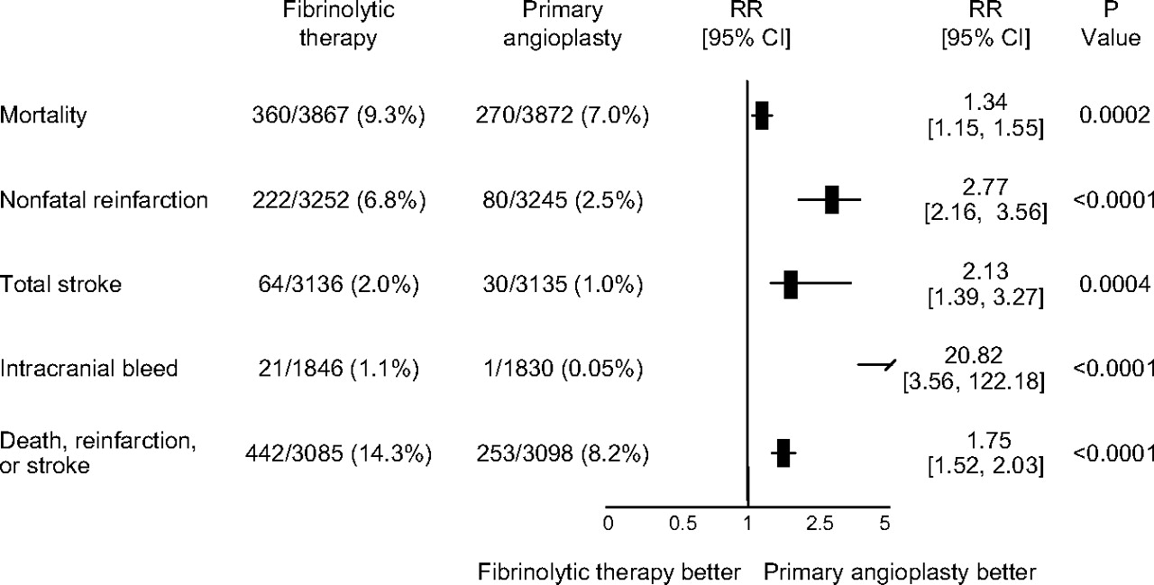

Pooled analysis of short-term results from 23 RCTs
Primary PCI vs Fibrinolytic therapy in 7739 pts.
Stone G W Circulation. 2008;118:538-551
Copyright © American Heart Association, Inc. All rights reserved.
Notes:
Figure 1. Pooled analysis of the short-term results from 23 randomized trials comparing primary PCI and fibrinolytic therapy in 7739 total patients. Data from Reference 13. Data vary slightly from Reference 13 because of presentation of relative risks (RRs) rather than ORs.

Slide 6
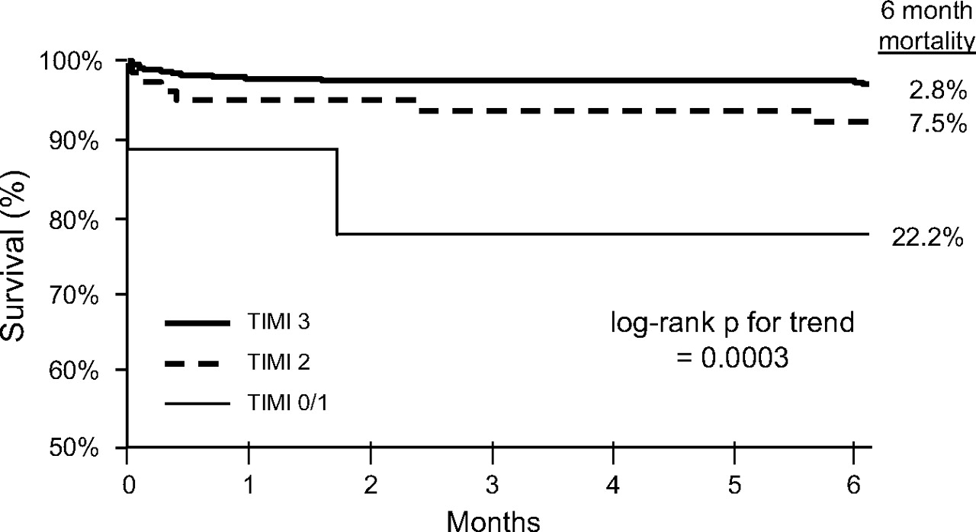
Impact of post-procedure TIMI flow on 6-mo
Survival after PPCI in 2507 patients
Stone G W Circulation. 2008;118:538-551
Copyright © American Heart Association, Inc. All rights reserved.
Notes:
Figure 2. Impact of postprocedure TIMI flow on 6-month survival after primary angioplasty in 2507 patients from the Primary Angioplasty in Myocardial Infarction-1, -2, and stent pilot and randomized trials (unpublished data). Postprocedure TIMI grade 3 flow (present in 92.5% of patients) was strongly correlated with long-term survival. Postprocedure TIMI grade 2 flow (present in 6.0% of patients) was associated with a 3-fold increase in mortality, whereas mortality was increased 8-fold in the 1.5% of patients with postprocedure TIMI grade 0/1 flow.

Slide 7
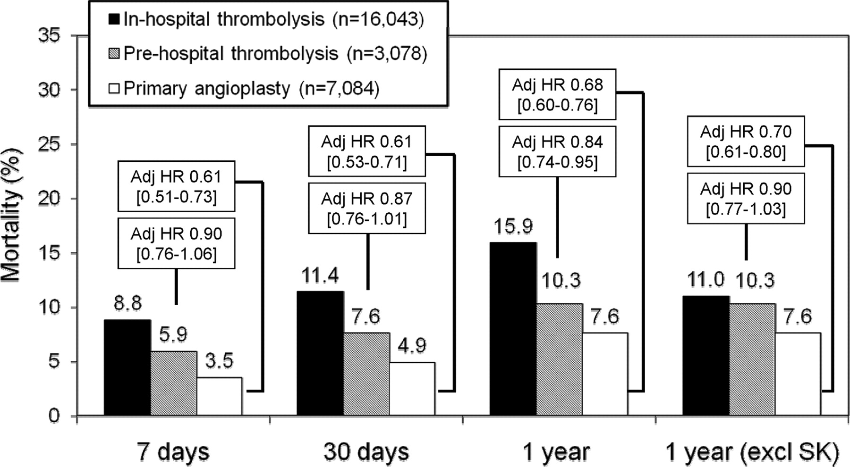
Mortality in 26,206 patients with STEMI treated with
In-hospital Lysis, Pre-hospital Lysis or PPCI without lysis
Stone G W Circulation. 2008;118:538-551
Copyright © American Heart Association, Inc. All rights reserved.
Notes:
Figure 3. Mortality at different time periods in Sweden between 1999 and 2005 in 26 206 patients with STEMI treated with in-hospital thrombolysis, prehospital thrombolysis, or primary PCI without fibrinolytic therapy. In each case, the adjusted hazard ratio (adj HR; after correction for differences in baseline characteristics and the propensity to receive primary PCI) for patients receiving in-hospital fibrinolysis was set to 1.0. The top box reflects the adjusted HR and 95% CI for the comparison of in-hospital fibrinolysis vs prehospital fibrinolysis; the bottom box reflects the comparison of in-hospital fibrinolysis with primary PCI. Excl SK indicates excluding patients who received streptokinase. Data from Reference 43.

Slide 8
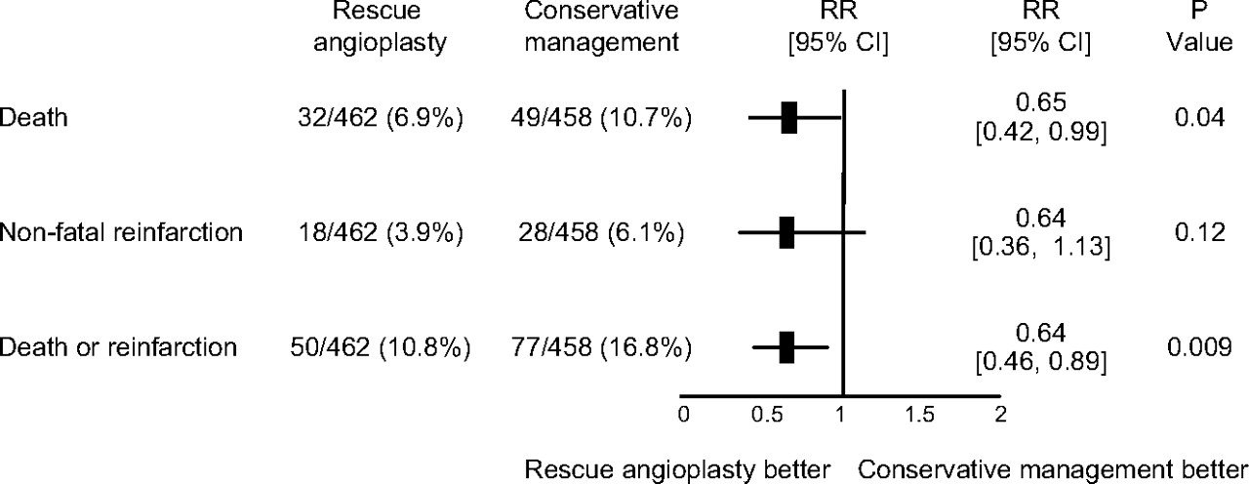
Pooled analysis of 30-day results from 5 RCTs :
Rescue PCI vs Conservative Rx post Failed Lysis in 920 pts.
Stone G W Circulation. 2008;118:552-566
Copyright © American Heart Association, Inc. All rights reserved.
Notes:
Figure 1. Pooled analysis of the 30-day results from 5 randomized trials comparing rescue angioplasty and conservative management after failed fibrinolytic therapy in 920 total patients. Data from Reference 9. Note that the data vary slightly from Reference 9 because of presentation of relative risks (RRs) rather than ORs.

Slide 9
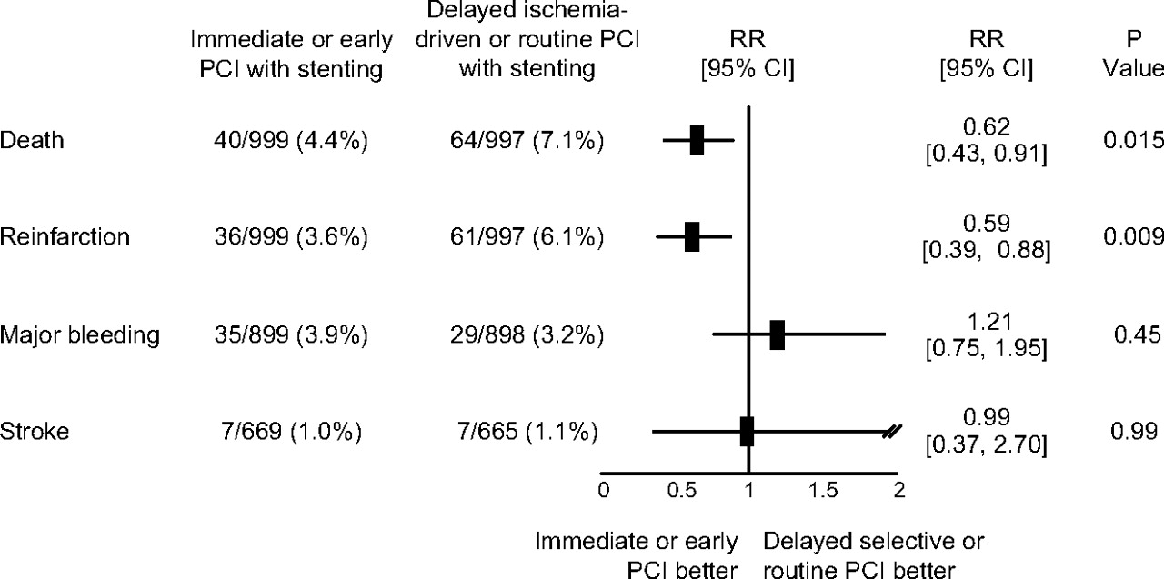
7 RCTs with Lysis → Routine immediate or early PCI
vs Delayed ischemia - guided / Routine stenting in 1996 patients.
Stone G W Circulation. 2008;118:552-566
Copyright © American Heart Association, Inc. All rights reserved.
Notes:
Figure 2. Pooled analysis of the results from 7 published randomized trials in patients treated with fibrinolytic therapy comparing the strategy of routine immediate or early catheterization followed by stenting when appropriate and delayed ischemia-guided or routine stenting (with early catheterization and revascularization reserved for rescue PCI) in 1996 total patients. Data are at the time of latest follow-up (3 months from the PRAGUE, WEST, CARESS, and Leipzig trials; 6 months from the CAPITAL-AMI and SIAM-III trials; and 1 year from the GRACIA-1 trial).22–28

Slide 10
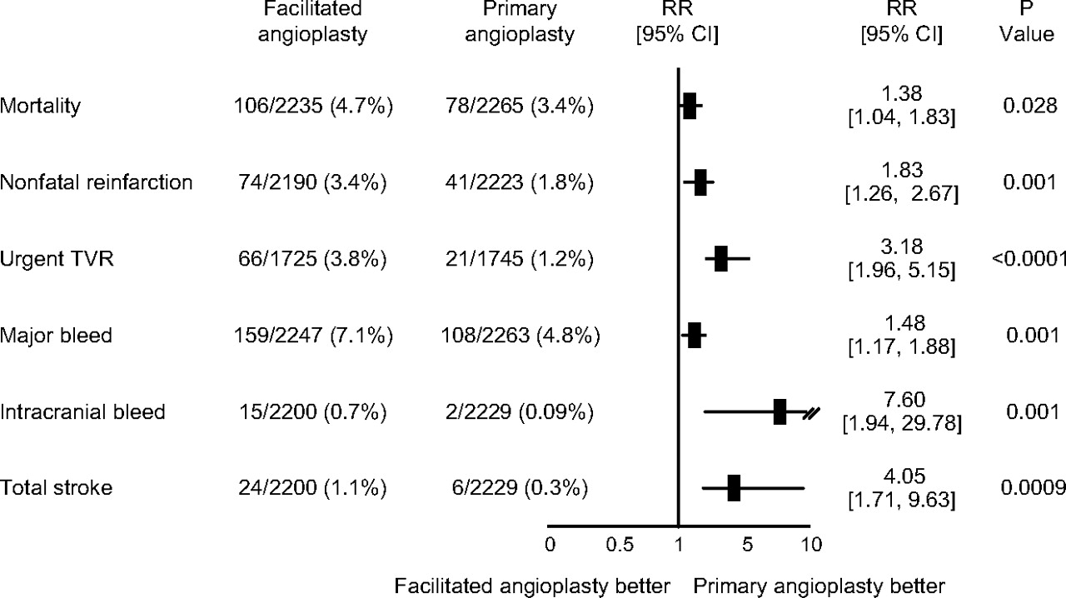
Pooled analysis of the short-term results from 17 RCTs
Facilitated PCI after Lysis vs Primary PCI - 4504 pts.
Stone G W Circulation. 2008;118:552-566
Copyright © American Heart Association, Inc. All rights reserved.
Notes:
Figure 3. Pooled analysis of the short-term results from 17 randomized trials comparing facilitated PCI after fibrinolytic therapy and primary PCI without antecedent pharmacological therapy in 4504 patients. Data from Reference 31. Note that the data vary slightly from Reference 31 because of presentation of relative risks (RRs) rather than ORs.

Slide 11
PCI in Acute MI – The Data
Primary PCI better than Lysis - (23 RCTs - 7739 patients)
TIMI 3 Flow is a must for the benefits of PCI
Primary PCI better than Pre-hospital Lysis even with TNK tPA
If Lysis fails – Rescue Angioplasty better than Conservative
(5 RCTs – 920 patients)
Routine Early CAG → PCI better than delayed / Ischemia Guided PCI
(7 RCTs – 1996 patients)
Facilitated PCI is significantly worse than Primary PCI without antecedent Pharmacological therapy (17 RCTs – 4504 pts)

Slide 12
Regional Systems of STEMI Care, Reperfusion Therapy
And Time-to-Treatment Goals
I
IIa
IIb
III
Primary PCI is the recommended method of reperfusion when it can be performed in a timely fashion by experienced operators.
A
I
IIa
IIb
III
EMS transport directly to a PCI-capable hospital for primary PCI is the recommended triage strategy for patients with STEMI with an ideal FMC-to-device time system goal of 90 minutes or less.*
B
Immediate transfer to a PCI-capable hospital for primary PCI is the recommended triage strategy for patients with STEMI who initially arrive at or are transported to a non–PCI-capable hospital, with an FMC-to-device time system goal of 120 minutes or less.*
I
IIa
IIb
III
B

Slide 13
PCI in Acute MI
Challenging – to Say the Least
Dealing with the Sickest of patients and Borderline Hemodynamics
Co-morbidities, Vascular Access
Technically Difficult Subsets – Ostial Lesions, LMCA, Bifurcation, Calcification all may be encountered while doing the case.
The Single most Important Problem : THROMBUS
The Most Devastating of All complications post PCI – Stent Thrombosis is much more common here.

Slide 14
Stent Thrombosis
Associated with MI & Death
Most Dreaded complication following PCI
Incidence is 1-3% ; Mortality → 10 – 40%
Risk Factors for Stent Thrombosis
Stent Length ACS
Mal apposition / Under-expansion Heart Failure
Dissection Bifurcation
Geographical Miss Diabetes Mellitus
All are more Common in Primary PCI

Slide 15
Primary PCI - Summary
Huge data Backing Primary PCI
Mortality Benefits – incontrovertible
Most rewarding of Medical Interventions.
Interventional Cardiologists are High on Aggression.
- Emergency, Adrenaline Rush, Crashes etc are a Norm us.
So …………. Why Back Out ???
- To do it well and Not Cause Any Harm to Our patients -

Slide 16
Post Dilatation in Primary PCI ?
Doing for the last 6 years with Good Result.
Almost all Cases – except those with extensive thrombus.
Non Compliant Balloon - Same size / 0.5mm more than the size of the Stent to high pressures (16 – 20 atm).
No cases of No re - flow following post dilatation !
Do we have Any Data ?
Tasul et al : Is post dilatation with a Non Compliant Balloon Necessary after Coronary Stent Deployment during Primary Angioplasty ? J Interv Cardiol 2013; 26;325-331
No Association between Post Dilatation & Mortality
Significant ↓ MACE : TLR & Stent Thrombosis

Slide 17
Which are the Cases You would Back Out ?
Co-Morbidities : Chronic Kidney Disease
Stroke in the Recent Past
Vascular Access Issues
Diffuse Disease
Large Thrombus Burden
Ectatic Vessels with Extensive Thrombus
Mechanical Complications – Acute MR / VSR
Complex PCI – Shock, LMCA, Ostial, Bifurcation, Calcification, etc etc are not
cases where you should back out !!!

Slide 18
Co-Morbidities
Chronic Kidney Disease
eGFR more important
Diabetes with CKD more sinister than CKD due to other etiology
Limit Contrast and Hydrate well before and after
Explain Risk of Contrast Nephropathy.
Stroke
Stroke in the Recent Past / On Table : Avoid

Slide 19
Co-Morbidities - Stroke
76 year Old, long standing Diabetic, admitted a week ago with CVA in the Neurology side
Presented with restlessness for 24 hours to the Neurology OPD
ECG – Acute IWMI with 10 mm ST elevation in inferior leads.
Explained about high risk for Lysis and PCI
- Relatives Keen on Revascularization.
- Taken for PCI (Against Instinct)

Slide 20
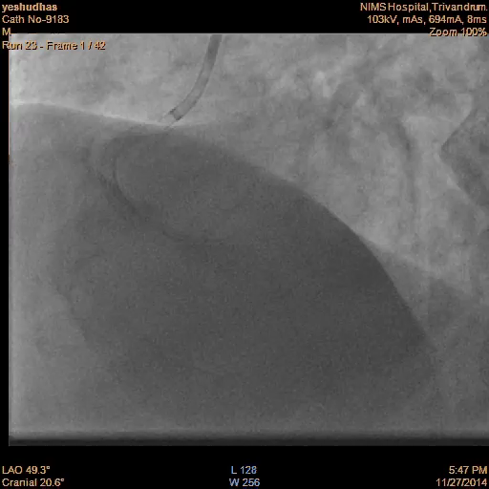
Post Stenting
Distal embolization of Thrombus
Unresponsive Patient
Hypotension not improving despite Maximal Inotropes
Patient Expired after 3 hours
? Related to CVA
?? Thrombus Embolization

Slide 21
Which are the Cases You would Back Out ?
Co-Morbidities : Chronic Kidney Disease
Stroke in the Recent Past
Vascular Access Issues
Diffuse Disease
Large Thrombus Burden
Ectatic Vessels with Extensive Thrombus
Mechanical Complications – Acute MR / VSR
Complex PCI – Shock, LMCA, Ostial, Bifurcation, Calcification, etc etc are not
cases where you should back out !!!

Slide 22
Which are the Cases You would Back Out ?
Co-Morbidities : Chronic Kidney Disease
Stroke in the Recent Past
Vascular Access Issues
Diffuse Disease
Large Thrombus Burden
Ectatic Vessels with Extensive Thrombus
Mechanical Complications – Acute MR / VSR
Complex PCI – Shock, LMCA, Ostial, Bifurcation, Calcification, etc etc are not
cases where you should back out !!!

Slide 23
What do you Do ???
Had come at 5 AM
Pain with Shortness of Breath since 1 AM
Denied any previous h/o ACS or treatment for CAD
Taken for Primary PCI – ECG QS in V1-4; ST ↑ V4-6, Pulm Edema
CAG : Diffuse 3 Vessel Disease ; Culprit probably D1 (thrombus)
Plan : Medical Management with IV Tirofiban
Echo : Dilated LA /LV with thinned AW & Inferior wall.
s/o Old AWMI / IWMI. LVEF ~ 30%

Slide 24
Which are the Cases You would Back Out ?
Co-Morbidities : Chronic Kidney Disease
Stroke in the Recent Past
Vascular Access Issues
Diffuse Disease
Large Thrombus Burden
Ectatic Vessels with Extensive Thrombus
Mechanical Complications – Acute MR / VSR
Complex PCI – Shock, LMCA, Ostial, Bifurcation, Calcification, etc etc are not
cases where you should back out !!!

Slide 25
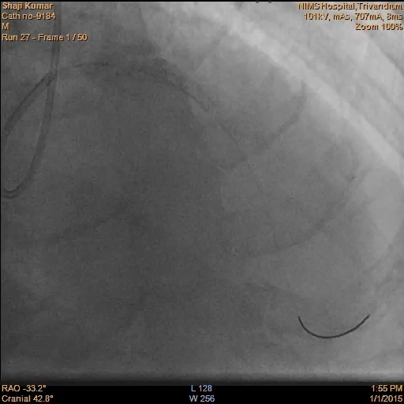
Final Result
Large Thrombus is a Challenge
Thrombus Aspiration / Intra-coronary IIb / IIIa etc may not always work
Regular DES / M Guard
Higher Restenosis with M Guard is a concern

Slide 26
Which are the Cases You would Back Out ?
Co-Morbidities : Chronic Kidney Disease
Stroke in the Recent Past
Vascular Access Issues
Diffuse Disease
Large Thrombus Burden
Ectatic Vessels with Extensive Thrombus
Mechanical Complications – Acute MR / VSR
Complex PCI – Shock, LMCA, Ostial, Bifurcation, Calcification, etc etc are not
cases where you should back out !!!

Slide 27
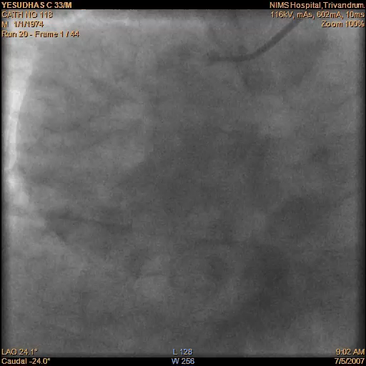
Post Thrombus Aspiration & POBA of Occlusion
Extensive Thrombus in Ectatic Vessel
Intra-coronary Tirofiban for 12 hours followed by LMWH for 5 days
Discharged on DAPT after 5 days

Slide 28
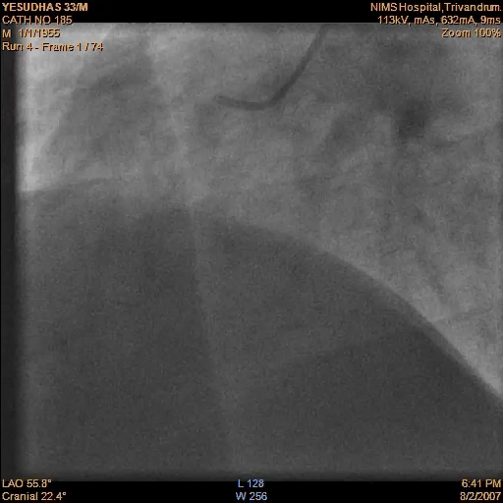
Re-Angio after 4 weeks
Patient well
Echo – No RWMA, Good LV Function
TMT : Negative at 8 METS after 1 year
But, still 110 Kg !!! ( after 7 years!)

Slide 29
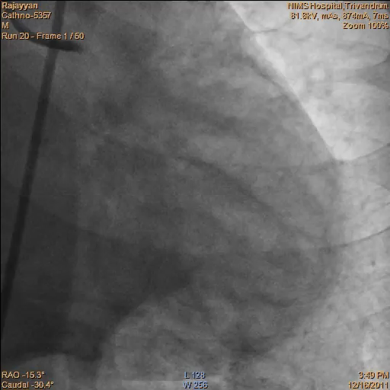
Final Result
Extensive Thrombus in Ectatic
Not stented due to Size mismatch & length with risk of Stent Thrombosis
Tirofiban Infusion & LMWH
Moderate – Severe LV Dysfunction
NYHA Class II.

Slide 30
Ectatic Coronaries & Extensive Thrombus
What do you do ?
Intra-coronary thrombolysis – is an option
5mg tNK repeated every 5 minutes to a max of 25 mg
TIMI 2/3 flow in - 97% of patients
Safety of Adjunctive Intra-coronary Thrombolytic Therapy
CCI Vol 66, 327-332, Nov 2005.
tPA Registry : Bleeding – 9.2% 31 ± 15mg of tPA
MI – 17.6%
CABG – 4.2%
Death – 7%

Slide 31
Which are the Cases You would Back Out ?
Co-Morbidities : Chronic Kidney Disease
Stroke in the Recent Past
Vascular Access Issues
Diffuse Disease
Large Thrombus Burden
Ectatic Vessels with Extensive Thrombus
Mechanical Complications – Acute MR / VSR
Complex PCI – Shock, LMCA, Ostial, Bifurcation, Calcification, etc etc are not
cases where you should back out !!!

Slide 32
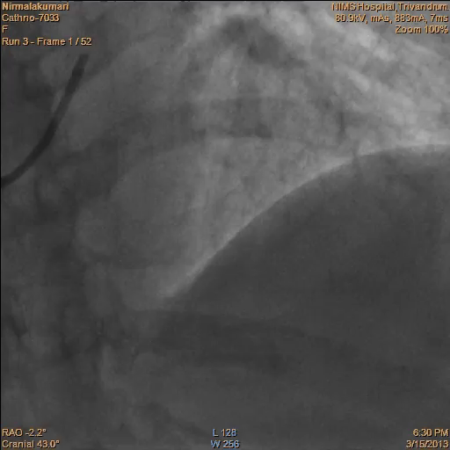
70 Yr Old Lady – AWMI – Pain 6 hrs

Slide 33
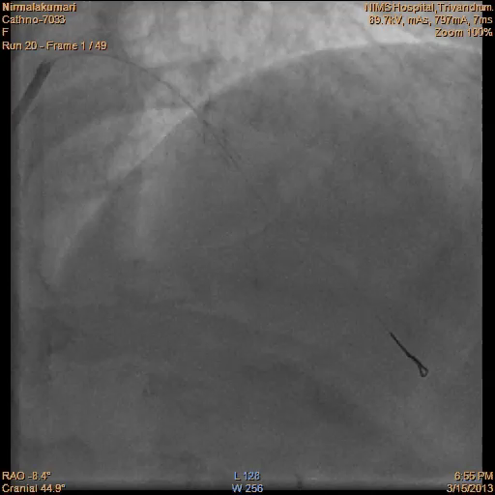
Post PCI with a DES
Patient still restless post PCI
BP & SpO2 Low
Asked JR to Auscultate for Pulmonary Edema
- New Murmur found !

Slide 34
Which are the Cases You would Back Out ?
Co-Morbidities : Chronic Kidney Disease
Stroke in the Recent Past
Vascular Access Issues
Diffuse Disease
Large Thrombus Burden
Ectatic Vessels with Extensive Thrombus
Mechanical Complications – Acute MR / VSR
Complex PCI – Shock, LMCA, Ostial, Bifurcation, Calcification, etc etc are not
cases where you should back out !!!

Slide 35
Summary
Primary PCI is Life saving and a Mountain of Data Backing it
Must ensure TIMI 3 Flow and avoid causes of Stent Thrombosis – Technically Good result imperative before leaving the Cath Lab.
Stroke in the Recent Past and CKD are things one should Look For – Procedure went off well, but Patient is dead !
Diffuse Disease is Challenging – Stent if you can put a stent well in a Non diseased segment with good distal run off, otherwise ……..
Ectatic Vessels with Extensive thrombus – May be, Back out – Intracoronary IIb/ IIIa or Lysis ? & Pray …………..

Slide 36

Thank You

