Slide 1
Vascular Access and
Basic Hardware
Dr. K. SURESH
SK Hospital and KIMS Hospital, Trivandrum

Slide 2
Vascular access
First important step in diagnostic / interventional catheterization
Percutaneous approach has replaced the cutdown approach in the modern era
Transradial has emerged as the frontline vascular option in most centers –both for diagnostic catheterisation and in interventional practice

Slide 3
Vascular access
Arterial | Femoral Radial | Ulnar Brachial Axillary Lumbar
Venous | Femoral Internal jugular | Subclavian Antecubital
Antegrade and Retrograde approach

Slide 4
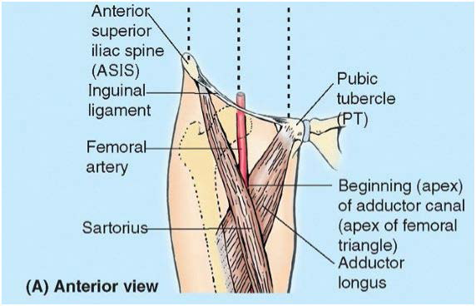
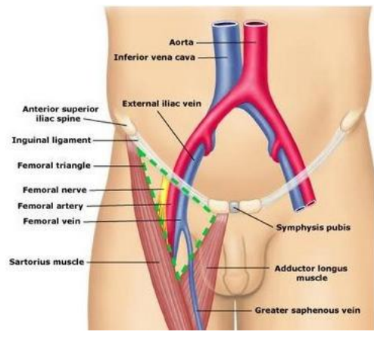
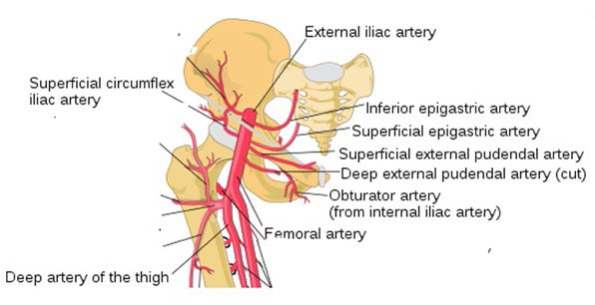
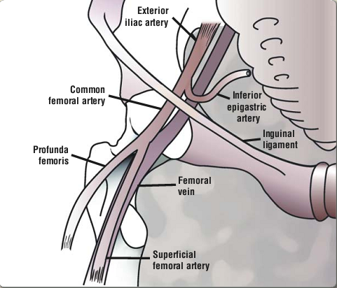
Femoral access - anatomy
CFA- Continuation of External Iliac A below Inguinal ligament to bifurcation into PFA and SFA
or
Angiographically–segment between origin of Inferior epigastric artery and bifurcation into SFA & PFA

Slide 5
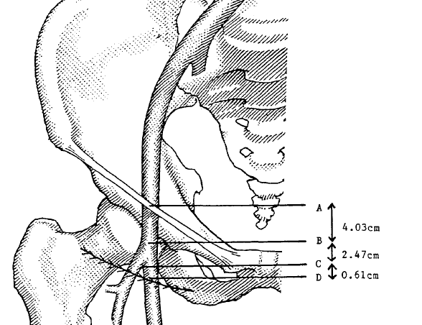
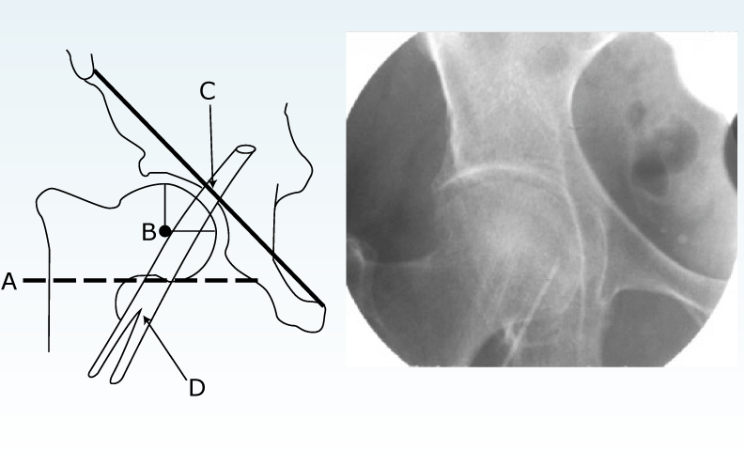
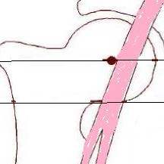
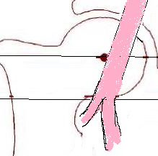
Femoral access
Site of puncture -> CFA : 2cm below inguinal ligament
Landmarks used to guide
Inguinal skin crease | Point of maximal pulsation | Fluoroscopy –femoral head
Misleading – skin crease is distal to bifurcation (CFA bifurcation was approx 6 mm above skin crease) in > 70% of people, especially in obese 50% rely on skin crease and get into low punctures | A-inguinal ligament B-point of maximal impulse C-bifurcation of CFA D-inguinal crease Issues: Maximum impulse maybe over SFA in 5% May not obtain a good impulse in obese –may need to rotate
Localization of the skin nick by fluoroscopy
Nick to overlie the inf: border of femoral head
Puncture at the center of femoral head

Slide 6
Femoral - complications
Bleeding and hematoma (5-10%)
RPH
Local complications of femoral access (2-10%)
  Pseudoaneurysm (1-6%)
  AV fistula (1%)
  Dissection acute closure (<1%)
  Thrombosis distal embolisation (1%)
  Infection
  Nerve damage
Puncture site relation to complications
  Low puncture: Pseudoaneurysm, AV fistula, Nerve damage, Hematoma
  High punctures / posterior punctures: RPH , Hematoma

Slide 7
FEMORAL - WHEN
IABP
Rotablator
Bifurcation strategies
Structural HD interventions
LMCA intervention
Acute MI

Slide 8
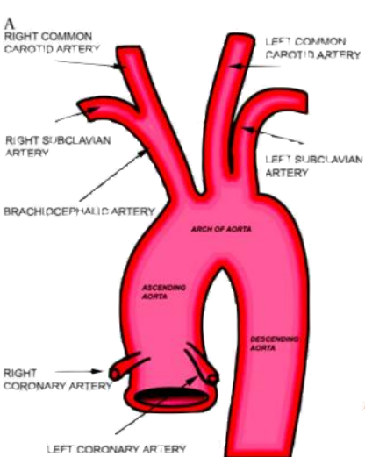
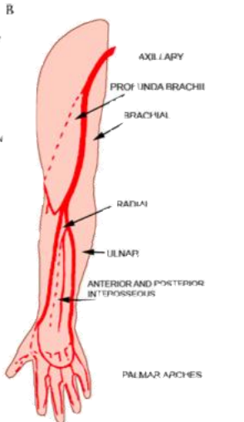
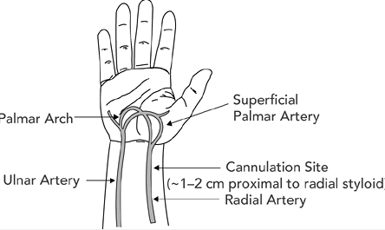
Radial access –Basic anatomy
Puncture site – not over a joint, so no bleeding with motion
Flat bony radium provides ease of compression
Vast collateralisation – prevents hand ischemia
Palmar arch complete in 80%
Dom: supply to hand by ulnar
Allens test:
Once an absolute requisite before doing a radial procedure is no longer considered so

Slide 9
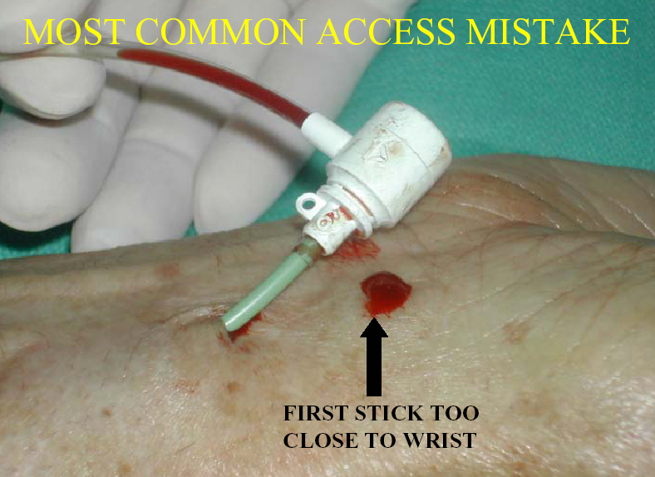
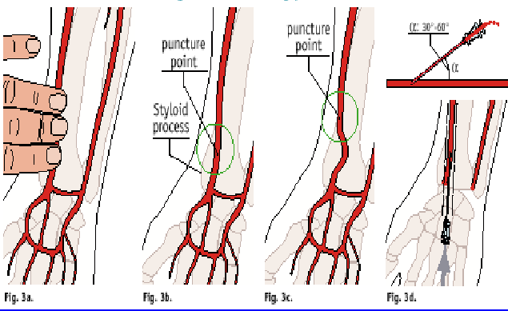
Radial Access:
Proximal to styloid process – Not really the wrist!
Use a 21 G x 2.5 cm thin wall needle
to cannulate the radial artery
Advance a 0.025 inch guidewire
through the needle
Insert the introducer /sheath
Give the “cocktail” of
CCB – Verapamil or Diltiazem 2-5 mg
Nitroglycerine100-200 mcg
Heparin bolus 50 units/kg

Slide 10
Radial access – indications, contraindications
CONDITIONS WHERE RADIAL ACCESS IS PREFERRED
Absent femoral pulses / Femoral bruit
Femoral artery graft surgery
Extensive inguinal scarring from past surgery
Surgery / radiation treatment near inguinal area
Extensively tortuous iliac system / lower abdominal aorta
Abdominal aortic aneurysm or PVD
Obese individuals who are at risk of complications from TF access
Patient request
CONDITIONS WHERE RADIAL ACCESS IS BETTER AVOIDED
Radial artery being considered for CABG / AV fistula
Upper limb atherosclerosis, extreme tortuosity, Raynaud’s or Burger’s disease.
Need for 7F or larger sheath.

Slide 11
Trans-radial - Access Site Complications
Radial artery occlusion (≈5%, higher rates when routine doppler is used, mostly asymptomatic)
Forearm hematoma and/or pain
Radial artery pseudoaneurysm
Radial or brachial artery perforation
Uncontrolled bleeding with resultant compartment syndrome
Pain / severe spasm – precluding advancement / removal of catheters
Need for femoral conversion (5-10%)

Slide 12
Radial access
Advantages | Disadvantages
Decrease the incidence of major vascular complications Decrease the incidence of bleeding complications Appears to decrease MACE in patients with ACS Better control over vascular access and hemostasis for obese and overall patients Decreased time to ambulation Improved patient movement and comfort Allows early discharge policy May decrease cost | Associated with a significant operator learning curve Has limited compatibility with very large equipment Elderly patients may have tortuousity of the radial and subclavian arteries which makes the procedure more challenging May have limited guiding catheter support in most challenging PCI scenarios (heavy calcifications, tortousity, complex bifurcations) Access to LIMA Associated with upper limb arterial complications (rare) Higher radiation exposure to the operator

Slide 13
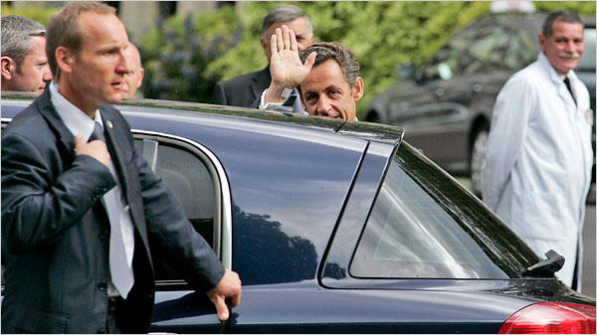
The radial approach is the best choice for your patient, even if this is the president
Sarkozy Given a Clean Bill of Health
The New York Times 07/28/2009

Slide 14
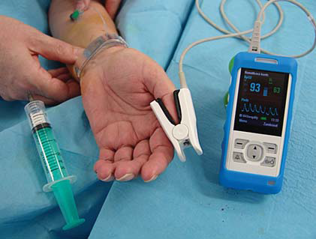
Developments with trans-radial equipment
Dedicated and better TR access tools
  hydrophilic sheaths
  Sheathless guiding catheters – smaller, larger lumen, hydrophilic coating, special braided technology
  BASTI – Balloon assisted sheathless transradial interventions
  Single catheter diagnostics (e.g. Tiger)
5 French compatible PCI equipment
Ability to perform complex interventions
  STEMI, bifurcations, CTO, LM, long lesions etc.
Better Hemostasis

Slide 15
Ulnar access
SITE
  2-3 cm above the crease of wrist
ADVANTAGES
  Preservation of radial artery for CABG
PREREQUISITE
  Reverse Allen’s test
  Not to be used after failed ipsilateral radial attempt
COMPLICATIONS
  Same as with radial artery access; nerve damage more likely
EVIDENCE – PCVI-CUBA trial radial vs ulnar
  Success rate - access 96% vs 93%,
  PCI – 96% vs 95%,
  Complication rate 1% vs 1.2 % .

Slide 16
Brachial access – seldom done
Cutdown / puncture
SITE OF PUNCTURE
Medial aspect of cubital fossa, 2-3 cm above the elbow crease
INDICATIONS
Need for upper limb or venous access, but CI for radial access
Severe PVD / Renal or lower limb artery angioplasty
Selective LIMA access from left arm
COMPLICATIONS
Hand ischemia - Due to thrombosis
Compartment syndrome - Hematoma extends into forearm
Median nerve injury - 0.2 and 1.4%
Orator’s hand posture
ACCESS trial – radial vs brachial access
More complications with brachial approach ( 0.2% vs 2.6% p 0.03 )

Slide 17
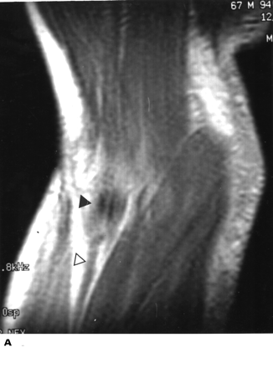
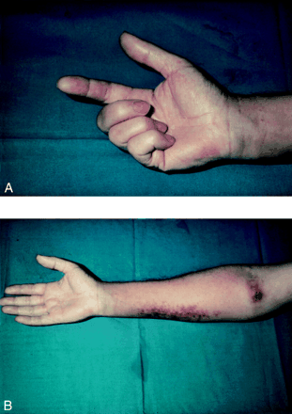
Brachial Access - Complications

Slide 18
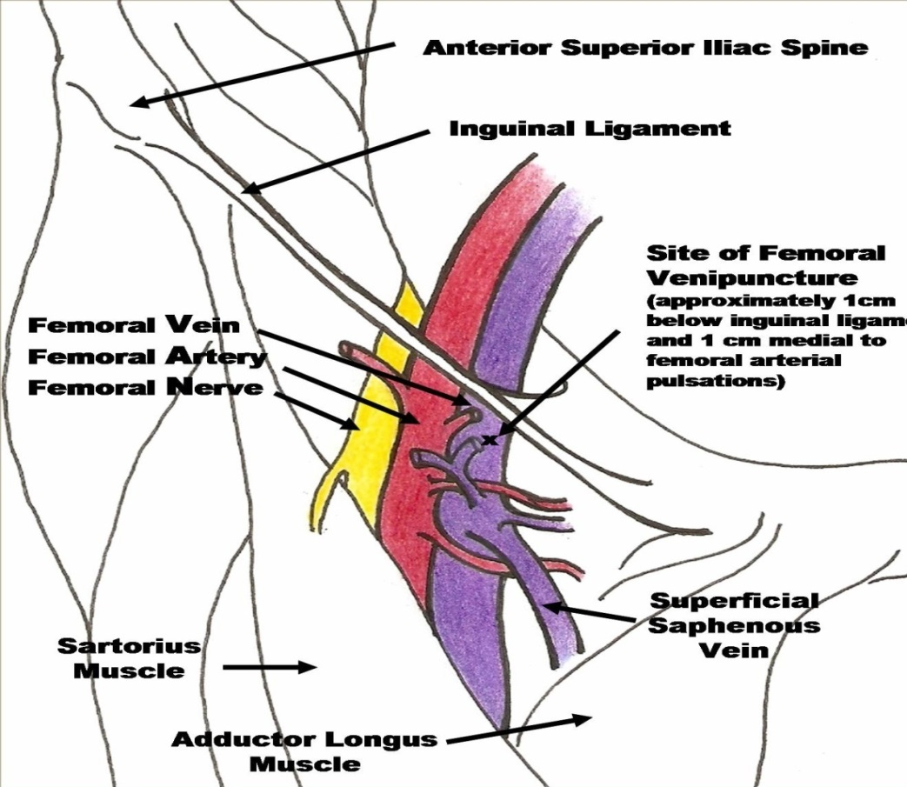
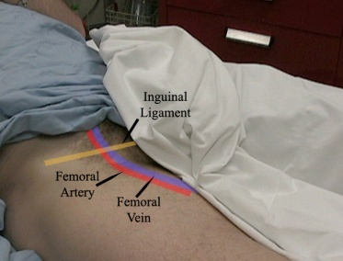
Femoral venous access
Indications:
1. Right heart study 2. TPI 3. IVC filter 4. Venous access
Puncture site
  1cm Medial to femoral artery
  Needle held at 45 degree angle
  Skin insertion 2 cm below inguinal ligament

Slide 19
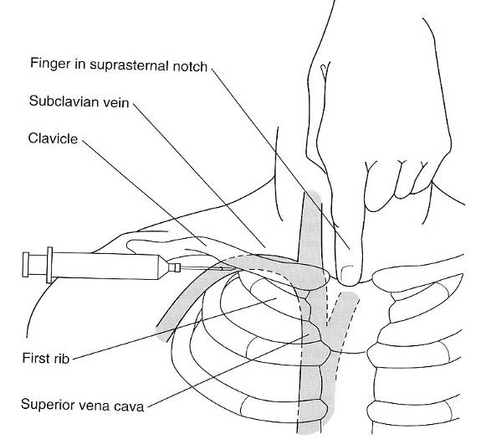
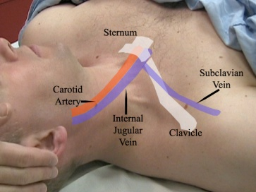
Subclavian venous access
Positioning
  Right side preferred
  Supine position, head neutral
  Arm abducted
  Trendelenburg (10-15 degrees)
  Shoulders neutral with mild retraction
Puncture site
  Junction of middle and medial thirds of clavicle
  At the small tubercle in the medial deltopectoral groove
  Needle should be parallel to skin
  Aim towards the finger in supraclavicular notch
  and just under the clavicle

Slide 20
Subclavian venous access
INDICATIONS
PPI leads // TPI // IVC filter // Central venous access // Chemoport
AVOIDED IN
Coagulopathy Thrombolysis Chest wall deformity
COMPLICATIONS
Infection Bleeding Pneumothorax
Thrombosis Air embolization Brachial plexus injury

Slide 21
IJV access
Indications
TPI
Central venous line
Avoided in
Trendelenburg tilt is not possible – pulmonary edema
Child < 1 yr who cannot be sedated / paralysed
Positioning
  Right side preferred – (LIJV circuitous, thoracic duct on left)
  Trendelenburg position – IJV distends
  Head turned slightly away from side of venipuncture
Central approach (Most preferred )
Locate the triangle formed by the clavicle and sternal / clavicular heads of the SCM muscle
Place 3 fingers of left hand on carotid artery
Place needle at 30 to 40 degrees to the skin, lateral to the carotid artery
Aim to the ipsilateral nipple under the medial border of lateral head of SCM muscle
Vein is 1-1.5 cm deep, avoid deep probing in the neck

Slide 22
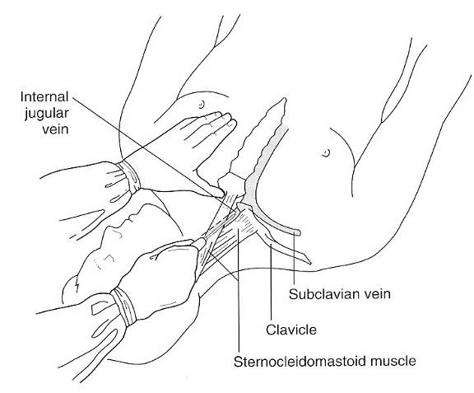
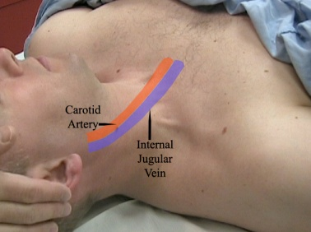
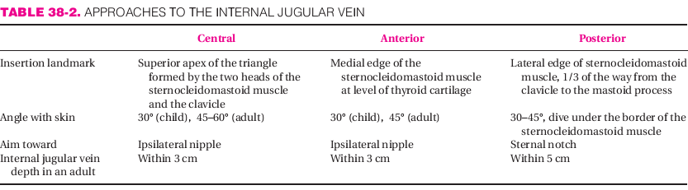
Internal jugular vein access
Risk of injury to carotid

Slide 23
Venous access
Location | Advantage | Disadvantage
Internal Jugular | Bleeding can be recognized and controlled Malposition is rare Less risk of pneumothorax | Risk of carotid artery puncture Pneumothorax possible
Femoral | Easy to find vein No risk of pneumothorax Preferred site for emergencies and CPR Fewer bad complications | Highest risk of infection Risk of DVT Not good for ambulatory patients
Subclavian | Most comfortable for conscious patients | Highest risk of pneumothrax, Vein is non-compressible

Slide 24
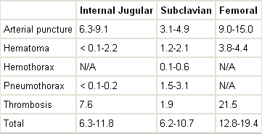
Venous access - complications

Slide 25
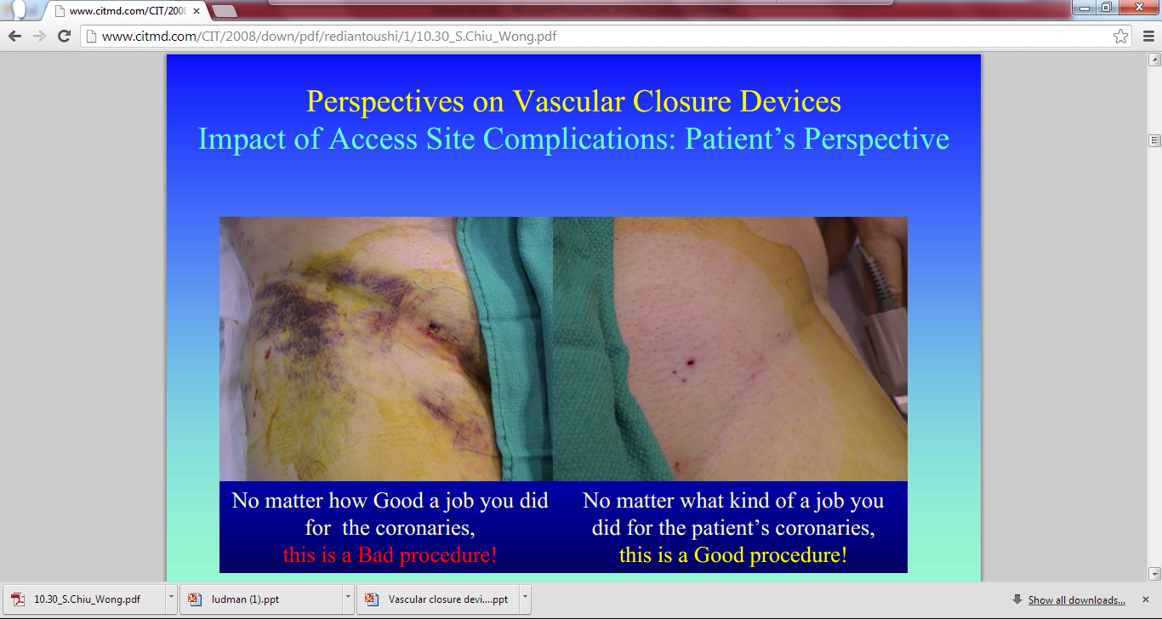

Slide 26
Hemostasis
MANUAL COMPRESSION
MECHANICAL COMPRESSION
TOPICAL HEMOSTATIC AIDS
VASCULAR CLOSURE DEVICES
      Active
      Passive

Slide 27
MANUAL COMPRESSION
Remains the “gold standard”
Timing of sheath removal
Diagnostic procedure - Immediately
Interventions - 4-6 hrs, ACT < 170 sec
Site
2 cm proximal to skin puncture site
Duration
3-4 min compression / french size, 15 – 30 min avg
longer time -> larger sheath, anticoagulants
Disadvantage
Patient discomfort; Bedrest for 6-8 hours
Ineffective compression due to fatigue /impatience

Slide 28
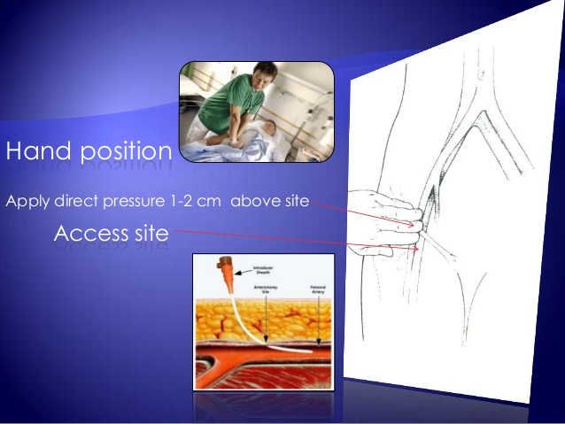
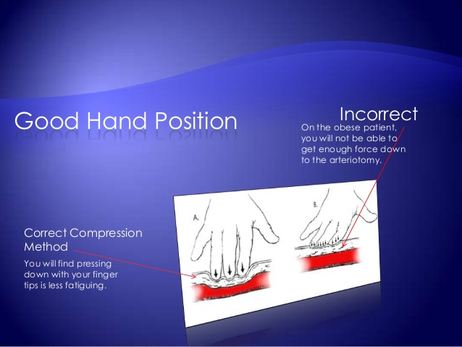
Manual compression

Slide 29
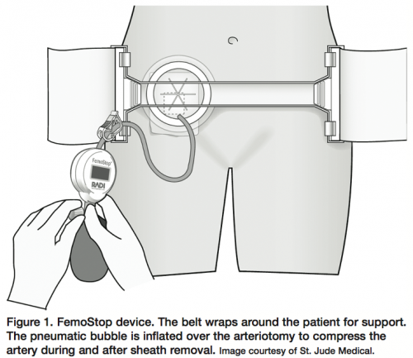
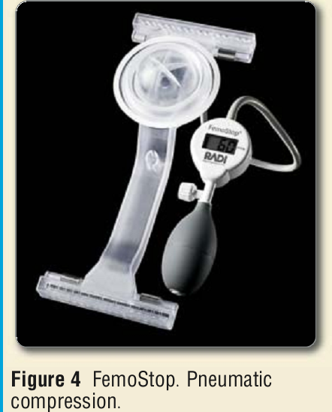
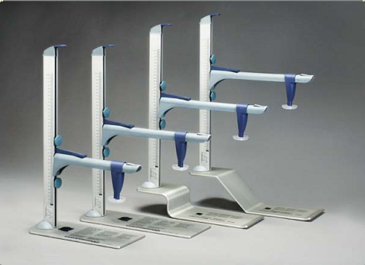
Mechanical compression
CLAMP EASE
PRESSURE PAD
Advantages
More effective compression
Dis-advantages
Doesn’t decrease
Time to hemostasis / ambulation.
Patient discomfort
C-ARM
METAL PAD

Slide 30
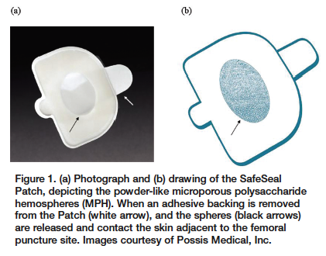
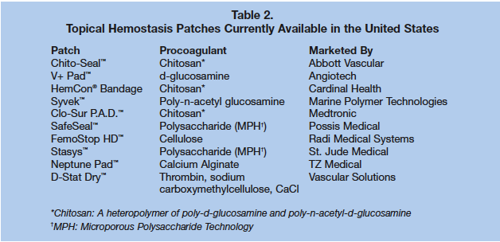
TOPICAL HEMOSTATIC AIDS
A variety of topical patches, pads, bandages, and powders are available
Assist with hemostasis with manual / mechanical compression.
Accelerate the naturalclotting process , thus facilitating hemostasis
Topical agents leave no foreign body behind
Topical agents still require compression

Slide 31
VASCULAR CLOSURE DEVICES
Introduced in 1995
To decrease vascular complications and
To reduce the time to hemostasis and ambulation
CLASSIFICATION
PASSIVE
Enhance hemostasis with prothrombotic material or mechanical compression,
But do not achieve prompt hemostasis or shorten the time to ambulation
ACTIVE
Suture (Perclose), Collagen Plugs (Angioseal), Clips (Starclose)
Achieve prompt hemostasis or shorten the time to ambulation

Slide 32
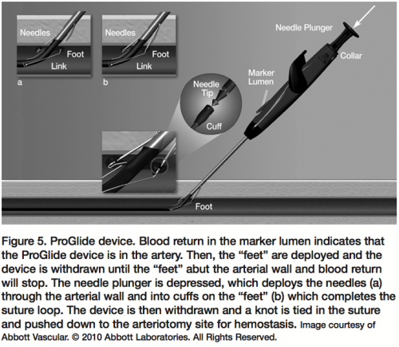
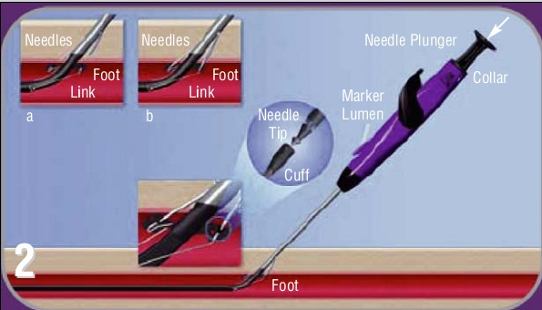
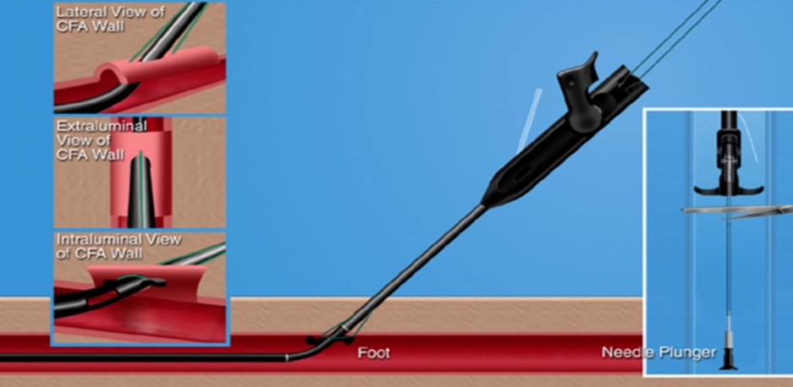
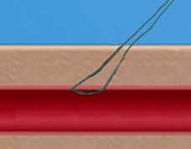
Suture (Perclose)
Success rate : 91–94%
Advantages :
Closure with only suture in the wall of the vessel
No thrombogenic material in the lumen.
Re-access of the vessel has no restrictions
Disadvantages :
Difficult to learn than some of the other devices.
Difficult to use in calcified vessels

Slide 33
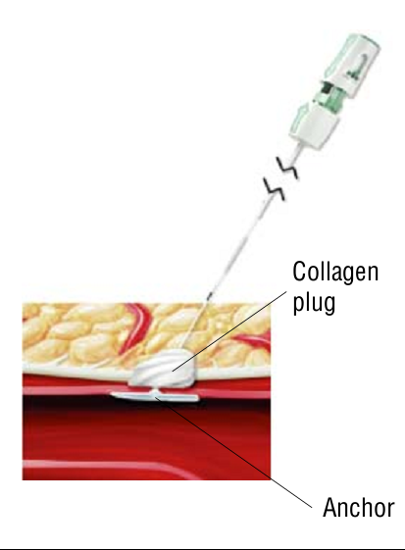
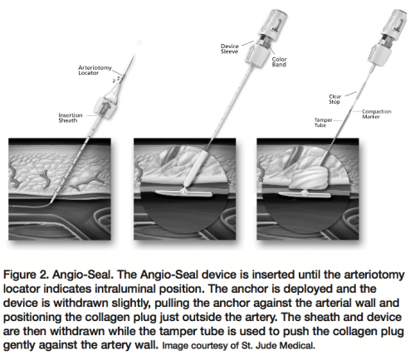
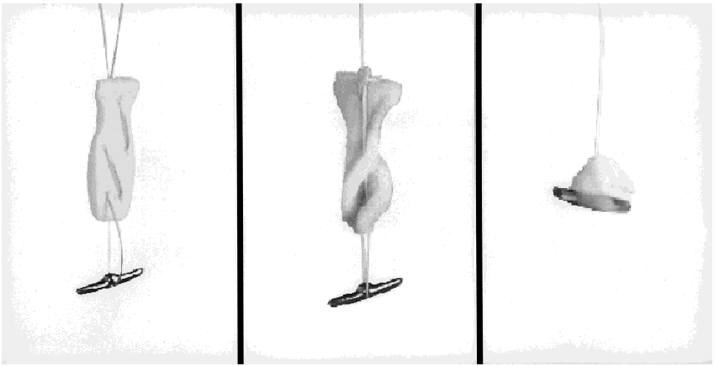
Angioseal (Collagen plug)
Components: 1.Biodegradable anchor (intra-arterial), 2. Collagen plug (extra-arterial), 3. 3-0 Vycril suture (with clinch knot)
Success rate : 90 - 97%*
Advantages : 1. One of the easiest devices to learn and use. 2. Has a very high initial success rate. 3. The collagen plug in the tract also acts to reduce oozing from the site.
4. The retained components of the device are completely resorbed
Disadvantages : 1. The intravascular anchor has the potential to further obstruct a heavily diseased vessel. 2. Embolization of the intravascular anchor. 3. Repeat access of the same vessel within 90 days of device deployment should be avoided using the same puncture site. 4. Infection

Slide 34
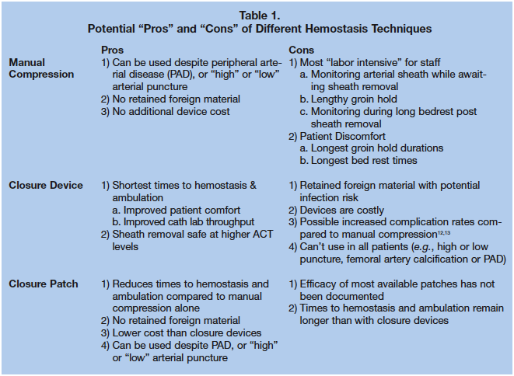

Slide 35
Vascular closure Devices: Recommendations
ACCF/AHA/SCAI Guidelines for PCI
Class I
1. Patients considered for vascular closure devices should undergo a femoral angiogram to ensure their anatomic suitability for deployment.
Class IIa
1. The use of vascular closure devices is reasonable for the purposes of achieving faster hemostasis and earlier ambulation
Class III: NO BENEFIT
1. The routine use of vascular closure devices is not recommended for the purpose of decreasing vascular complications

Slide 36
Thank You

