Slide 1
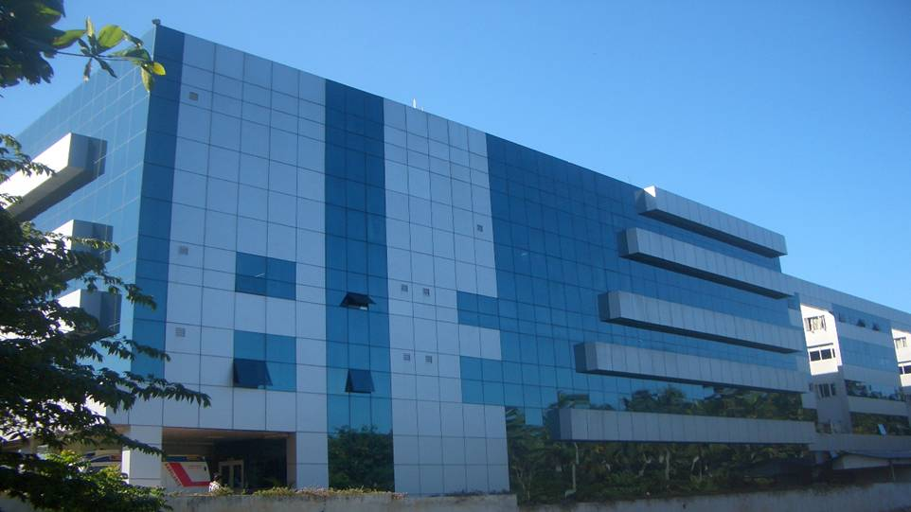
Guide wires in CTO PCI
Dr.C.G.Bahuleyan, MD,DM, FRCP(UK), FSCAI
(Former Professor & Head, Department of Cardiology,
Medical College and Hospital, Trivandrum)
Chairman –Cardiovascular Centre,
Ananthapuri Hospitals and Research Institute, Trivandrum

Slide 2
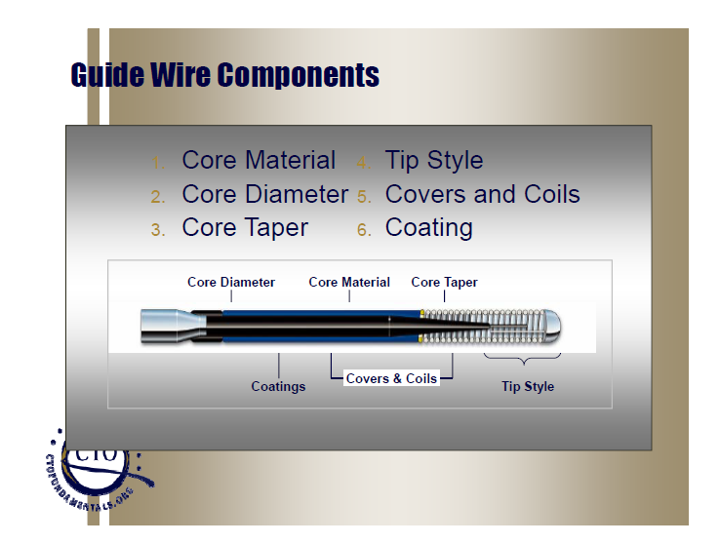
Guide Wire Components
1. Core Material 4. Tip Style
2. Core Diameter 5. Covers and Coils
3. Core Taper 6. Coating

Slide 3
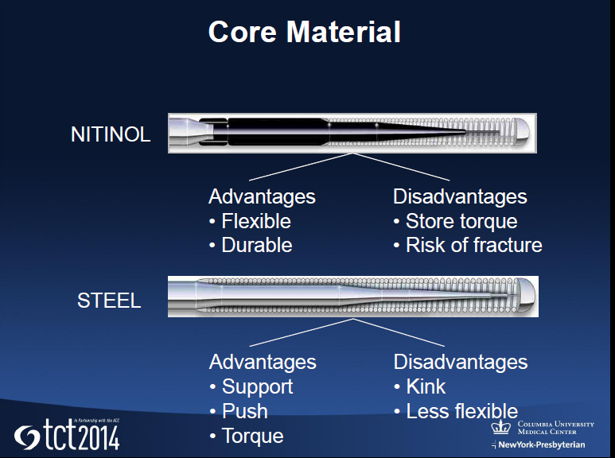
Core Material

Slide 4
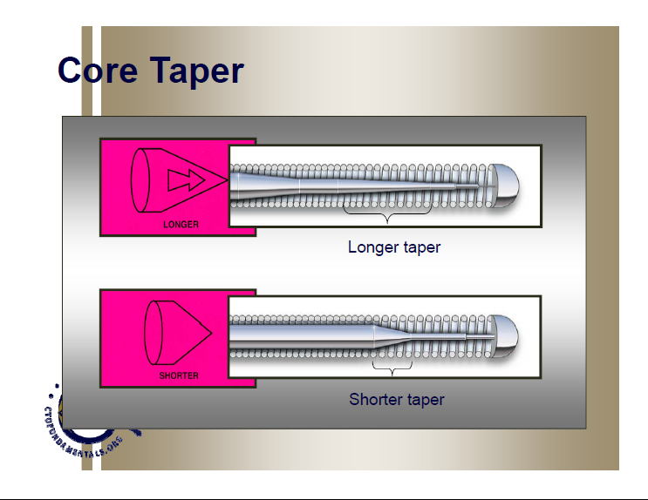
Core Taper

Slide 5
Impact of Core Tapering
Longer Taper
More Trackable Less Prolapse Tendency Less Rail suppor
Short Taper Less Trakable More Support More Prolapse Tendency

Slide 6
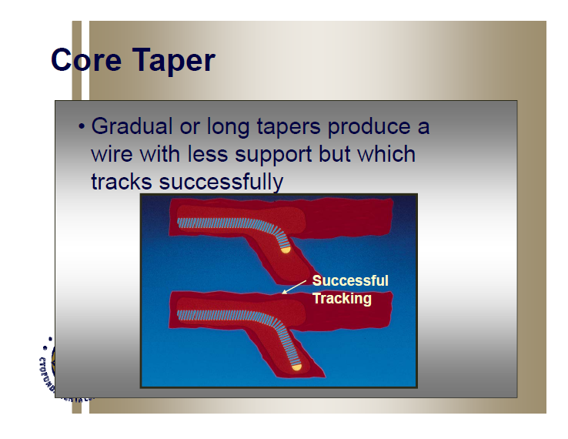
Core Taper
Gradual or long tapers produce a wire with less
support but which tracks successfully

Slide 7
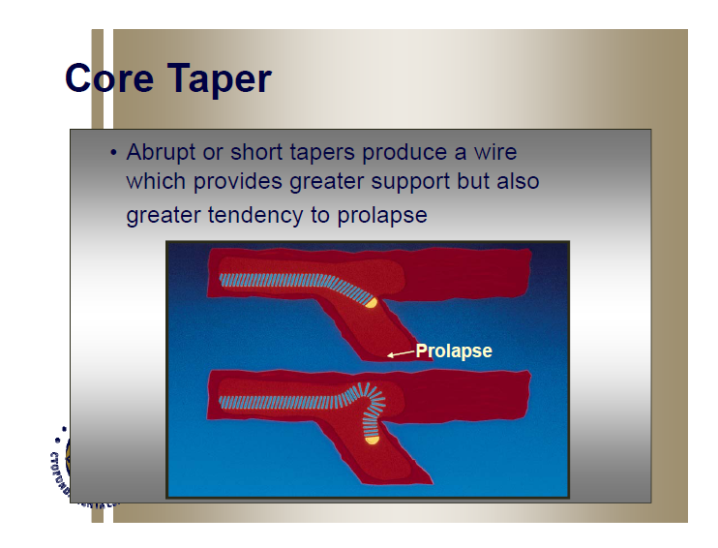
Core Taper
Abrupt or short tapers produce a wire
Which provides greater support but also greater
tendency to prolapse

Slide 8
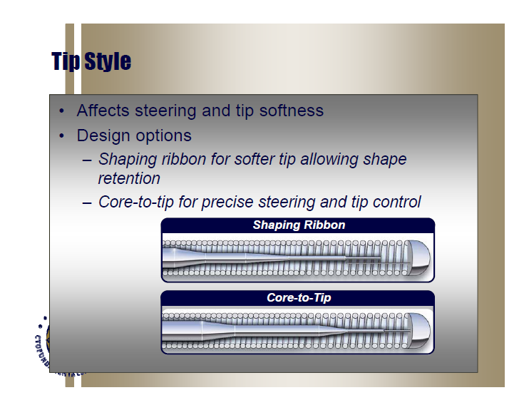
Tip Style
Affects steering and tip softness
Design options
Shaping ribbon for softer tip allowing shape retention
Core-to-tip for precise steering and tip control

Slide 9
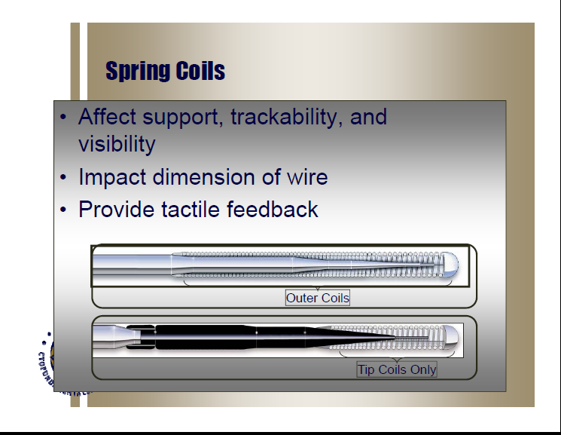
Spring Coils
Affect support, trackability, and visibility
Impact dimension of wire
Provide tactile feedback

Slide 10
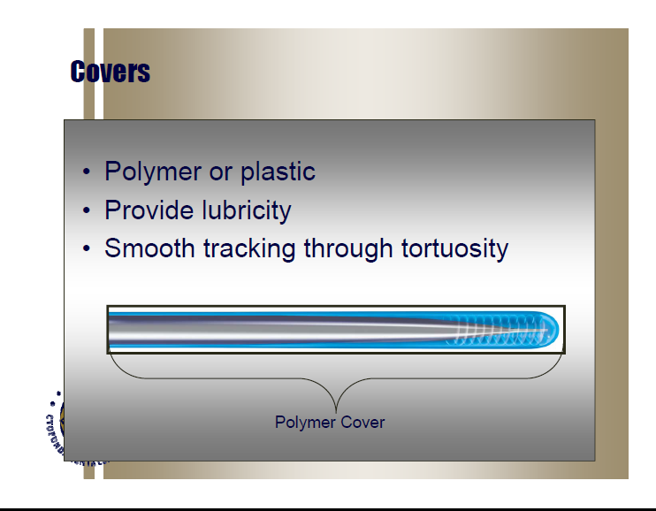
Covers
Polymer or plastic
Provide lubricity
Smooth tracking through tortuosity

Slide 11
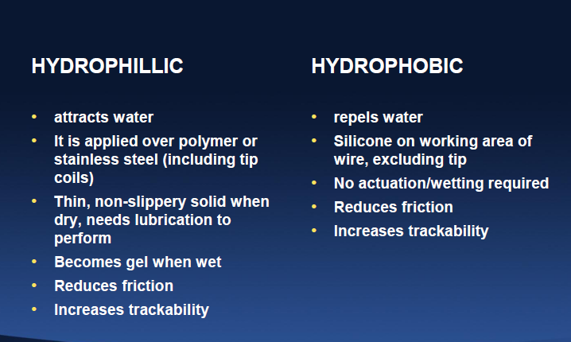
Guide Wire Coating

Slide 12
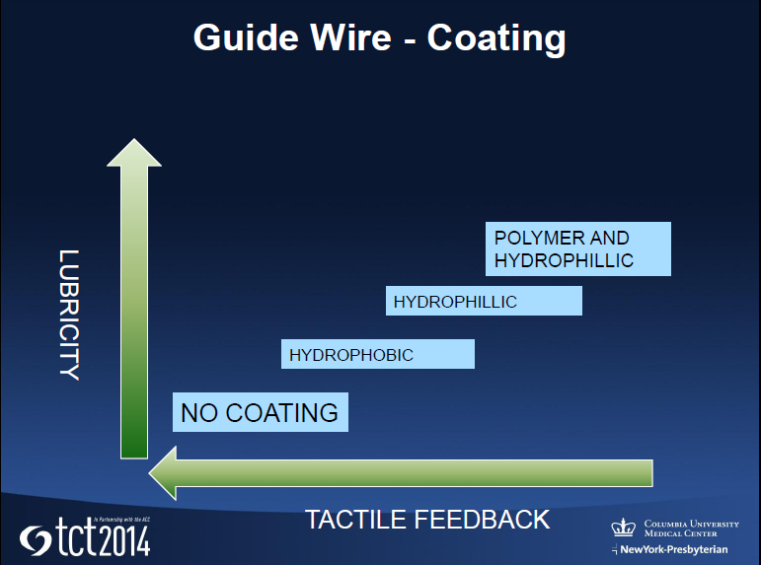
Guide Wire-Coating

Slide 13
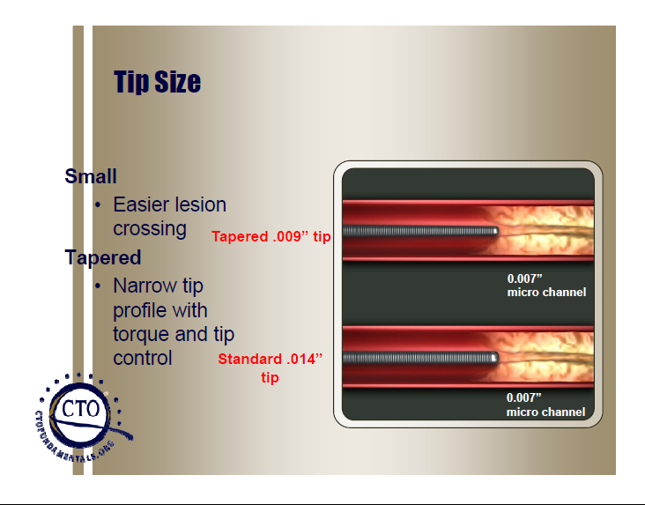
Tip Size
Small
Easier Lesion crossing
Tapered .009”tip
Tapered
Narrow tip profile with torque
and tip control Standard .014” tip

Slide 14
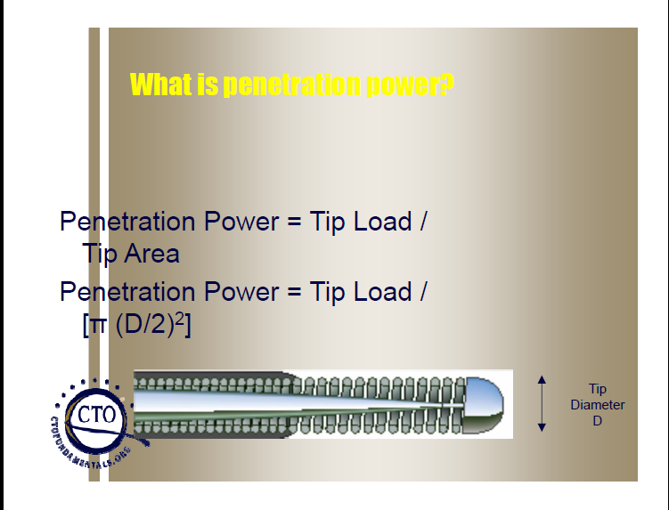
What is penetration power
Penetration Power = Tip Load/Tip Area
Penetration Power = Tip Load/ (∏ (D/2)²)

Slide 15
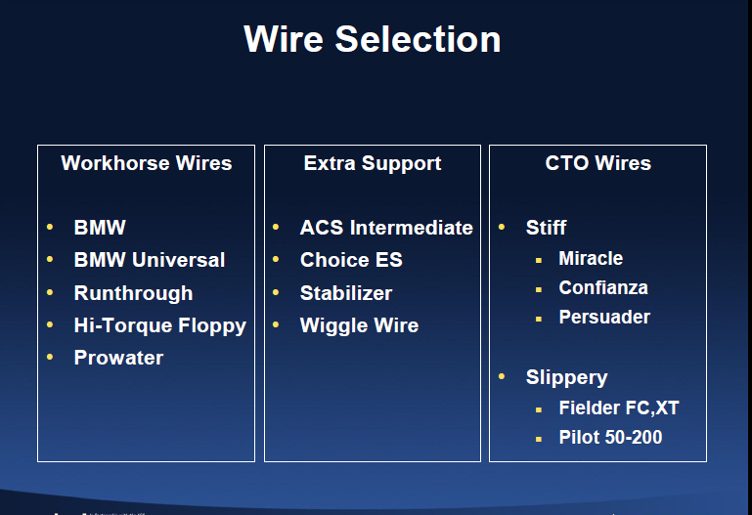
Wire selection

Slide 16
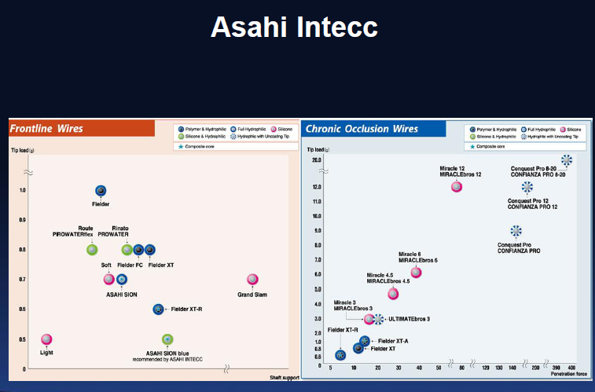
Guide wires

Slide 17
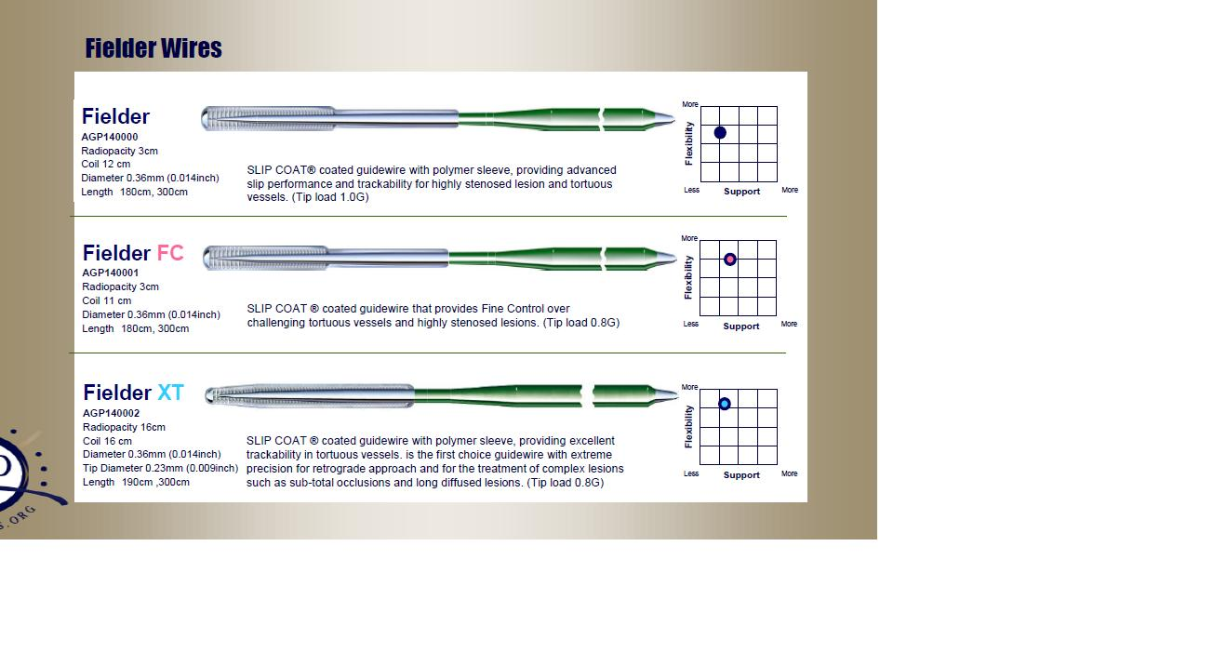
Fielder wires

Slide 18
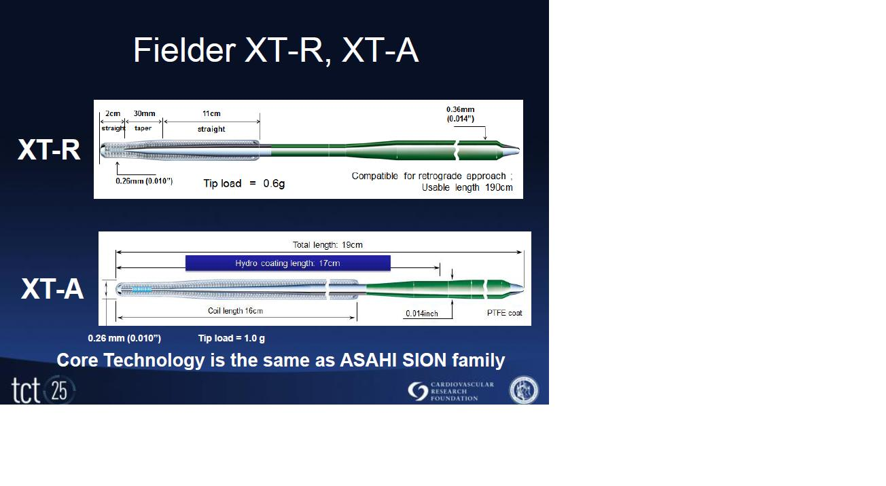

Slide 19
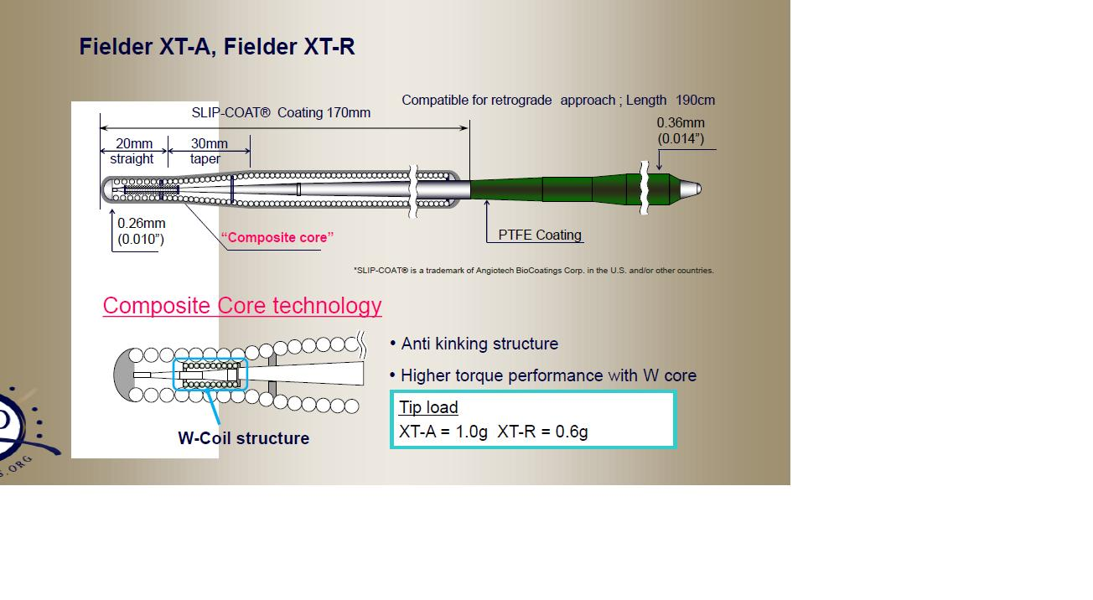
Fielder XT-R

Slide 20
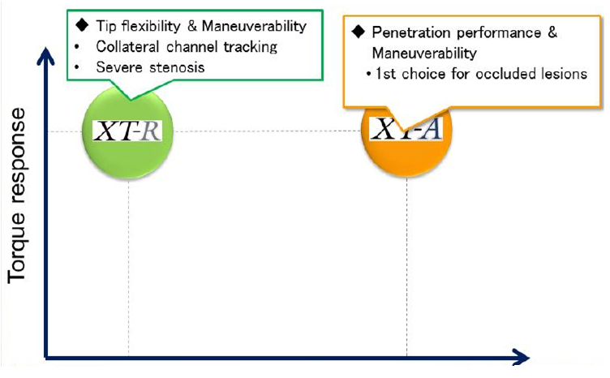
Fielder XT-R, XT-A
Penetration

Slide 21
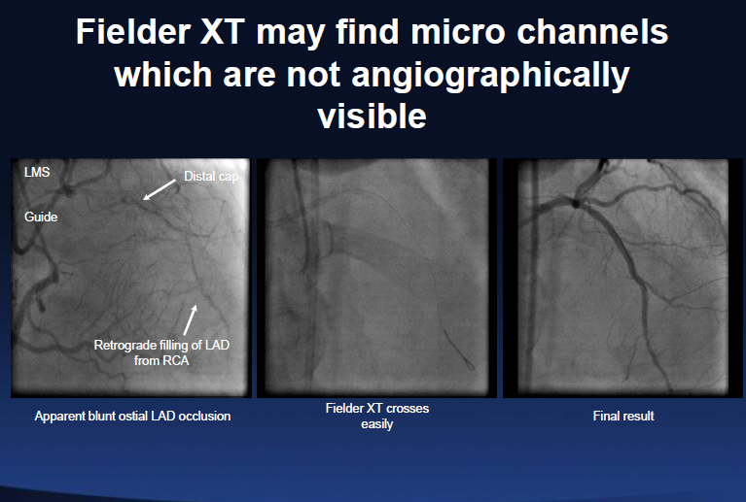
Fielder XT may find micro channels which are not angiographically visible

Slide 22
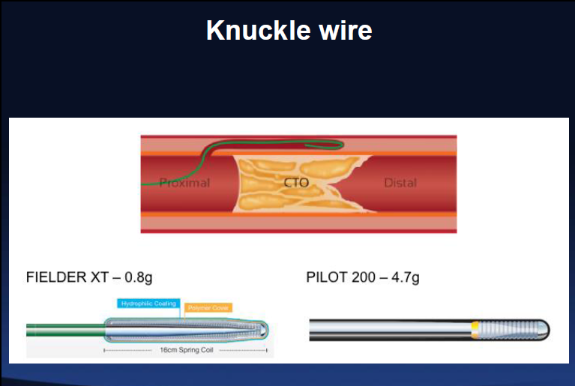
Knuckle wire

Slide 23
ASAHI Gaia
Total Length 1900mm
SLIP-COAT® Coating Length 400mm
Coil Length 150mm
0.36mm (0.014inch)
PTFE coat
Various models for different situations and/or lesions
ASAHI Gaia First
Diameter ：0.26mm (0.010”) - 0.36mm (0.014”)
Tip load ：1.7g
ASAHI Gaia Second
Diameter ：0.28mm (0.011”) - 0.36mm (0.014”)
Tip load ：3.5g
ASAHI Gaia Third
Diameter ：0.30mm (0.012”) - 0.36mm (0.014”)
Tip load ：4.5g
Coated with hydrophilic coating which enhances smooth controllability inside the micro catheter

Slide 24
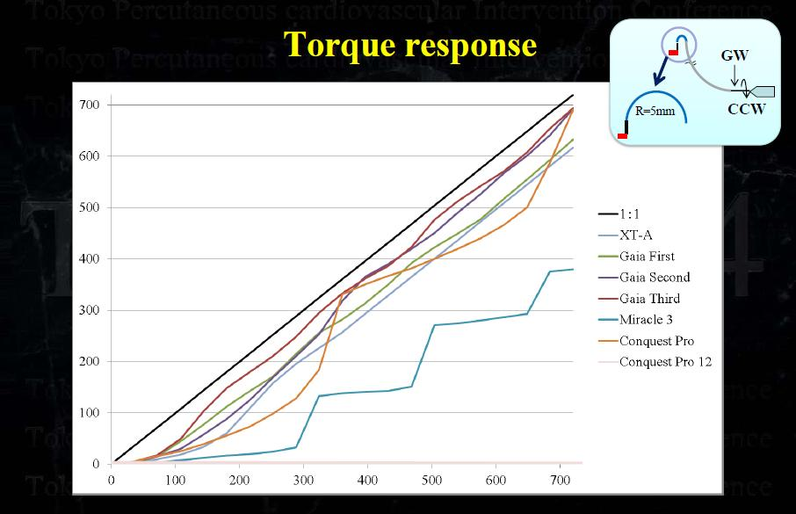

Slide 25
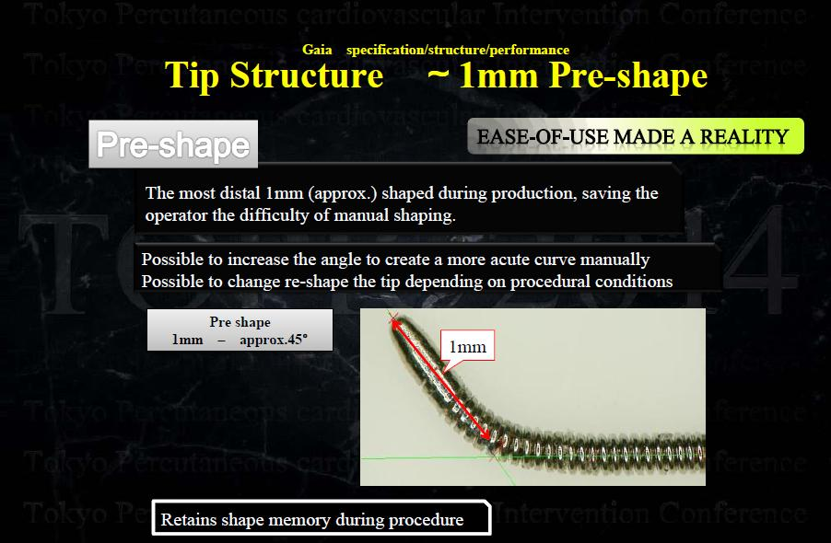
Gaia specification/structure/performance

Slide 26
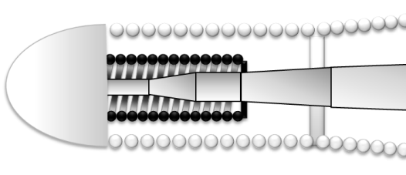
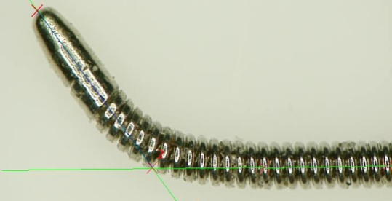
ASAHI Gaia concept for Chronic Occlusion
26
Gaia micro-cone tip
Smooth entry into the occluded lesion
Composite core
Easy control within the lesion
1mm Mini-pre shape
Maintains shaping memory within the
lesion

Slide 27
Tip structure - ASAHI Gaia micro cone-tip
ASAHI Gaia micro-cone tip
The ball tip was made smaller to increase its penetration efficacy while maintaining tip flexibility.
ASAHI Gaia micro-cone tip
Conventional wire tip

Slide 28
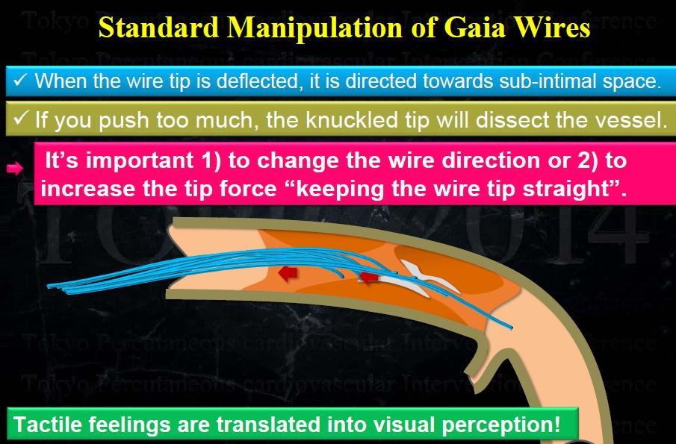
Standard Manipulation of Gaia Wires

Slide 29
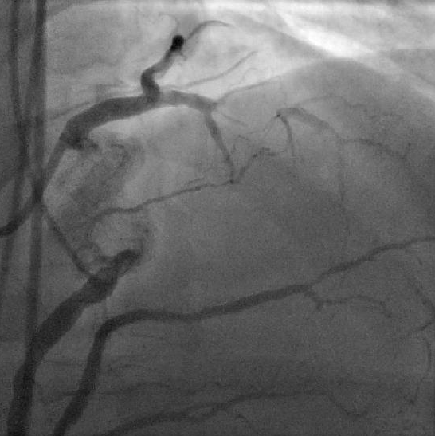
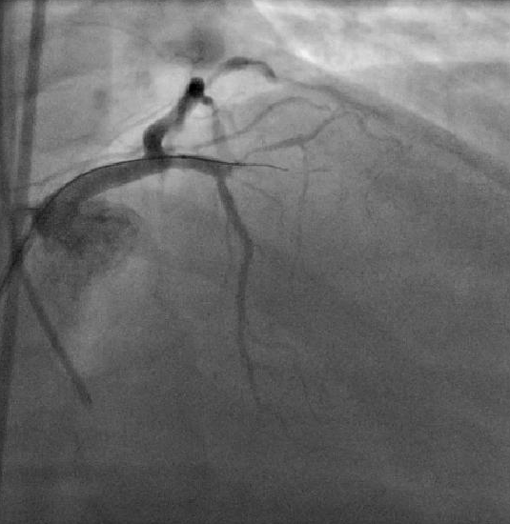
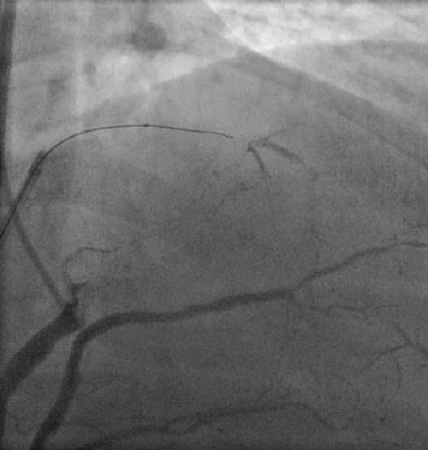
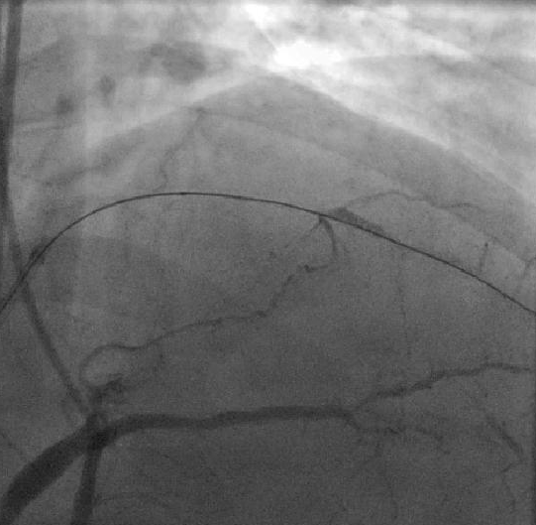
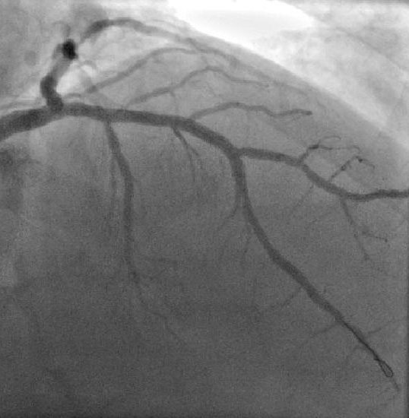
Gaia in Antegrade PCI

Slide 30
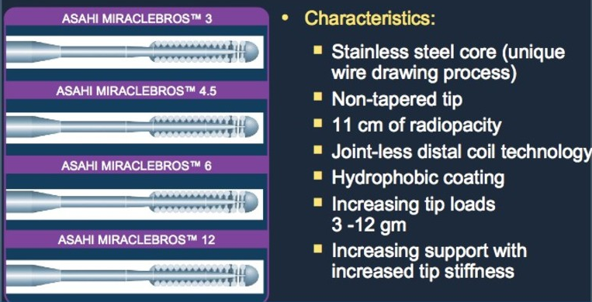
ASAHI MIRACLEBROSTM Family Straight Tip Guide Wires

Slide 31
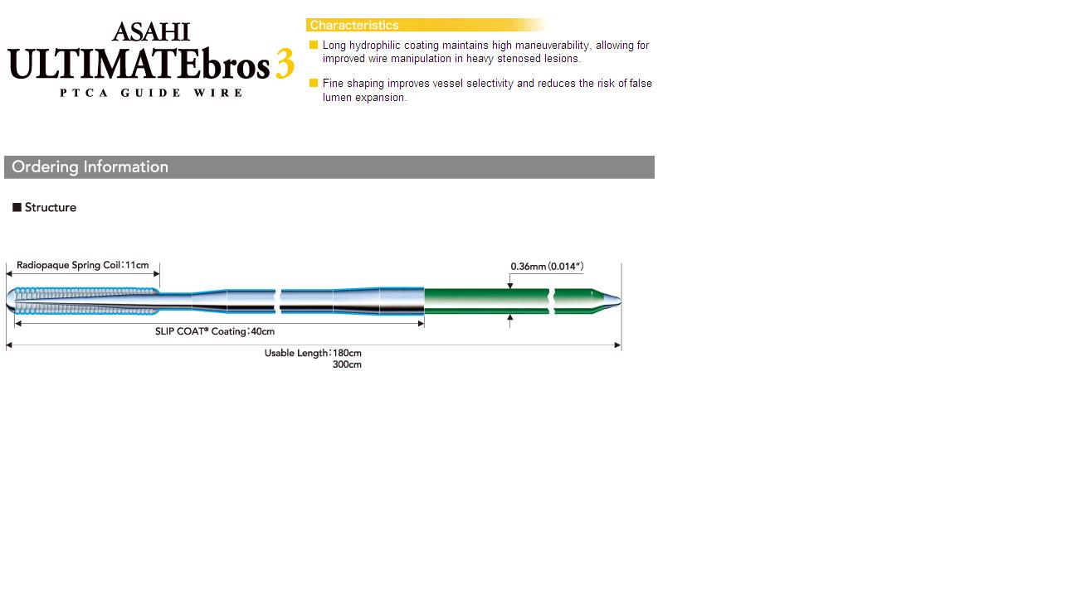

Slide 32
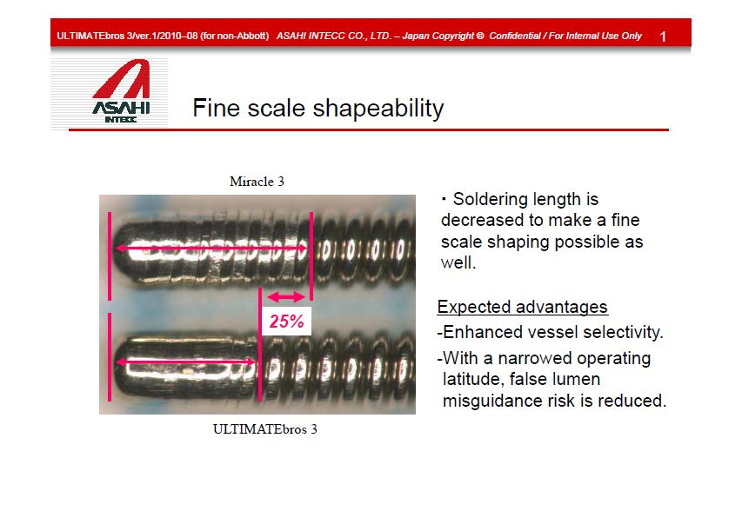
Fine scale Shapeability

Slide 33
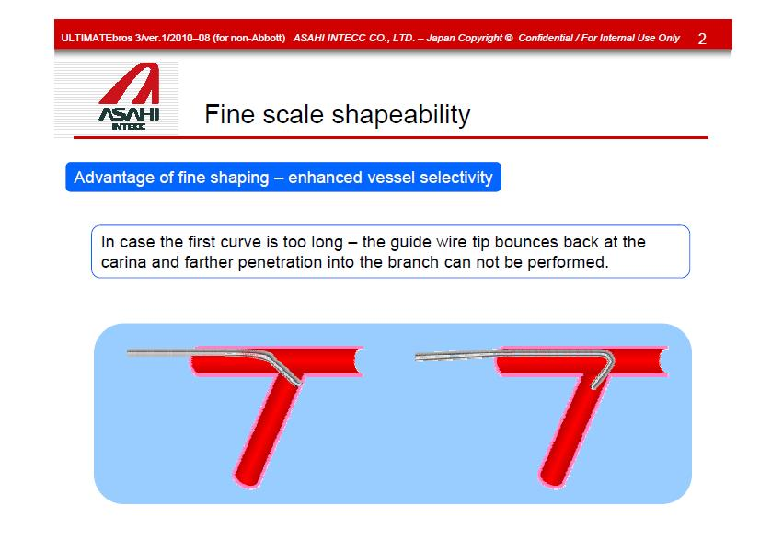
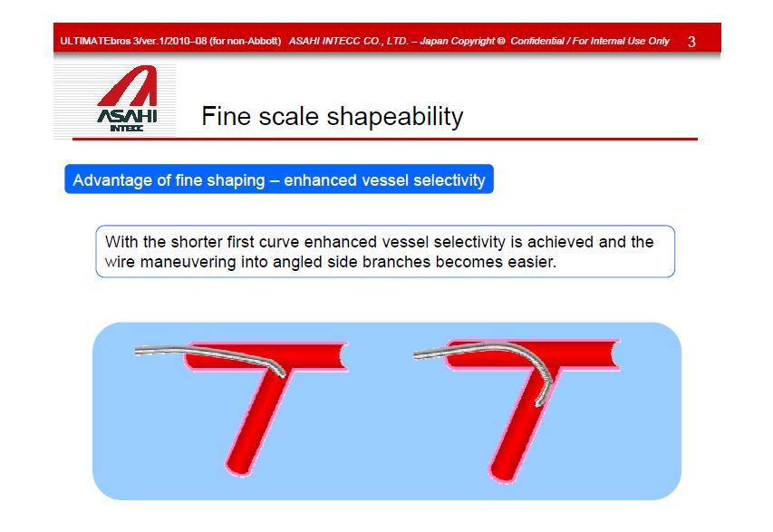
Advantage of the shaping-enhanced
vessel selectivity

Slide 34
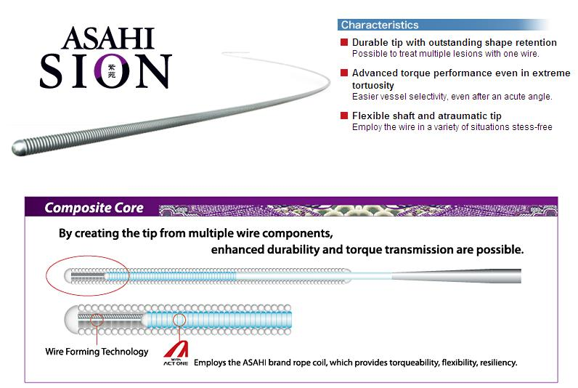

Slide 35
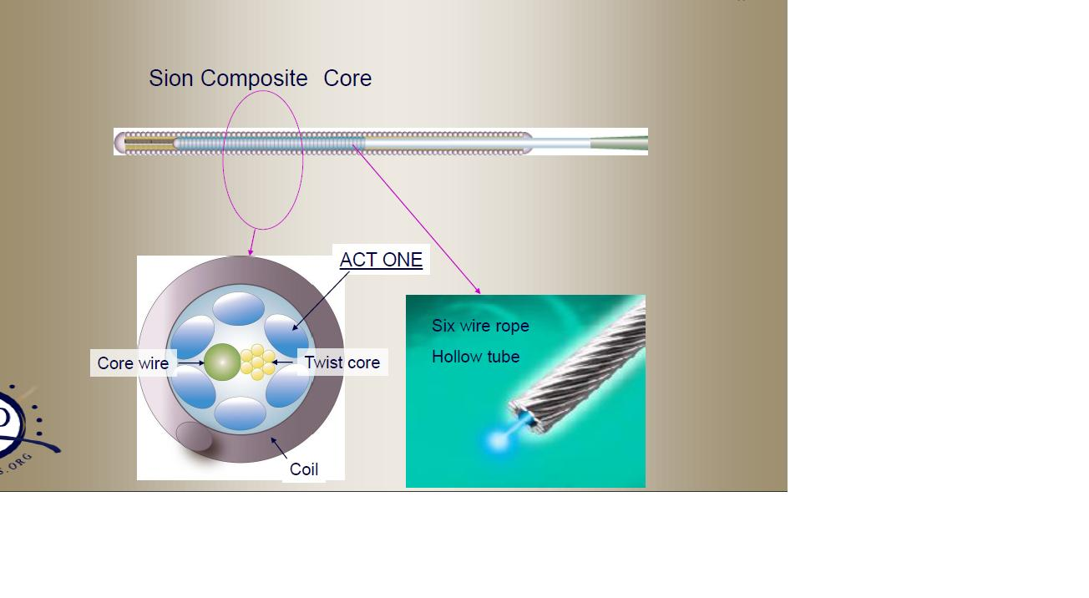
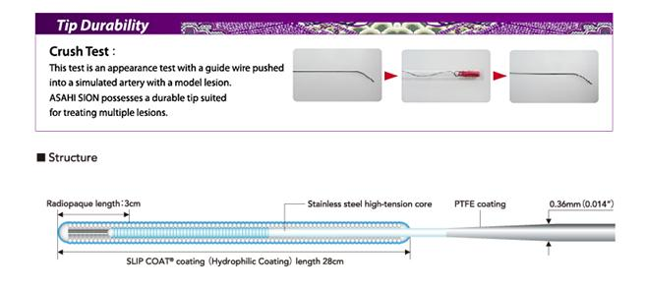

Slide 36
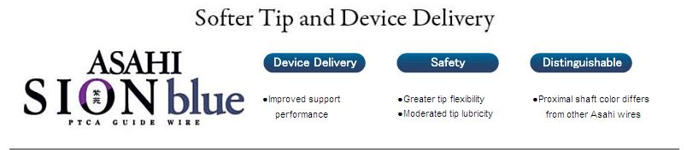
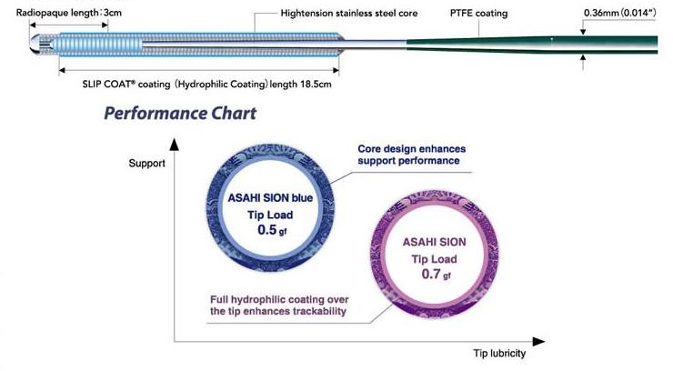

Slide 37
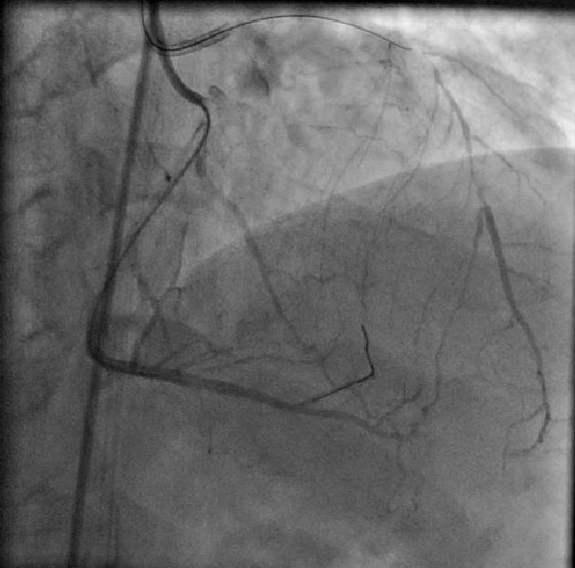
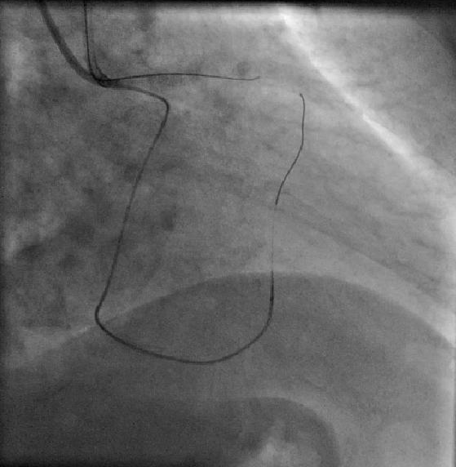
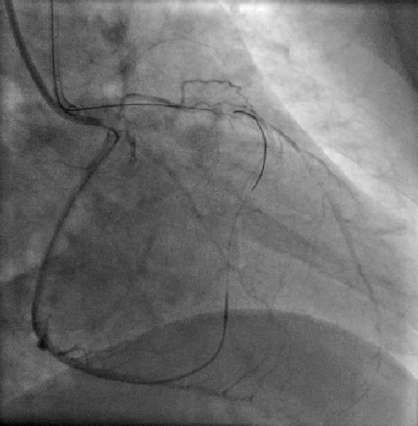
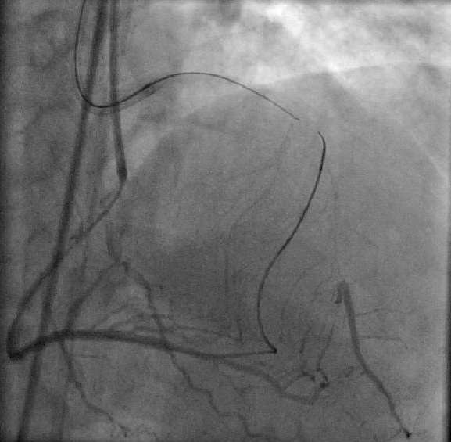
Sion Blue in Retrograde PCI

Slide 38
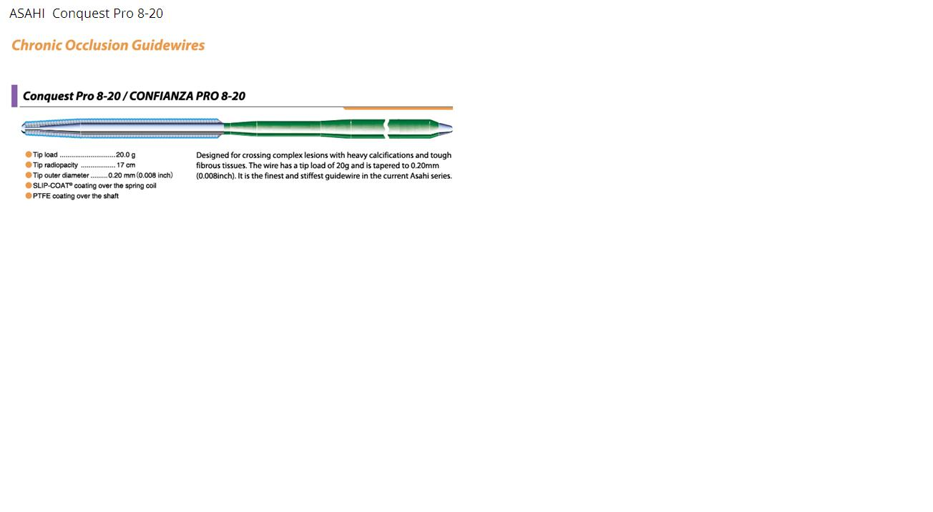
ASAHI Conquest Pro 8-20

Slide 39
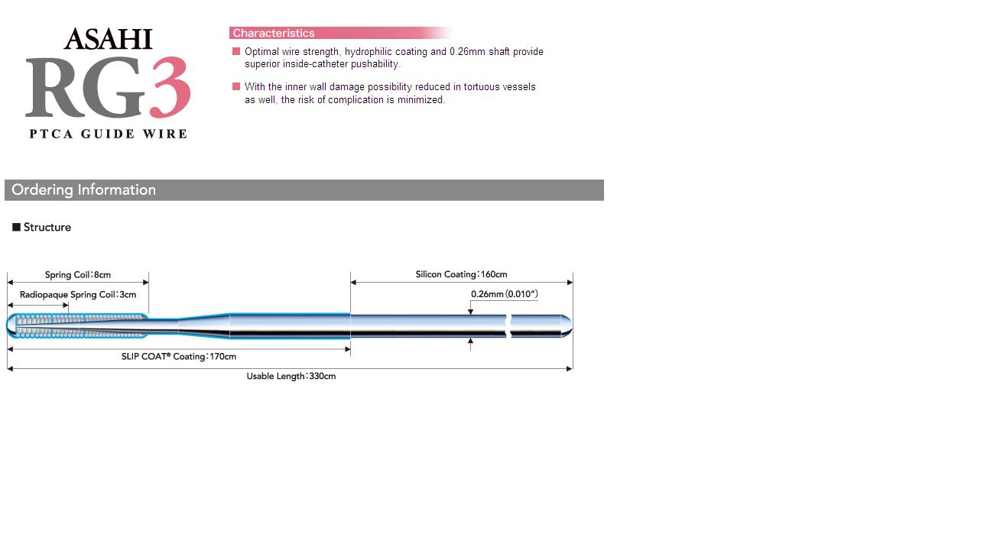

Slide 40
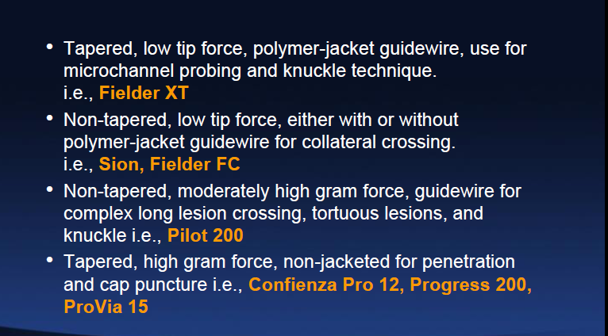
Guide wires for Hybrid Approach

Slide 41
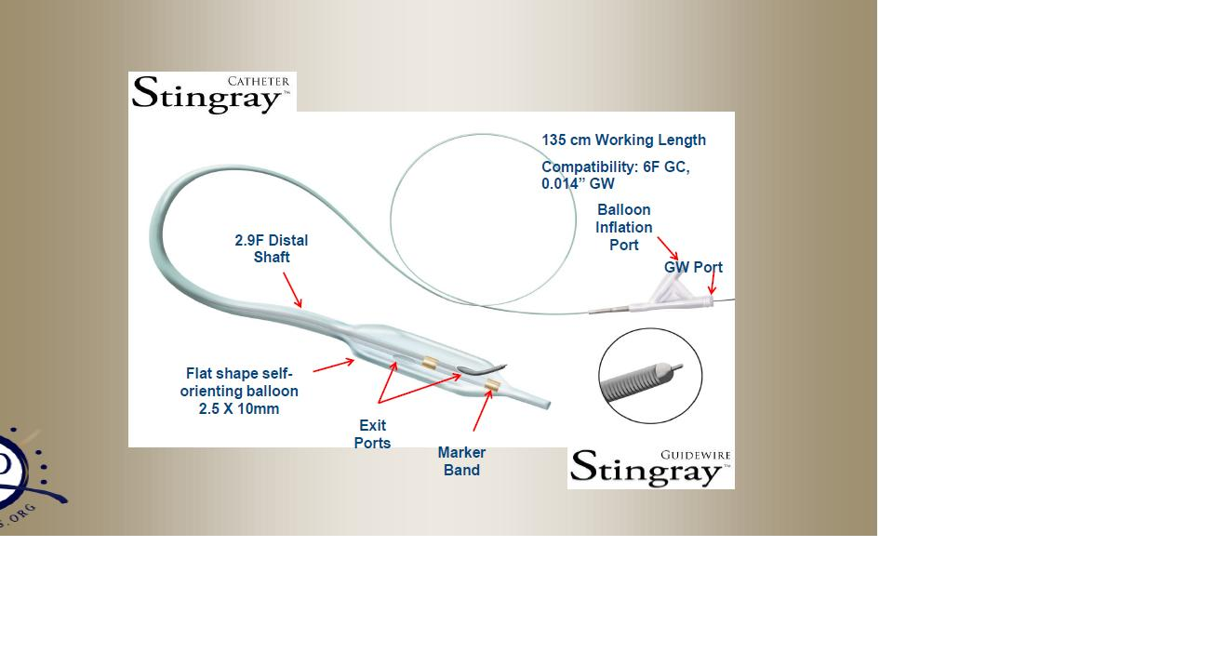
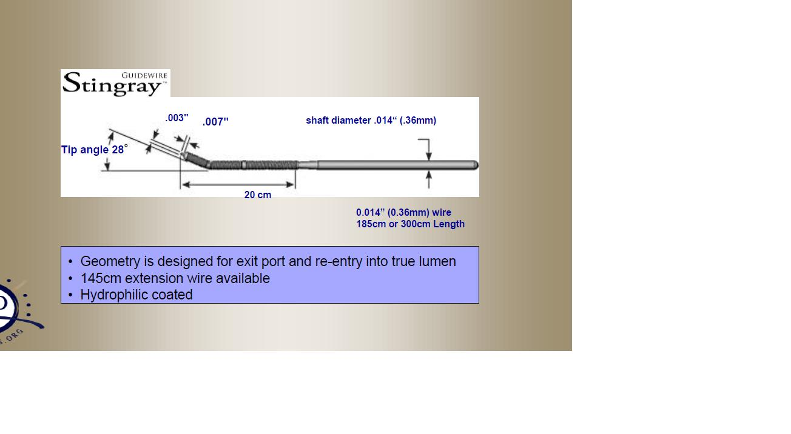

Slide 42
THANK YOU

